Slide 1
Date: Monday 18th January
LO To be able to identify features of a non – chronological report.
Subject: English

Slide 2
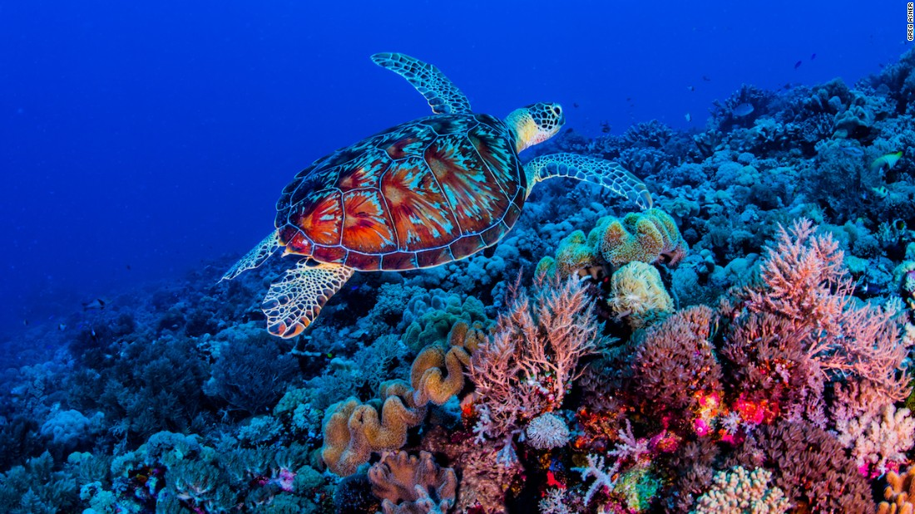
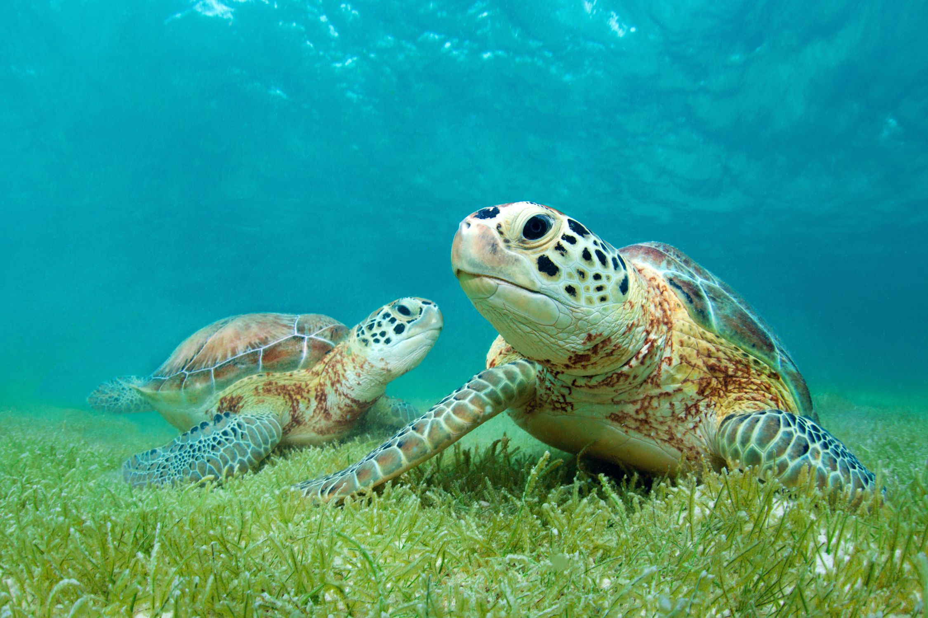
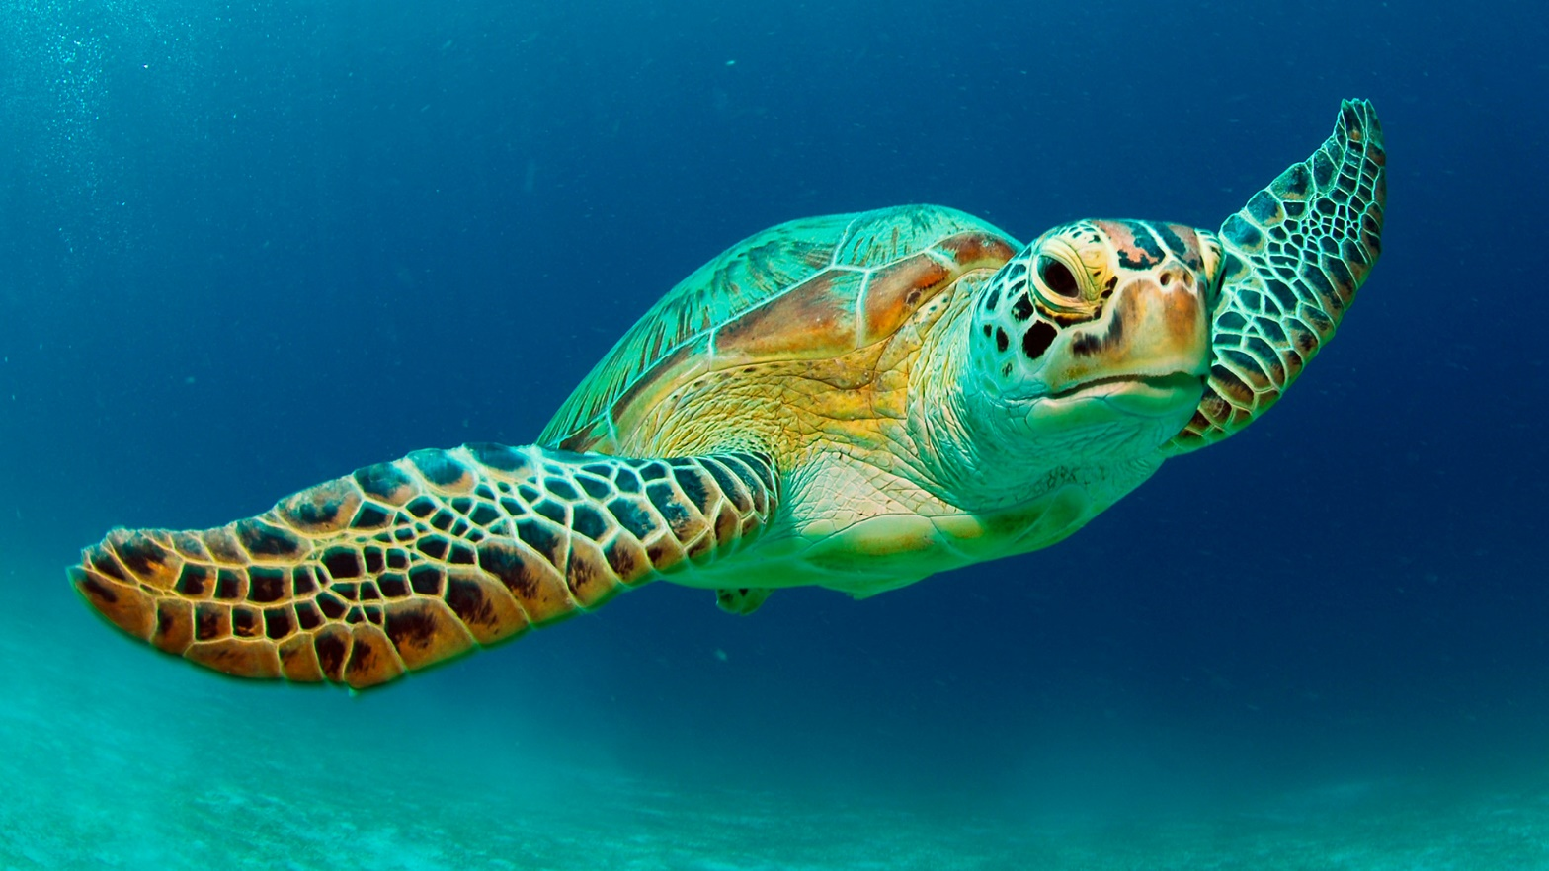
Super Scaly Sea Turtles!
This week we are going to be writing about Sea turtles!
To learn more about sea turtles click on the link or copy and paste the link into your internet browser to watch the video.
Sea Turtles 101 | National Geographic - YouTube

Slide 3
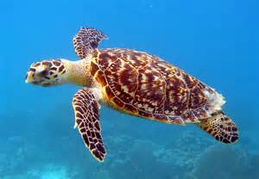
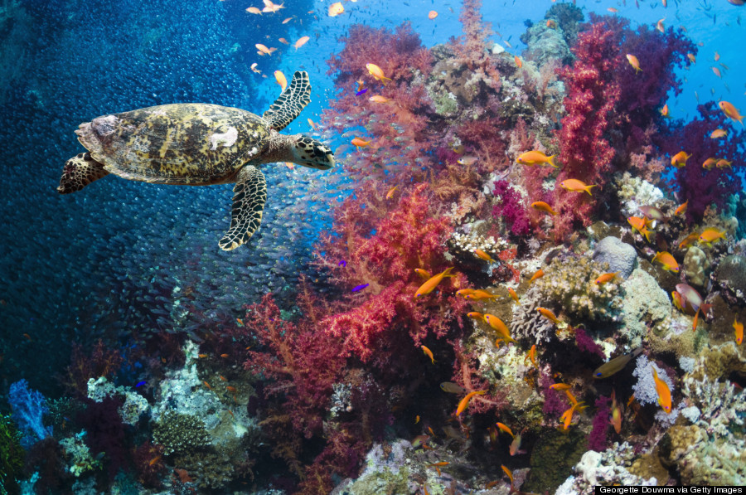
Read my report!
Super Scaly Sea Turtles!
Sea turtles are marine creatures which live in seas and oceans. They are cold blooded, have scaly skin and lay eggs – this makes them reptiles!
What do sea turtles look like?
Sea turtles have four flippers, a big smooth shell and two round eyes. The smooth shell makes the sea turtle streamlined which helps the turtle to swim through the water with elegance. Turtles have four flippers to help them swim quickly through the deep, salty ocean.
Did you know?
Sea turtles have glands in their body to help remove the salt from the water to keep them hydrated! The salty water comes out of the turtles eyes and makes the turtle look like it is crying!
Where do sea turtles live?
Sea turtles live in warm seas and oceans around the world. There are no turtles in the Artic Ocean because it is too cold! Turtles usually live in shallow water so that they can feel the heat from the bright, scorching sun. Adult sea turtles are usually found living in bays, lagoons or on the sea shore. Turtles spend the majority of their life in the water but female turtles come onto the shore to lay eggs on small, smooth grains of sand.
Did you know?
Sea turtles can hold their breath for up to five hours! This means turtles can stay under water for a long time without having to come out for oxygen.
What do sea turtles eat?
Most sea turtles are omnivores and eat a mixture of small marine creatures and plants. Sea turtles like to eat squid, shrimps, jelly fish and anemones. They also like to eat plants including algae, crinkle grass and seaweed.
Did you know?
Sea turtles don’t have teeth! They use their mouth to hold the food and break it up. Their mouth is made of keratin which is the same stuff your fingernails are made of!

Slide 4
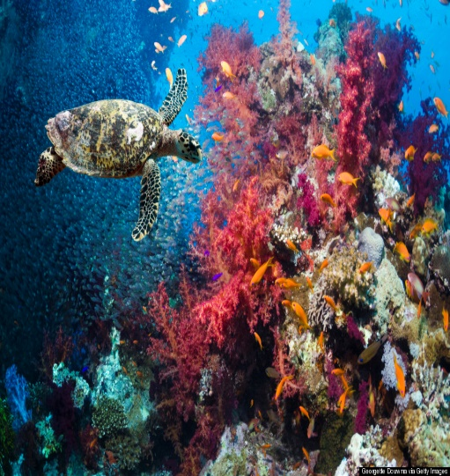
Super Scaly Sea Turtles!
Now find the features!
Sea turtles are marine creatures which live in seas and oceans. They are cold blooded, have scaly skin and lay eggs – this makes them reptiles!
Appearance
Sea turtles have four flippers, a big smooth shell and two round eyes. The smooth shell makes the sea turtle streamlined which helps the turtle to swim through the water with elegance. Turtles have four flippers to help them swim quickly through the deep, salty ocean.
Did you know?
Sea turtles have glands in their body to help remove the salt from the water to keep them hydrated! The salty water comes out of the turtles eyes and makes the turtle look like it is crying!
Habitat
Sea turtles live in warm seas and oceans around the world. There are no turtles in the Artic Ocean because it is too cold! Turtles usually live in shallow water so that they can feel the heat from the bright, scorching sun. Adult sea turtles are usually found living in bays, lagoons or on the sea shore. Turtles spend the majority of their life in the water but female turtles come onto the shore to lay eggs on small, smooth grains of sand.
Did you know?
Sea turtles can hold their breath for up to five hours! This means turtles can stay under water for a long time without having to come out for oxygen.
Diet
Most sea turtles are omnivores and eat a mixture of small marine creatures and plants. Sea turtles like to eat squid, shrimps, jelly fish and anemones. They also like to eat plants including algae, crinkle grass and seaweed.
Did you know?
Sea turtles don’t have teeth! They use their mouth to hold the food and break it up. Their mouth is made of keratin which is the same stuff your fingernails are made of!
Use the key to highlight/ underline the key features in the correct colour
Remember commas are used to separate things in a list.
The last two things in the list are separated with the word ‘and’.
Title
Subheading
Picture
Question
Commas in a list

Slide 5
Well done for all of your hard work today! We cant wait to see your completed work.
Could any completed work / photographic evidence of completed work please be sent to pioneerspupils@gmail.com
Thank you!

Slide 6
Date: Tuesday 19th January
LO To be able to punctuate sentences correctly.
Subject: English

Slide 7
Recap -Capital letters
Why do I need capital letters?
Capital letters are needed at the start of a sentence, for peoples names and places.
Full stops
Full stops go at the end of sentences so that the person reading your writing knows you have finished your sentence.

Slide 8
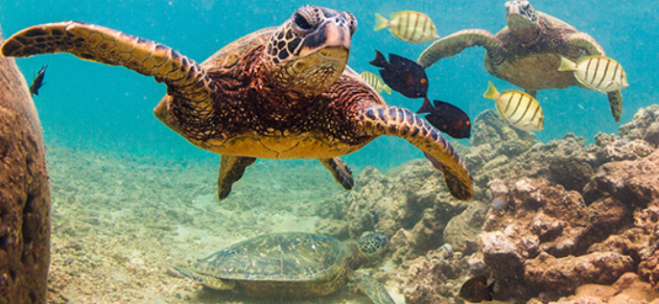
Capital letters and full stops
Example
Use of capital letters and a full stop
Full stop at the end of the sentence
Sea turtles have a hard shell.
Capital letter for the start of the sentence
Sea turtles live in the Pacific Ocean.
Capital letter for a place
Capital letter for the start of the sentence
Full stop at the end of the sentence

Slide 9
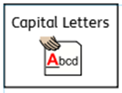
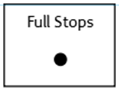
Punctuate the sentences correctly
Add the capital letters and full stops
1. sea turtles have a shell
2. they have four flippers
3. sea turtles eat fish and plants
4. below the sea turtle is a sharp rock

Slide 10
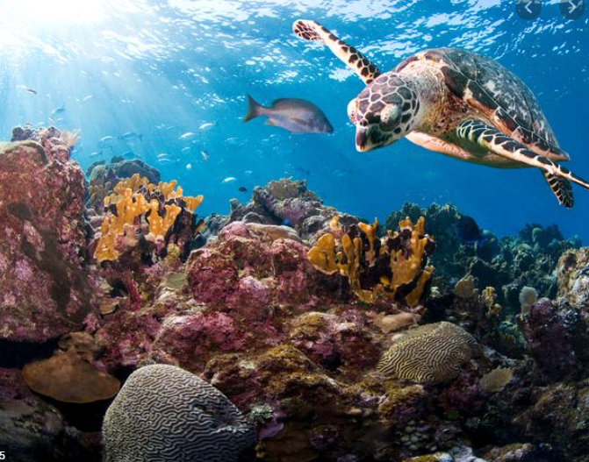
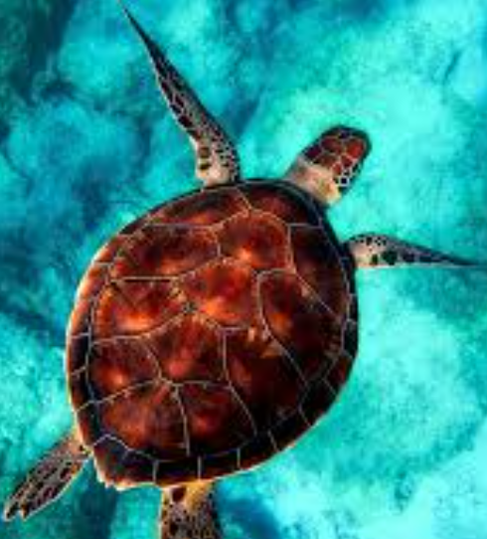
Using capital letters and full stops
Use the pictures to help you write 5 sentences about sea turtles.
Don’t forget:
Winnie can see a big red crab. The orange fish is next to the old treasure chest.

Slide 11
Well done for all of your hard work today! We cant wait to see your completed work.
Could any completed work / photographic evidence of completed work please be sent to pioneerspupils@gmail.com
Thank you!

Slide 12
Date: Wednesday 20th January
LO To be able to punctuate questions with a question mark.
Subject: English

Slide 13
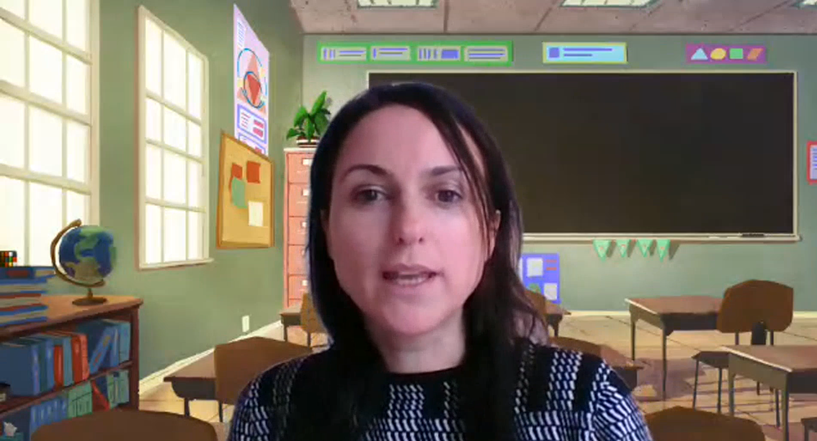
Pre Recorded Teaching
On the school website you will find a pre recorded video that will support the teaching of todays lesson. The video is called English video – using a question mark.

Slide 14
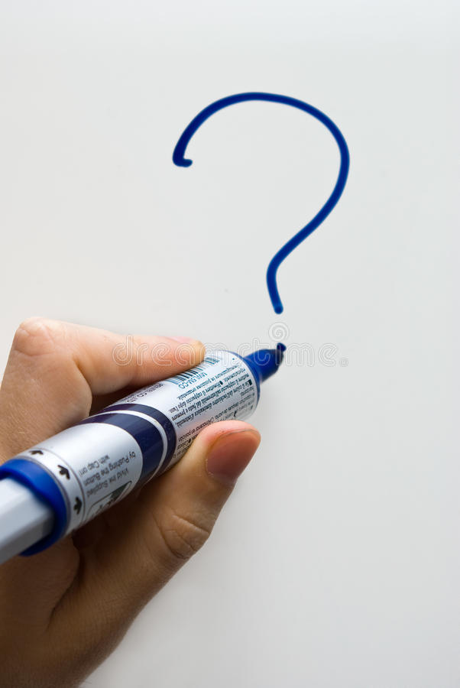
Question Mark
A question mark looks like this ?
It goes at the end of a question
Can you draw a question mark with your finger?
Now can you write a question mark on your paper?

Slide 15
What?
Question words
When?
Who?
Now can you ask questions about turtles using these question words?
Where?
Why?
How?
Example
Where do sea turtles live?
Write 3 questions on the lines below or on a piece of paper.

Slide 16
Did
The word ‘did’ is often used to start questions.
Look at these examples:
Did you like football practise?
Did you go for a walk today?
Did Emily come to your house?
Did you know that elephants have large ears?
Did you know sea turtles live in warm water?
All of the examples end with a question mark because when we use the word ‘did’ at the start of a sentence we are asking a question.

Slide 17
Add the question mark
Can you punctuate the sentences correctly using a question mark – remember a question mark looks like this ?
Where do sea turtles live
What do sea turtles eat
How do sea turtles glide through the water
When do sea turtles lay their eggs
Did you know that turtles have a hard, protective shell
Remember the ? goes at the end of the sentence

Slide 18
Add the question mark - answers
Check your answers. Did you put the question mark in the right place?
Where do sea turtles live?
What do sea turtles eat?
How do sea turtles glide through the water?
When do sea turtles lay their eggs?
Did you know that turtles have a hard, protective shell?

Slide 19
Question or statement?
A statement is a simple sentence.
A statement is always punctuated with a full stop at the end.
A question is something you can ask or answer.
A question is always punctuated with a question mark at the end .

Slide 20
Question or statement?
Read the sentences and decide if they need a full stop or question mark at the end. Use the word at the start of the sentence to help you decide.
1. Sea turtles have a huge protective shell
2. How do sea turtles breath under water
3. Did you know sea turtles like to live in warm water
4. Sea turtles have two, round eyes
5. When do sea turtles lay their eggs
6. Sea turtles have four flippers to help them swim faster
7. Sea turtles eat small fish and plants
8. Why do sea turtles have a shell

Slide 21
Question or statement? Answers
Check your answers. Did you get them all right?
1. Sea turtles have a huge protective shell.
2. How do sea turtles breath under water?
3. Did you know sea turtles like to live in warm water?
4. Sea turtles have two, round eyes.
5. When do sea turtles lay their eggs?
6. Sea turtles have four flippers to help them swim faster.
7. Sea turtles eat small fish and plants.
8. Why do sea turtles have a shell?

Slide 22
Now can you write your own questions about sea turtles?
You can use some of the questions we have already looked at to help.
What?
Who?
Question words
When?
Why?
Where?
Write your questions neatly onto a piece of paper or type them on the lines below. You will be able to use them in your writing tomorrow!
How?
Did?

Slide 23
Well done for all of your hard work today! We cant wait to see your completed work.
Could any completed work / photographic evidence of completed work please be sent to pioneerspupils@gmail.com
Thank you!

Slide 24
Date: Thursday 21st January
LO To be able to write a non-chronological report.
Subject: English

Slide 25
Read my report again to get it back in your head.
Super Scaly Sea Turtles!
Sea turtles are marine creatures which live in seas and oceans. They are cold blooded, have scaly skin and lay eggs – this makes them reptiles!
What do sea turtles look like?
Sea turtles have four flippers, a big smooth shell and two round eyes. The smooth shell makes the sea turtle streamlined which helps the turtle to swim through the water with elegance. Turtles have four flippers to help them swim quickly through the deep, salty ocean.
Did you know?
Sea turtles have glands in their body to help remove the salt from the water to keep them hydrated! The salty water comes out of the turtles eyes and makes the turtle look like it is crying!
Where do sea turtles live?
Sea turtles live in warm seas and oceans around the world. There are no turtles in the Artic Ocean because it is too cold! Turtles usually live in shallow water so that they can feel the heat from the bright, scorching sun. Adult sea turtles are usually found living in bays, lagoons or on the sea shore. Turtles spend the majority of their life in the water but female turtles come onto the shore to lay eggs on small, smooth grains of sand.
Did you know?
Sea turtles can hold their breath for up to five hours! This means turtles can stay under water for a long time without having to come out for oxygen.
What do sea turtles eat?
Most sea turtles are omnivores and eat a mixture of small marine creatures and plants. Sea turtles like to eat squid, shrimps, jelly fish and anemones. They also like to eat plants including algae, crinkle grass and seaweed.
Did you know?
Sea turtles don’t have teeth! They use their mouth to hold the food and break it up. Their mouth is made of keratin which is the same stuff your fingernails are made of!

Slide 26
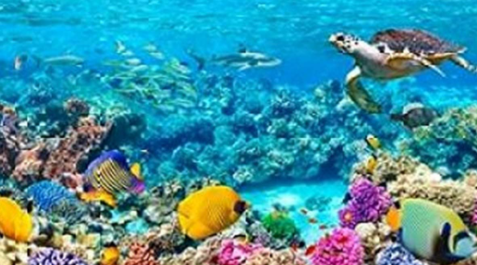
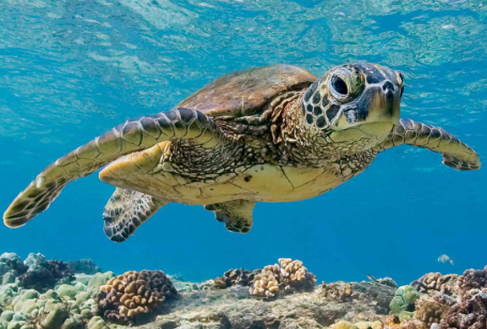
Super Scaly Sea Turtles!
Before you write your report click on the links to watch the videos and read the facts to learn more!
Video 1
https://www.youtube.com/watch?v=QTjrqhamIfk
Video 2
https://www.youtube.com/watch?v=qJfAbyz4qS0
Links to websites for facts:
https://kids.nationalgeographic.com/animals/reptiles/green-sea-turtle/
https://www.ducksters.com/animals/sea_turtles.php
https://animalfactguide.com/animal-facts/green-turtle/

Slide 27
Write a non chronological report
Your report must include:
A title
Subheadings
Commas in a list
Question marks
Describing words
Pictures
You can use the blank template on the next slide or create your own report on paper.
Title
Picture
Information
Picture
Remember commas are used to separate things in a list.
The last two things in the list are separated with the word ‘and’.

Slide 29
Well done for all of your hard work today! We cant wait to see your completed work.
Could any completed work / photographic evidence of completed work please be sent to pioneerspupils@gmail.com
Thank you!

Slide 30
Date: Friday 22nd January
LO To be able to read and spell words ending with the ‘ay’ sound.
Subject: English

Slide 31
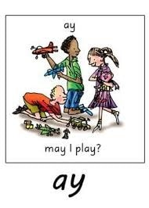
ay
The sound we are focusing on today is ay.
The aysound is normally at the end of words.
Click on the links or copy and paste the links into your internet browser to watch the phonics videos.
Phonics Lesson - Set 2 'ay' sound for Reception and Year 1 – YouTube
The AY Sound | Phase 5 | Phonics – YouTube
The /ay/ spelling pattern - Mr Thorne Does Phonics - YouTube

Slide 32
Read the ‘ay’ words
day
may
way
lay
say
hay
bay
play
pay
tray
clay
gray
sway
away
today
Now write the words on a piece of paper and underline the ‘ay’ sound.

Slide 33
word | 1st try | 2nd try | 3rd try
say
day
may
way
hay
play
tray
sway
Practice writing the words on a piece of paper or type into the table on your computer.

Slide 34
Just add ‘ay’ …
Write the words by adding ay on the blank lines. Then read the words out loud.

Slide 35
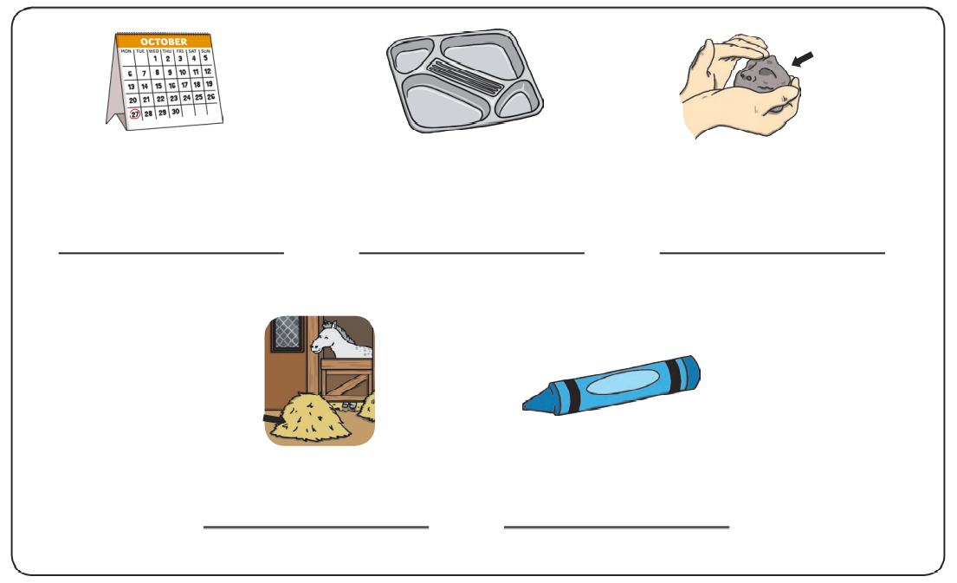
Write the ‘ay’ words
Write the correct ‘ay’ word under the pictures.

Slide 36
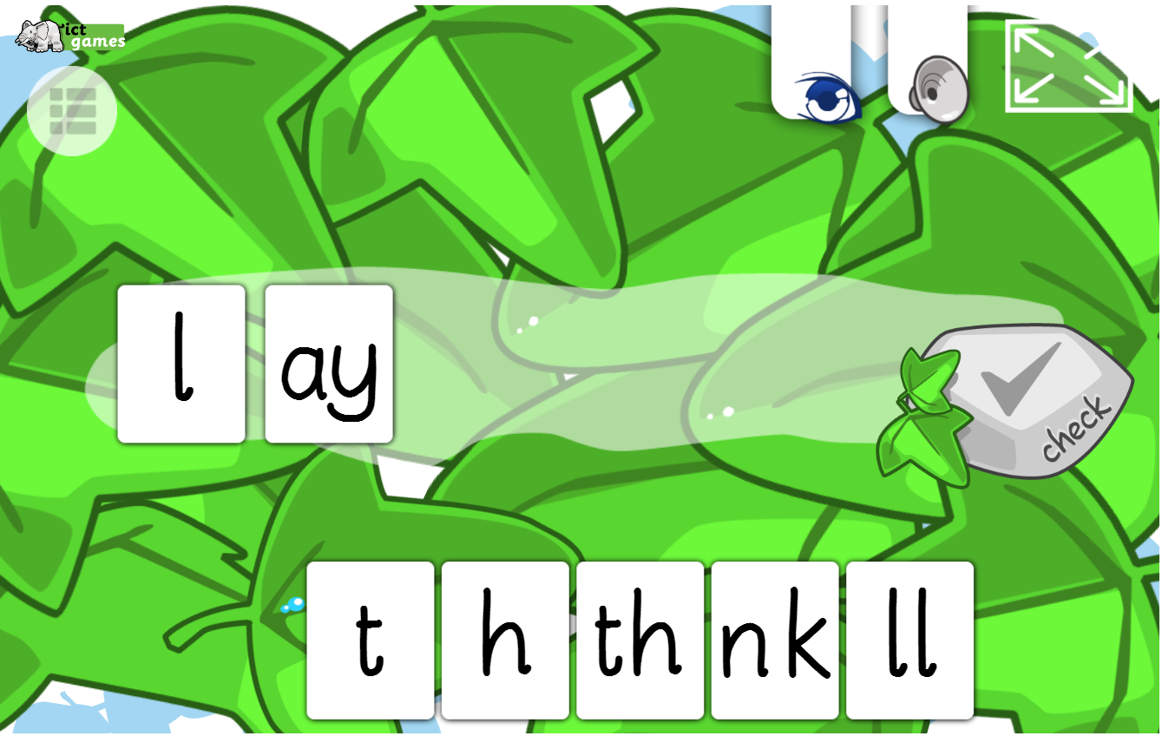
Spelling game!
Use the link to play the game and practice spelling the ‘ay’ words
Forest Phonics - mobile friendly (ictgames.com)

Slide 37
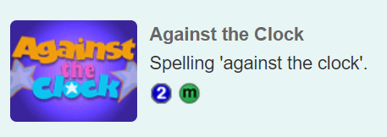
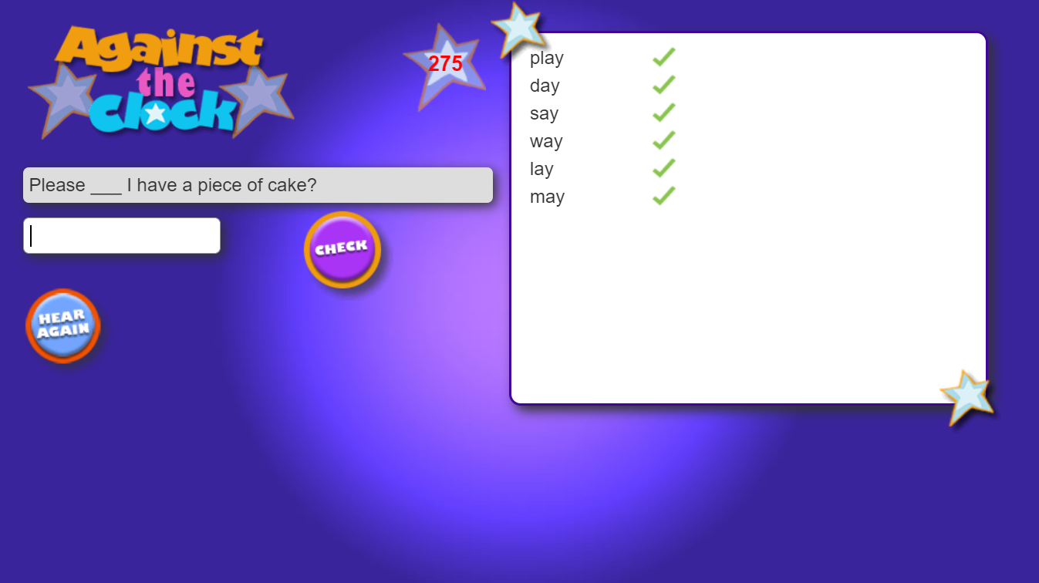
Spelling game!
Use the link to play the game and practice spelling the ‘ay’ words
Spelling games: ay a-e ai (spellzone.com)

Slide 38
Well done for all of your hard work today! We cant wait to see your completed work.
Could any completed work / photographic evidence of completed work please be sent to pioneerspupils@gmail.com
Thank you!

