Slide 1



Date: Monday 25th January 2021
LO
LO. To be able to construct a model .
Subject: DT

Slide 2


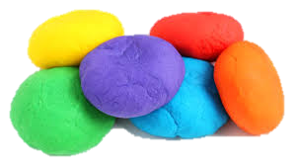
May be you would like to follow this simple playdough recipe if you have none at home.
Ingredients
1 cup of plain flour
1 cup of water
1 tablespoon cooking oil
2 teaspoons cream of tartar
half a cup of salt
food colouring (optional)
Method 1 - Saucepan
Place all the ingredients in a saucepan at a low heat. Stir continuously until the mixture thickens to a firm dough texture.
Method 2 - Microwave
Place all the ingredients in a plastic container and cook for one and a half minutes in a microwave. Stir the mixture and microwave again for one minute.

Slide 3


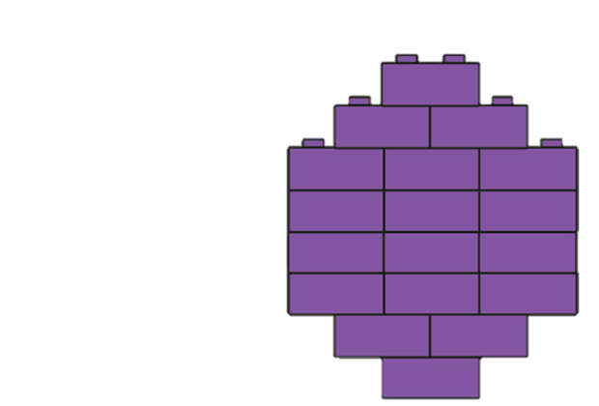
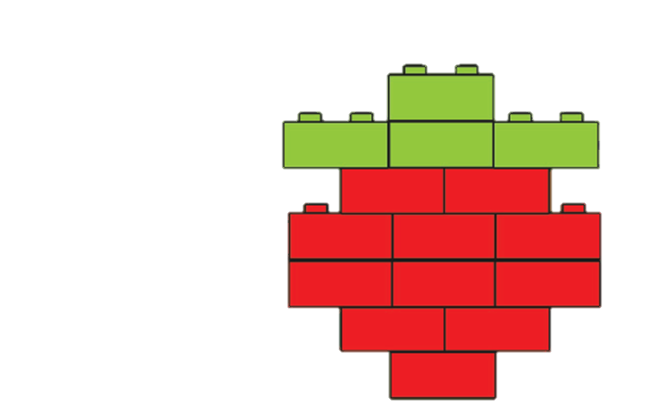
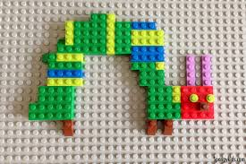
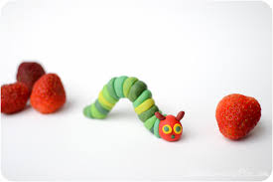

Now use your use your playdough from the recipe above or alternatively make a model from lego or beads.

Slide 4
Date: Tuesday 26th January 2021
LO
LO. To make a collage using different materials.
Subject: Art

Slide 5


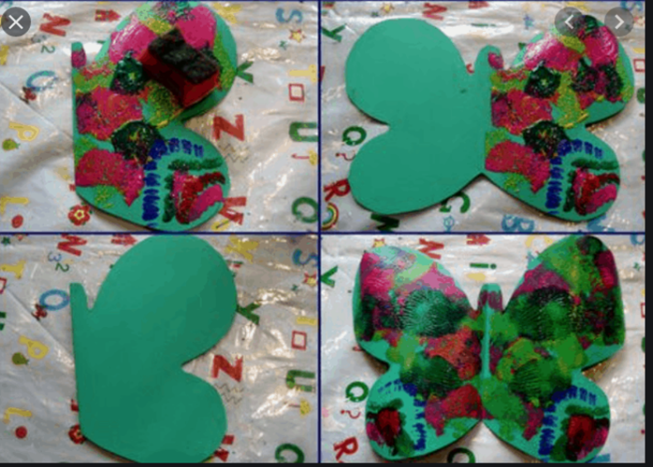
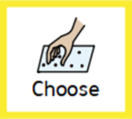





Slide 6
Date: Tuesday 26th January 2021
LO
LO. To series a lifecycle of a butterfly.
Subject: Science

Slide 7

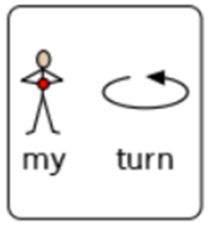
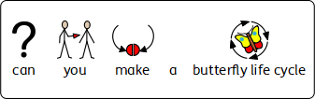
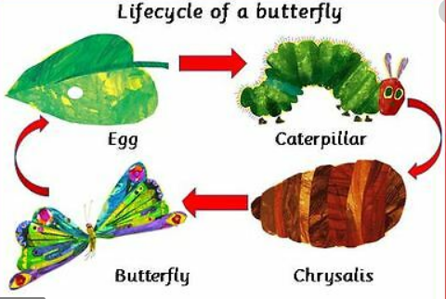

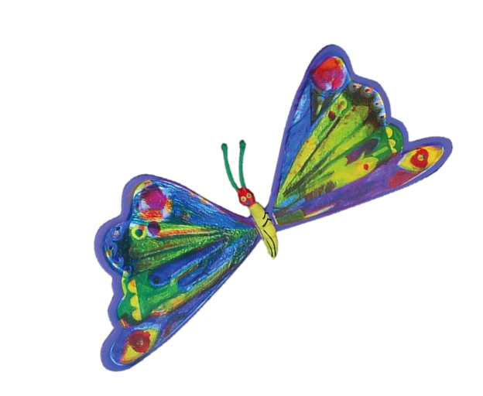
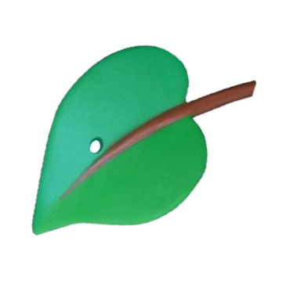
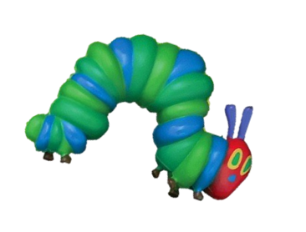
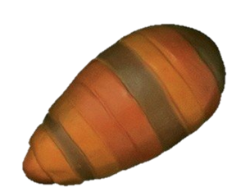
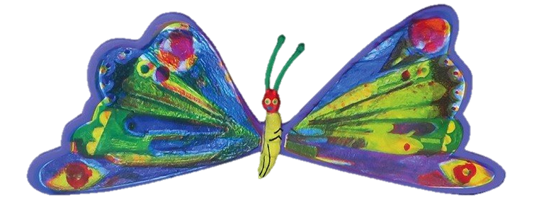

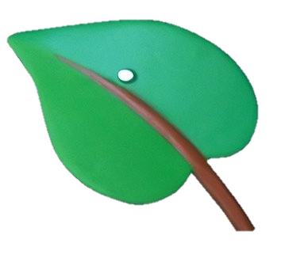
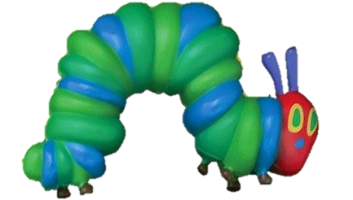

Slide 8
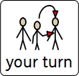

Slide 9
Date: Thursday 28th January 2021
LO
LO. To combine different parts of the body when singing and dancing .
Subject: PE

Slide 10


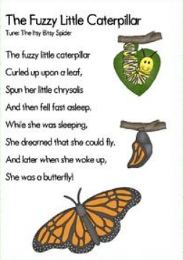
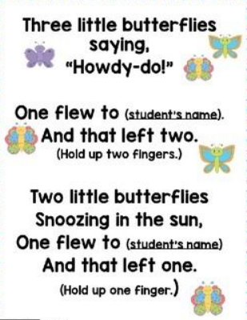
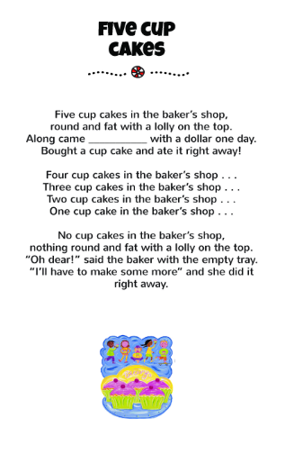

Join in with our favourite action songs by following the link below
https://www.youtube.com/watch?v=0Cs6hc1xhvQ
https://sites.google.com/alice-smith.edu.my/jbklassfit/pe-activities/eyfs-year-2/dance/zumba-for-kids

Slide 11
Date: Friday 29th January 2021
LO
LO. To follow a set of instructions to make a tasty snack.
Subject: DT

Slide 12






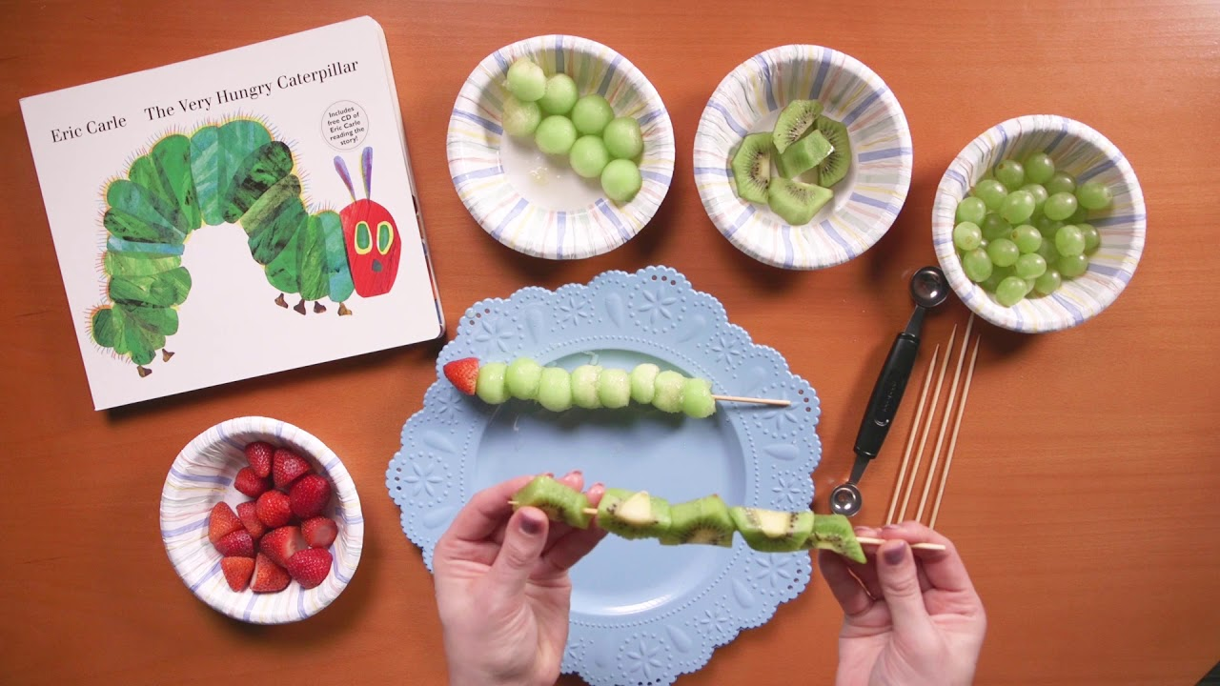

Add 8 grapes.
Add 1 strawberry.
Add 5 pieces of Kiwi
Add 1 strawberry
Add 1 grape
Add 1 kiwi
Add 1 grape
Add 1 kiwi
Add 1 strawberry
https://www.google.com/url?sa=i&url=https%3A%2F%2Fm.youtube.com%2Fwatch%3Fv%3DA_qxHi_NfYE&psig=AOvVaw2YlyCrq86Zxs-BAiObqUEP&ust=1611403463351000&source=images&cd=vfe&ved=0CAIQjRxqFwoTCKD96vG_r-4CFQAAAAAdAAAAABAD

Slide 13

Date: Friday 29th January 2021
LO
LO. To make a caterpillar picture by printing from objects.
Subject: Art

Slide 14

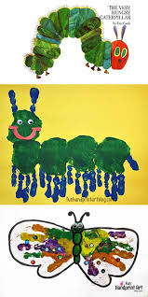
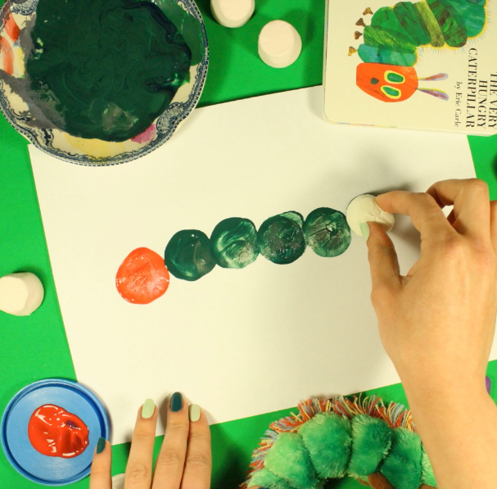
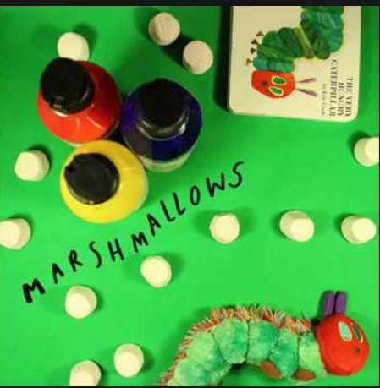

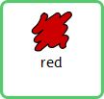


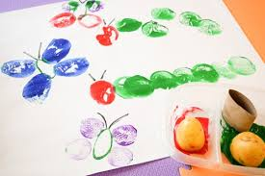
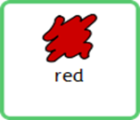
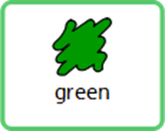
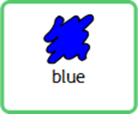
Why don’t you use some objects from around your home. You could use fruit, a cup, marshmallows or even a ball to make the circles for his body.
You could even use your hands to do some printing

