Slide 1
Date: Monday 18th January
LO To be able to identify features of a non – chronological report.
Subject: English

Slide 2
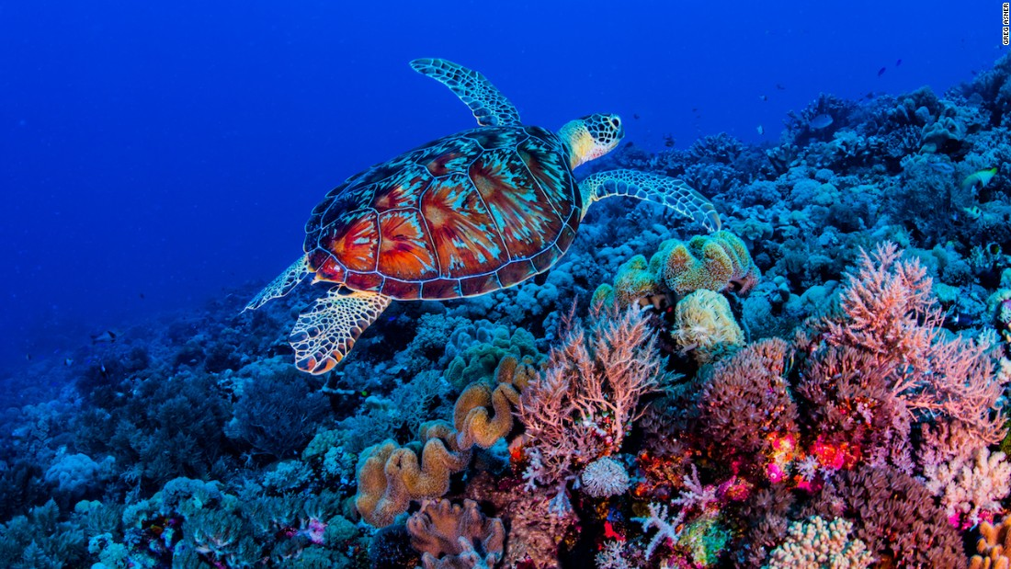
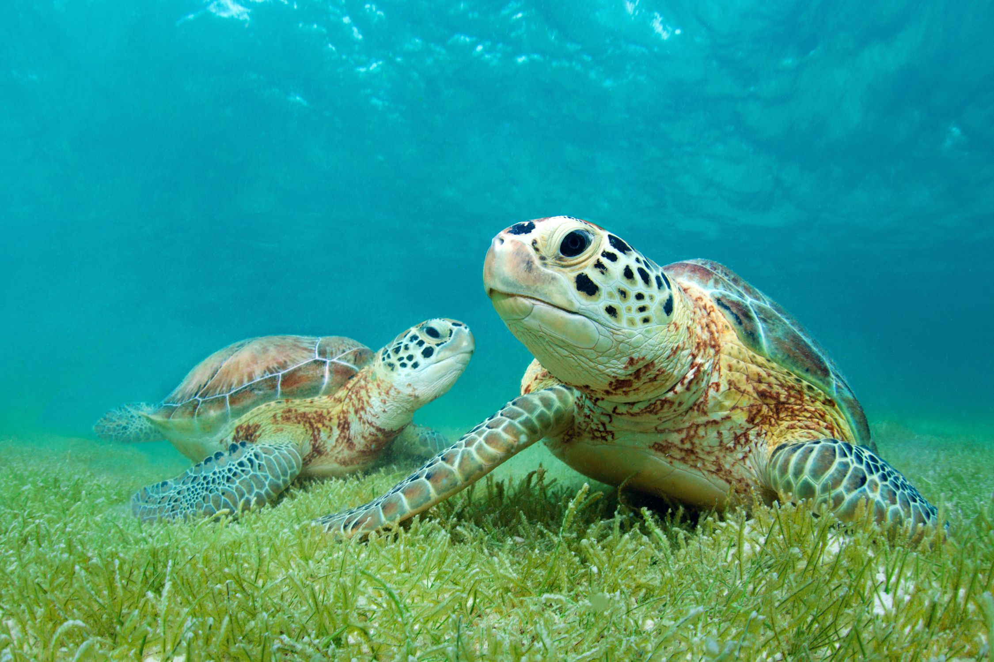
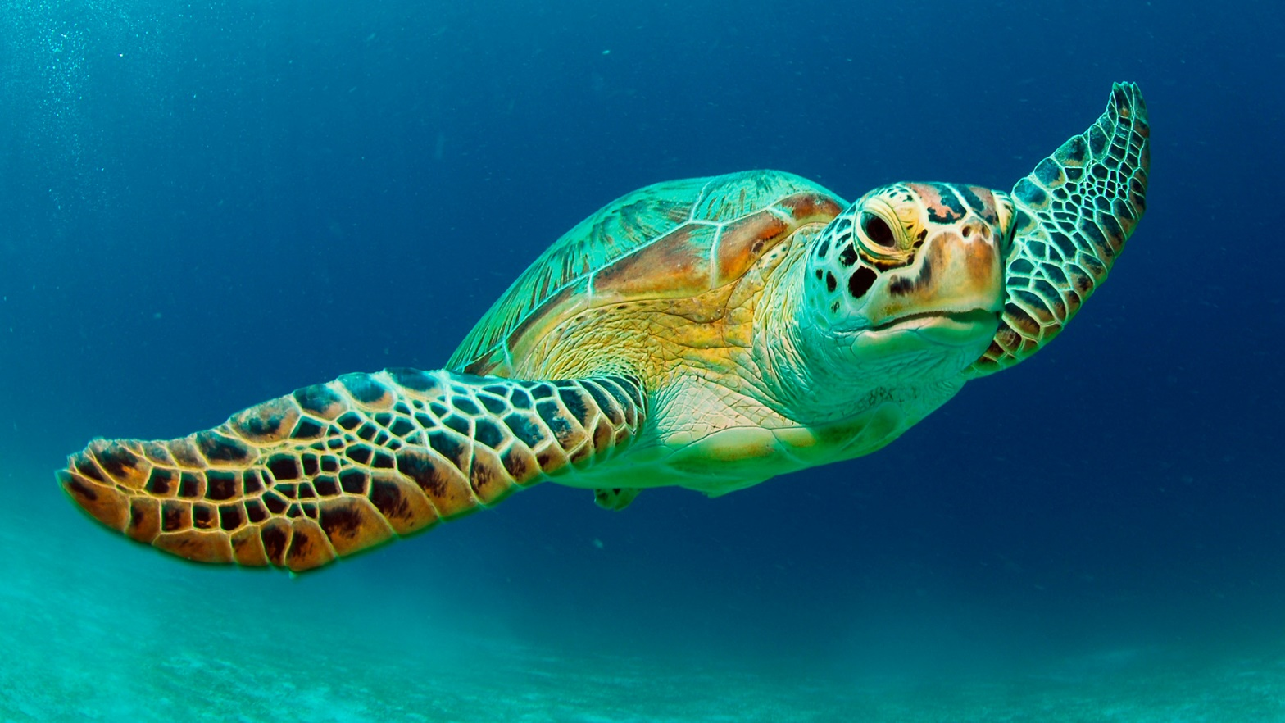
Super Scaly Sea Turtles!
This week we are going to be writing about Sea turtles!
To learn more about sea turtles click on the link or copy and paste the link into your internet browser to watch the video.
Sea Turtles 101 | National Geographic - YouTube

Slide 3
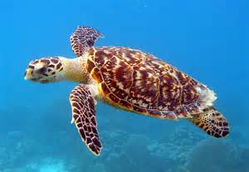
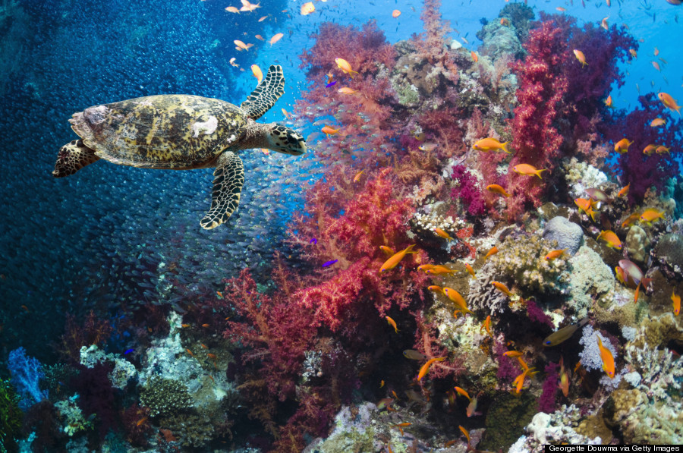
Read my report!
Super Scaly Sea Turtles!
Sea turtles are marine creatures which live in seas and oceans. They are cold blooded, have scaly skin and lay eggs – this makes them reptiles!
What do sea turtles look like?
Sea turtles have four flippers, a big smooth shell and two round eyes. The smooth shell makes the sea turtle streamlined which helps the turtle to swim through the water with elegance. Turtles have four flippers to help them swim quickly through the deep, salty ocean.
Did you know?
Sea turtles have glands in their body to help remove the salt from the water to keep them hydrated! The salty water comes out of the turtles eyes and makes the turtle look like it is crying!
Where do sea turtles live?
Sea turtles live in warm seas and oceans around the world. There are no turtles in the Artic Ocean because it is too cold! Turtles usually live in shallow water so that they can feel the heat from the bright, scorching sun. Adult sea turtles are usually found living in bays, lagoons or on the sea shore. Turtles spend the majority of their life in the water but female turtles come onto the shore to lay eggs on small, smooth grains of sand.
Did you know?
Sea turtles can hold their breath for up to five hours! This means turtles can stay under water for a long time without having to come out for oxygen.
What do sea turtles eat?
Most sea turtles are omnivores and eat a mixture of small marine creatures and plants. Sea turtles like to eat squid, shrimps, jelly fish and anemones. They also like to eat plants including algae, crinkle grass and seaweed.
Did you know?
Sea turtles don’t have teeth! They use their mouth to hold the food and break it up. Their mouth is made of keratin which is the same stuff your fingernails are made of!

Slide 4
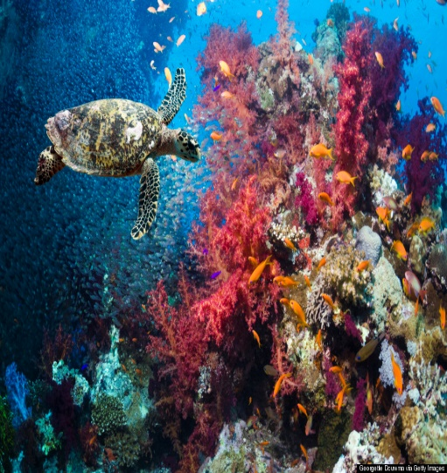
Super Scaly Sea Turtles!
Now find the features!
Sea turtles are marine creatures which live in seas and oceans. They are cold blooded, have scaly skin and lay eggs – this makes them reptiles!
Appearance
Sea turtles have four flippers, a big smooth shell and two round eyes. The smooth shell makes the sea turtle streamlined which helps the turtle to swim through the water with elegance. Turtles have four flippers to help them swim quickly through the deep, salty ocean.
Did you know?
Sea turtles have glands in their body to help remove the salt from the water to keep them hydrated! The salty water comes out of the turtles eyes and makes the turtle look like it is crying!
Habitat
Sea turtles live in warm seas and oceans around the world. There are no turtles in the Artic Ocean because it is too cold! Turtles usually live in shallow water so that they can feel the heat from the bright, scorching sun. Adult sea turtles are usually found living in bays, lagoons or on the sea shore. Turtles spend the majority of their life in the water but female turtles come onto the shore to lay eggs on small, smooth grains of sand.
Did you know?
Sea turtles can hold their breath for up to five hours! This means turtles can stay under water for a long time without having to come out for oxygen.
Diet
Most sea turtles are omnivores and eat a mixture of small marine creatures and plants. Sea turtles like to eat squid, shrimps, jelly fish and anemones. They also like to eat plants including algae, crinkle grass and seaweed.
Did you know?
Sea turtles don’t have teeth! They use their mouth to hold the food and break it up. Their mouth is made of keratin which is the same stuff your fingernails are made of!
Use the key to highlight/ underline the key features in the correct colour
Remember commas are used to separate things in a list.
The last two things in the list are separated with the word ‘and’.
Title
Subheading
Picture
Question
Commas in a list

Slide 5
Well done for all of your hard work today! We cant wait to see your completed work.
Could any completed work / photographic evidence of completed work please be sent to pioneerspupils@gmail.com
Thank you!

Slide 6
Date: Tuesday 19th January
LO To be able to use commas in a list.
Subject: English

Slide 7
Recap - Commas in a list
What is a comma?
A comma is a piece of punctuation and it looks like this ,
What are commas in a list?
Commas are used to separate things in a list. For example this could include: colours, objects, names and places.

Slide 8
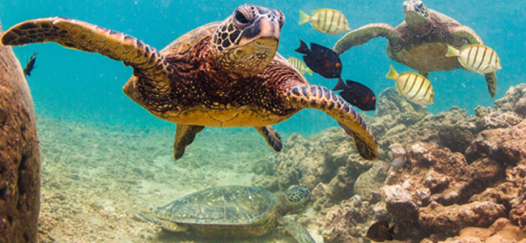
Commas in a list
Example
Use of commas in a list
Sea turtles have a hard shell, flippers and two round eyes.
Key:
Colour
Comma
Commas are used to separate things in a list.
The last two things in the list are separated by the word ‘and’
and

Slide 9
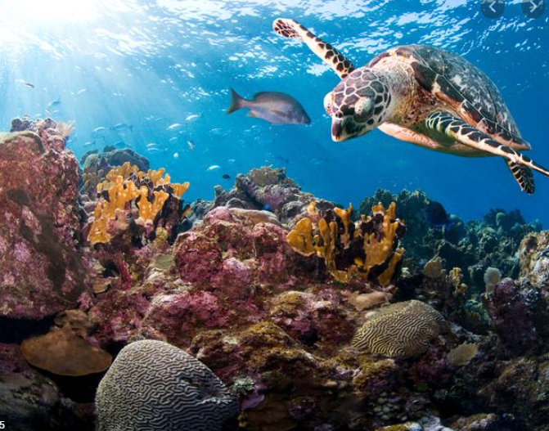
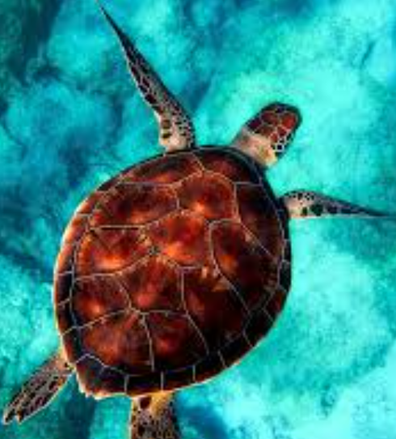
Commas in a list
Punctuate the sentences correctly
First add the ,
1. Sea turtles have flippers ___ a shell ________ scaly skin.
2. They eat shrimps ___ squid ________ jelly fish.
3. Sea turtles swim alongside dolphins ___ sharks ________ whales.
4. Turtles also eat plants including algae ___ seaweed ________ crinkle grass.
Then add the word and

Slide 10
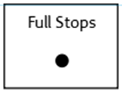
Using commas in a list
Use the pictures to help you write your own sentences using commas in a list.
Don’t forget:
Sea turtles have scales, a shell and glands in their eyes.

Slide 11
Identify commas in a list
Re read my report and highlight/underline the commas in a list.
Super Scaly Sea Turtles!
Sea turtles are marine creatures which live in seas and oceans. They are cold blooded, have scaly skin and lay eggs – this makes them reptiles!
Appearance
Sea turtles have four flippers, a big smooth shell and two round eyes. The smooth shell makes the sea turtle streamlined which helps the turtle to swim through the water with elegance. Turtles have four flippers to help them swim quickly through the deep, salty ocean.
Did you know?
Sea turtles have glands in their body to help remove the salt from the water to keep them hydrated! The salty water comes out of the turtles eyes and makes the turtle look like it is crying!
Habitat
Sea turtles live in warm seas and oceans around the world. There are no turtles in the Artic Ocean because it is too cold! Turtles usually live in shallow water so that they can feel the heat from the bright, scorching sun. Adult sea turtles are usually found living in bays, lagoons or on the sea shore. Turtles spend the majority of their life in the water but female turtles come onto the shore to lay eggs on small, smooth grains of sand.
Did you know?
Sea turtles can hold their breath for up to five hours! This means turtles can stay under water for a long time without having to come out for oxygen.
Diet
Most sea turtles are omnivores and eat a mixture of small marine creatures and plants. Sea turtles like to eat squid, shrimps, jelly fish and anemones. They also like to eat plants including algae, crinkle grass and seaweed.
Did you know?
Sea turtles don’t have teeth! They use their mouth to hold the food and break it up. Their mouth is made of keratin which is the same stuff your fingernails are made of!
Remember commas are used to separate things in a list.
The last two things in the list are separated with the word ‘and’.

Slide 12
Well done for all of your hard work today! We cant wait to see your completed work.
Could any completed work / photographic evidence of completed work please be sent to pioneerspupils@gmail.com
Thank you!

Slide 13
Date: Wednesday 20th January
LO To be able to punctuate questions with a question mark.
Subject: English

Slide 14
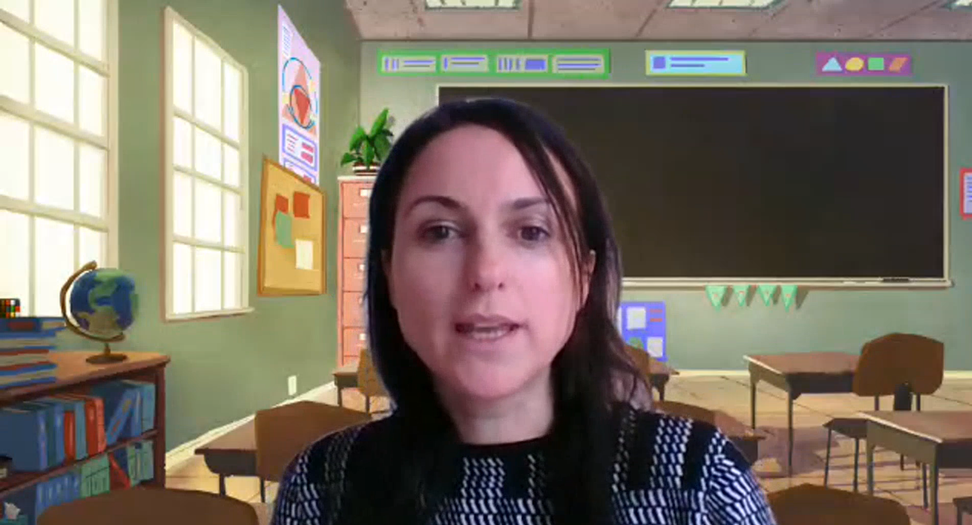
Pre Recorded Teaching
On the school website you will find a pre recorded video that will support the teaching of todays lesson. The video is called English video – using a question mark.

Slide 15
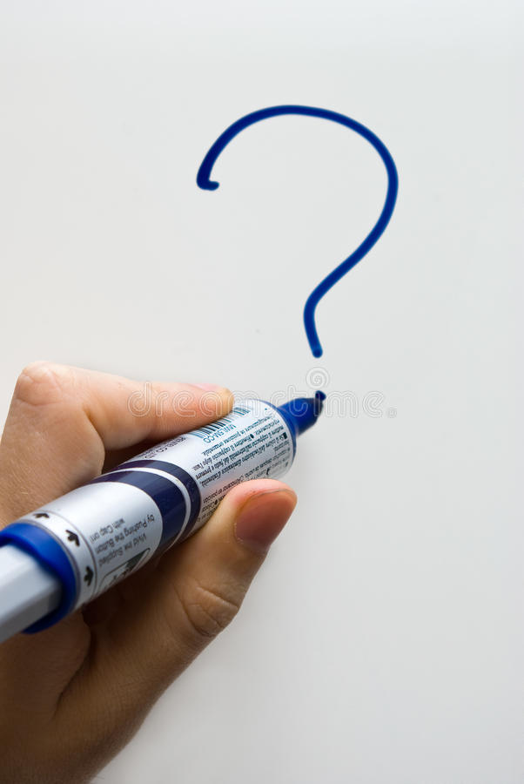
Question Mark
A question mark looks like this ?
It goes at the end of a question
Can you draw a question mark with your finger?
Now can you write a question mark on your paper?

Slide 16
What?
Question words
When?
Who?
Now can you ask questions about turtles using these question words?
Where?
Why?
How?
Example
Where do sea turtles live?
Write 3 questions on the lines below or on a piece of paper.

Slide 17
Did
The word ‘did’ is often used to start questions.
Look at these examples:
Did you like football practise?
Did you go for a walk today?
Did Emily come to your house?
Did you know that elephants have large ears?
Did you know sea turtles live in warm water?
All of the examples end with a question mark because when we use the word ‘did’ at the start of a sentence we are asking a question.

Slide 18
Add the question mark
Can you punctuate the sentences correctly using a question mark – remember a question mark looks like this ?
Where do sea turtles live
What do sea turtles eat
How do sea turtles glide through the water
When do sea turtles lay their eggs
Did you know that turtles have a hard, protective shell
Remember the ? goes at the end of the sentence

Slide 19
Add the question mark - answers
Check your answers. Did you put the question mark in the right place?
Where do sea turtles live?
What do sea turtles eat?
How do sea turtles glide through the water?
When do sea turtles lay their eggs?
Did you know that turtles have a hard, protective shell?

Slide 20
Question or statement?
A statement is a simple sentence.
A statement is always punctuated with a full stop at the end.
A question is something you can ask or answer.
A question is always punctuated with a question mark at the end .

Slide 21
Question or statement?
Read the sentences and decide if they need a full stop or question mark at the end. Use the word at the start of the sentence to help you decide.
1. Sea turtles have a huge protective shell
2. How do sea turtles breath under water
3. Did you know sea turtles like to live in warm water
4. Sea turtles have two, round eyes
5. When do sea turtles lay their eggs
6. Sea turtles have four flippers to help them swim faster
7. Sea turtles eat small fish and plants
8. Why do sea turtles have a shell

Slide 22
Question or statement? Answers
Check your answers. Did you get them all right?
1. Sea turtles have a huge protective shell.
2. How do sea turtles breath under water?
3. Did you know sea turtles like to live in warm water?
4. Sea turtles have two, round eyes.
5. When do sea turtles lay their eggs?
6. Sea turtles have four flippers to help them swim faster.
7. Sea turtles eat small fish and plants.
8. Why do sea turtles have a shell?

Slide 23
Now can you write your own questions about sea turtles?
You can use some of the questions we have already looked at to help.
What?
Who?
Question words
When?
Why?
Where?
Write your questions neatly onto a piece of paper or type them on the lines below. You will be able to use them in your writing tomorrow!
How?
Did?

Slide 24
Well done for all of your hard work today! We cant wait to see your completed work.
Could any completed work / photographic evidence of completed work please be sent to pioneerspupils@gmail.com
Thank you!

Slide 25
Date: Thursday 21st January
LO To be able to write a non-chronological report.
Subject: English

Slide 26
Read my report again to get it back in your head.
Super Scaly Sea Turtles!
Sea turtles are marine creatures which live in seas and oceans. They are cold blooded, have scaly skin and lay eggs – this makes them reptiles!
What do sea turtles look like?
Sea turtles have four flippers, a big smooth shell and two round eyes. The smooth shell makes the sea turtle streamlined which helps the turtle to swim through the water with elegance. Turtles have four flippers to help them swim quickly through the deep, salty ocean.
Did you know?
Sea turtles have glands in their body to help remove the salt from the water to keep them hydrated! The salty water comes out of the turtles eyes and makes the turtle look like it is crying!
Where do sea turtles live?
Sea turtles live in warm seas and oceans around the world. There are no turtles in the Artic Ocean because it is too cold! Turtles usually live in shallow water so that they can feel the heat from the bright, scorching sun. Adult sea turtles are usually found living in bays, lagoons or on the sea shore. Turtles spend the majority of their life in the water but female turtles come onto the shore to lay eggs on small, smooth grains of sand.
Did you know?
Sea turtles can hold their breath for up to five hours! This means turtles can stay under water for a long time without having to come out for oxygen.
What do sea turtles eat?
Most sea turtles are omnivores and eat a mixture of small marine creatures and plants. Sea turtles like to eat squid, shrimps, jelly fish and anemones. They also like to eat plants including algae, crinkle grass and seaweed.
Did you know?
Sea turtles don’t have teeth! They use their mouth to hold the food and break it up. Their mouth is made of keratin which is the same stuff your fingernails are made of!

Slide 27
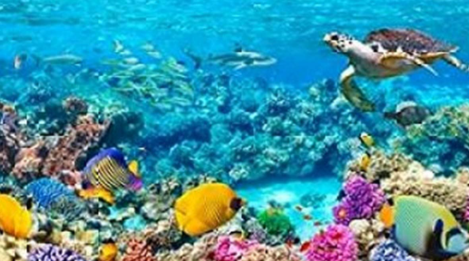
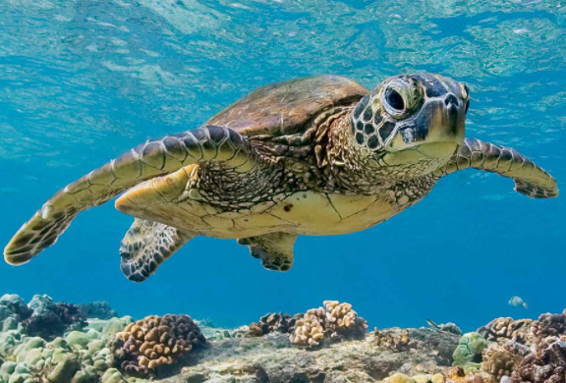
Super Scaly Sea Turtles!
Before you write your report click on the links to watch the videos and read the facts to learn more!
Video 1
https://www.youtube.com/watch?v=QTjrqhamIfk
Video 2
https://www.youtube.com/watch?v=qJfAbyz4qS0
Links to websites for facts:
https://kids.nationalgeographic.com/animals/reptiles/green-sea-turtle/
https://www.ducksters.com/animals/sea_turtles.php
https://animalfactguide.com/animal-facts/green-turtle/

Slide 28
Write a non chronological report
Your report must include:
A title
Subheadings
Commas in a list
Question marks
Describing words
Pictures
You can use the blank template on the next slide or create your own report on paper.
Title
Picture
Information
Picture
Remember commas are used to separate things in a list.
The last two things in the list are separated with the word ‘and’.

Slide 30
Well done for all of your hard work today! We cant wait to see your completed work.
Could any completed work / photographic evidence of completed work please be sent to pioneerspupils@gmail.com
Thank you!

Slide 31
Date: Friday 22nd January
LO To be able to read and spell words with the ‘dge’ sound.
Subject: English

Slide 32
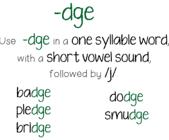
‘dge’ – pronounced j
The spelling rule we are focusing on today is ‘dge’.
It sounds like ‘j’
Click on the links or copy and paste the links into your internet browser to watch the spelling videos.
https://www.youtube.com/watch?v=QfHfY18alUQ
https://www.youtube.com/watch?v=zTEOMszP4P4
https://www.youtube.com/watch?v=uXA3PfE_4Qc

Slide 33
Read the ‘dge’ words
wedge
fudge
edge
bridge
hedge
ledge
lodge
smudge
nudge
judge
pledge
badge
fridge
dodge
Now write the words on a piece of paper and underline the ‘dge’ sound.

Slide 34
Word | 1st try | 2nd try | 3rd try
fudge
edge
bridge
hedge
wedge
ledge
badge
Practice writing the words on a piece of paper or type into the table on your computer.

Slide 35
Real or Alien words?
Read the words and decide if they are real words or alien words.
Real words
fudge
Alien words
wldge
hedge
sedge
wedge
bridge
lidge
edge
nudge
pudge
cludge
Remember alien words are made up words!

Slide 36
dge sound
Now pick 3 ‘dge’ words and write a sentence including each word.
fudge
edge
wedge
fridge
bridge
hedge
ledge
badge

Slide 37
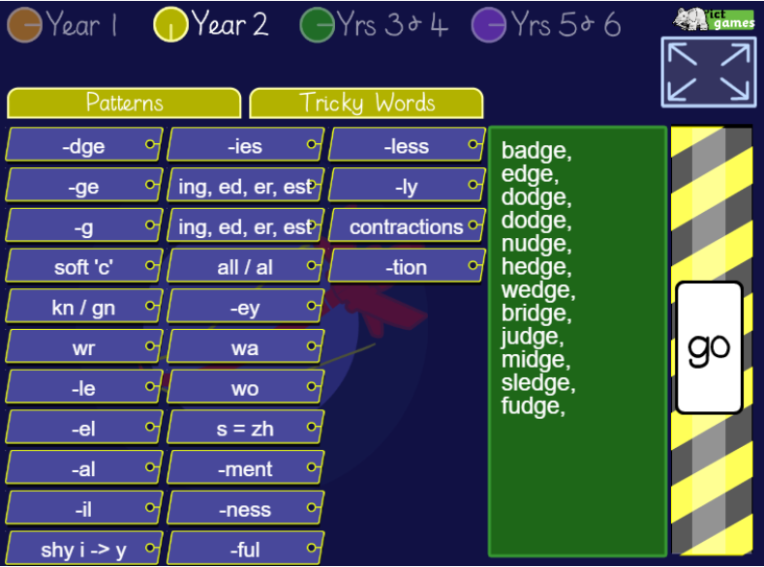
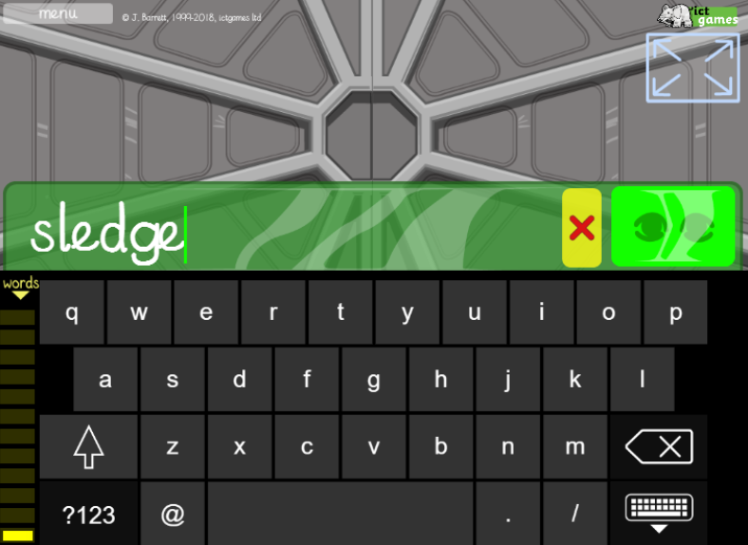
Spelling game
Use the link to play the game and practice spelling the ‘dge’ words
http://www.ictgames.com/mobilePage/lcwc/index.html

Slide 38
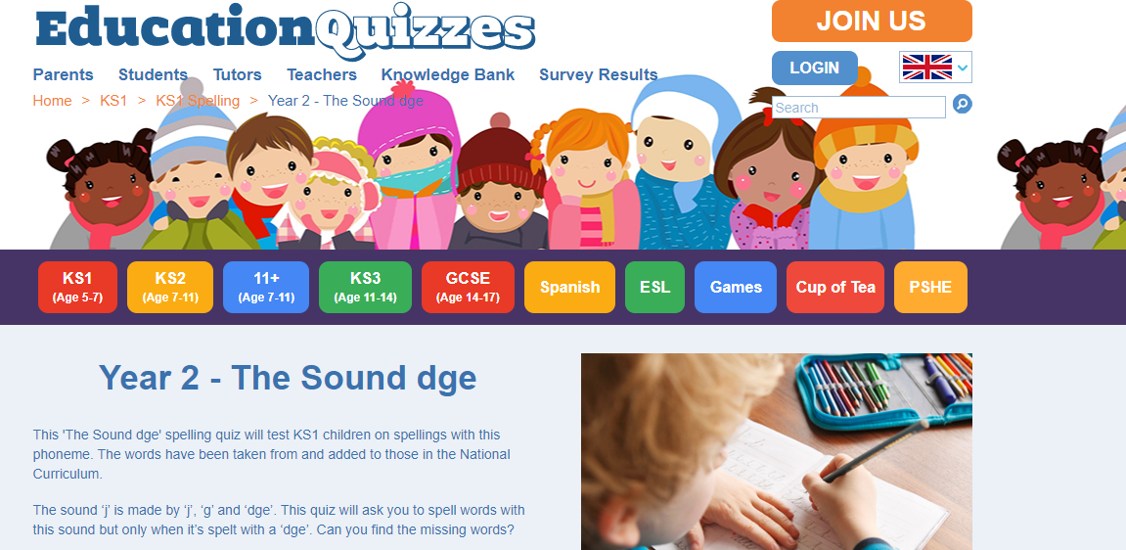
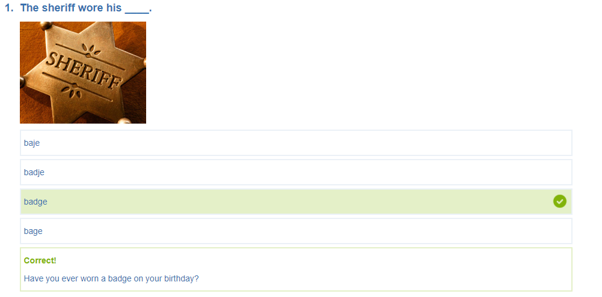
Spelling game
Use the link to play the game and practice spelling the ‘dge’ words
https://www.educationquizzes.com/ks1/english-spelling/year-2-the-sound-dge/

Slide 39
Well done for all of your hard work today! We cant wait to see your completed work.
Could any completed work / photographic evidence of completed work please be sent to pioneerspupils@gmail.com
Thank you!

