Slide 1
Date: Monday 25th January
L.O. To be able to spell words which contain the ‘ai’ sound.
Subject: English

Slide 2
Spellings
Remember:
1. rain
2. wait
3. aim
4. pain

Slide 3
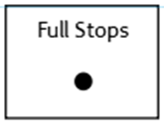
Spellings
Do not forget:
Can you put each one in a sentence?
1,
2,
3,
4,

Slide 4
Date: Tuesday 26th January
L.O. To be able to write a sentence using single nouns.
Subject: English

Slide 5
What is a singular noun?
A singular noun names only one person, animal, place, thing, or an idea.
Example:
The Giant Tortoise
The Lava Crab
The Galapagos Island
The Pacific Ocean

Slide 6
Can you circle the singular nouns?

Slide 7
Scaffold A Sentence: Can you add the singular nouns to finish the sentences?
________________________ can live up to 150 years.
___________________________________discovered the Galapagos Islands.
The Galapagos Islands are in______________
Don’t forget your full stops, capital letters and finger spaces.
The Giant Tortoise can live______________

Slide 8
Write a sentence: Write your own sentences about the Galapagos Islands using singular nouns.
The turtle swims in the Pacific Ocean.
The Galapagos Islands have lots of beaches.
Charles Darwin lived a long time ago.
.

Slide 9
Date: Wednesday 26th January
L.O. To be able to independently write a simple sentence.
Subject: English

Slide 10
What is a simple sentence?
A simple sentence is made up of different components.
It contains a subject (who) and a predicate which uses the verb to tell us what the subject is doing . Don't forget your capital letters and full stops.
For example
Charles Darwin discovered the Galapagos Island in the Pacific Ocean.
capital letter
full stop
Subject
who
Predicate
what he did.

Slide 11
Create A Sentence, my turn:
Charles Darwin discovered the Galapagos Island in the Pacific Ocean.
.
what he did
what he discovered
where it was at
full stop
capital letter
who it is

Slide 12
Singular nouns
Build A Sentence, your turn: can you drop and drag the picture to make your sentences.

Slide 13
Write a sentence: Write some of your own simple sentences
The turtle swims in the Pacific Ocean.
The Iguana eats leaves.
Charles Darwin lived a long time ago.
.

Slide 14
Date: Thursday 28nd January
L.O. To be able write the introduction of an information text.
Subject: English

Slide 15
To begin to write the introduction of an information text on the Galapagos Islands.
This is my introduction about the Galapagos Islands.
On the next page you are going to create your own introduction.
You need to think about:
An opening statement
1. what are the Galapagos Islands
Background information
2.Where there are?
3. What lives there?
4. How did the islands originate?
The Galapagos Islands belong to the South American country of Ecuador, located in the Pacific Ocean. The Islands form underwater volcanoes that spew lava up from the bottom of the sea. The Galapagos Islands are home to a variety of plants, animals and birds that have gradually adapted to life there. The Islands do not have big palm trees or lots of beach; only small bushes, desert plants and strips of sand.

Slide 16
Write 4 sentences to create your own introduction about the Galapagos Islands ?
.

Slide 17
Your title
Now we have an introduction can you think of a title and draw two animals that life on the Galapagos Island.
animals

Slide 18
Date: Friday 29th January
L.O. To be able to create an information text.
Subject: English

Slide 19
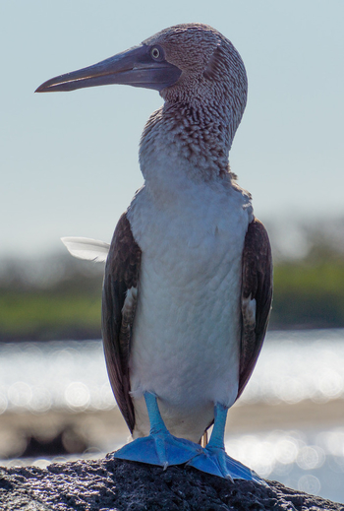
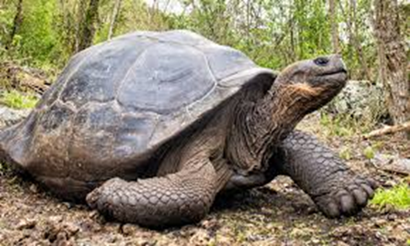
The Galapagos Islands
The Galapagos Islands belong to the South American country of Ecuador, located in the Pacific Ocean. The Islands are formed one-one form underwater volcanoes that spew lava up from the bottom of the sea. The Galapagos Islands are home to a variety of plants, animals and birds that have gradually adapted to life there. The Islands do not have big palm trees or lots of beach only small bushes, desert plants and strips of sand.
I hope you enjoyed doing yesterday's work.
Here is what I have done so far.

Slide 20
Writing an information text, my turn.
Now you are going to write three new pieces of information or facts you have learnt about the Galapagos Island.
Charles Darwin discovered the Galapagos Island on September 15, 1835.

Slide 21
Can you write 3 simple sentences using facts you have learnt about the Galapagos Islands.
1.
2.
3.
.

Slide 22
The Galapagos Islands
The Galapagos Islands belong to the South American country of Ecuador, located in the Pacific Ocean. The Islands are formed one-one form underwater volcanoes that spew lava up from the bottom of the sea. The Galapagos Islands are home to a variety of plants, animals and birds that have gradually adapted to life there. The Islands do not have big palm trees or lots of beach only small bushes, desert plants and strips of sand.
Charlies Darwin discovered the Galapagos
Add your information / facts to your overview.

Slide 23
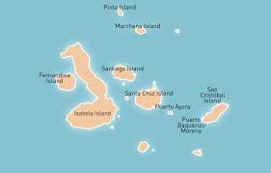
Here is my information text fully completed, we would love to see yours.
The Galapagos Islands belong to the South American country of Ecuador, located in the Pacific Ocean. The Islands are formed one-one form underwater volcanoes that spew lava up from the bottom of the sea. The Galapagos Islands are home to a variety of plants, animals and birds that have gradually adapted to life there. The Islands do not have big palm trees or lots of beach only small bushes, desert plants and strips of sand.
The Galapagos Island
Information 1,
The Lava Crab are also called Sally Lightfoot.
Animals that live on the island?
Iguanas
Seals
Tortoise
Lava Crab
The Blue Foot Boobie Bird lives off the western coasts of Central and South America.
Information 2,
The island has a different climate throughout the year.
Information 3
The Marine Iguanas are the only sea going lizards in the world.
The Giant Tortoise can live up to 150 years.

