Slide 1
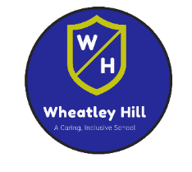

Remote Learning – Base 1
Week Beginning Monday 11th January 2021
Topic

Slide 2


Date: 11/01/2021
L.O. To make a weight-supporting bridge .
We hope you enjoyed last week’s task of building a tower! Can you remember what you did in order to make your tower strong and stable?
This week we are exploring bridges and the different structures used to build them in order to hold weight.
Subject: Design Technology

Slide 3
Around the world there are many different bridges in many different shapes and sizes. Each designed and built to do a specific job.
Can you think of any bridges that you have seen, or may have even been over, near your home ?
Answer the questions below about the bridges you have seen and discuss your answers with your adult at home.
Were they big or small bridges?
What were the bridges used for?
What shapes could you see on parts of the bridges?
What do you think the bridges were made from?

Slide 4
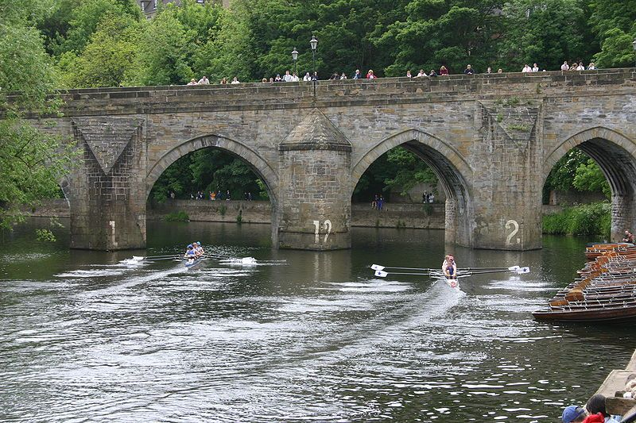
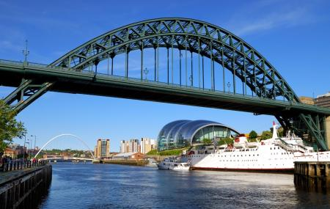
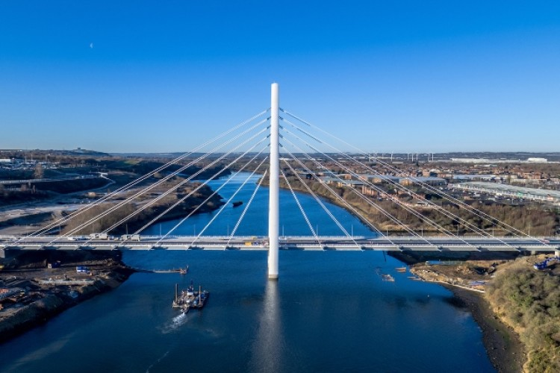
Here are some photographs are bridges from around the Northeast of England, where we live.
Answer the questions below about the bridges you can see in the photographs and discuss your answers with your adult at home.
What do you think these bridges are made from?
What do you think the bridges are used for?
What shapes can you see on these bridges?
This bridge is in Durham
This bridge is in Newcastle
This bridge is in Sunderland

Slide 5
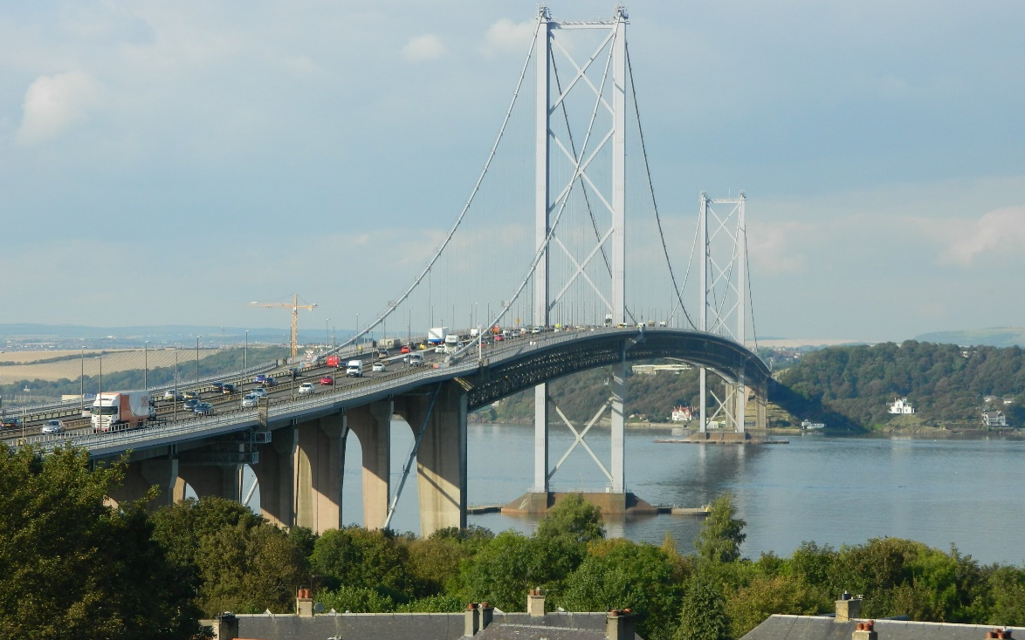
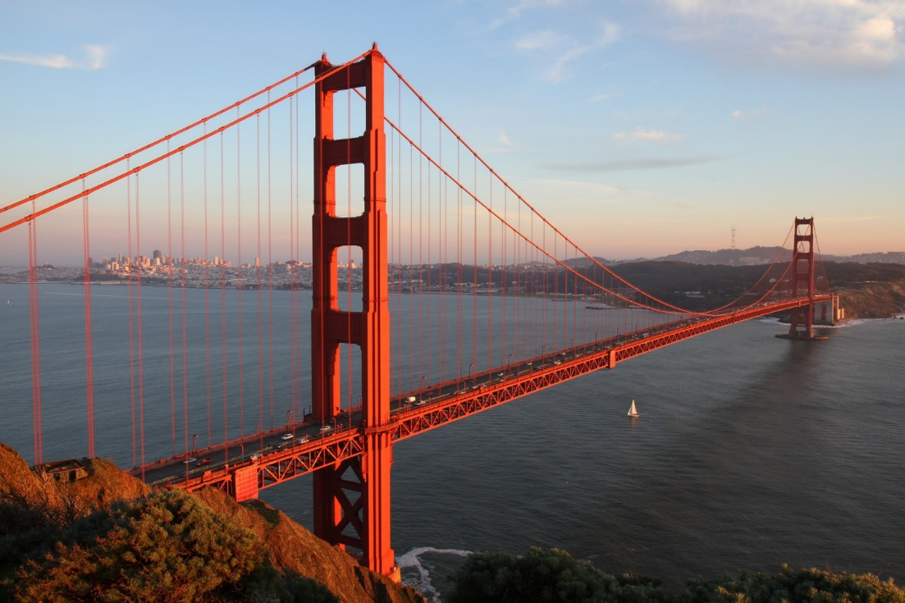
Forth Road Bridge,
Edinburgh, Scotland
Here are some photographs (on the next two pages) of famous bridges from around the world.
Answer the questions below about the bridges you can see in the photographs and discuss your answers with your adult at home.
What do you think these bridges are made from?
What do you think the bridges are used for?
What shapes can you see on these bridges?
What do you think these bridges built over?
Golden Gate Bridge,
San Francisco, California

Slide 6
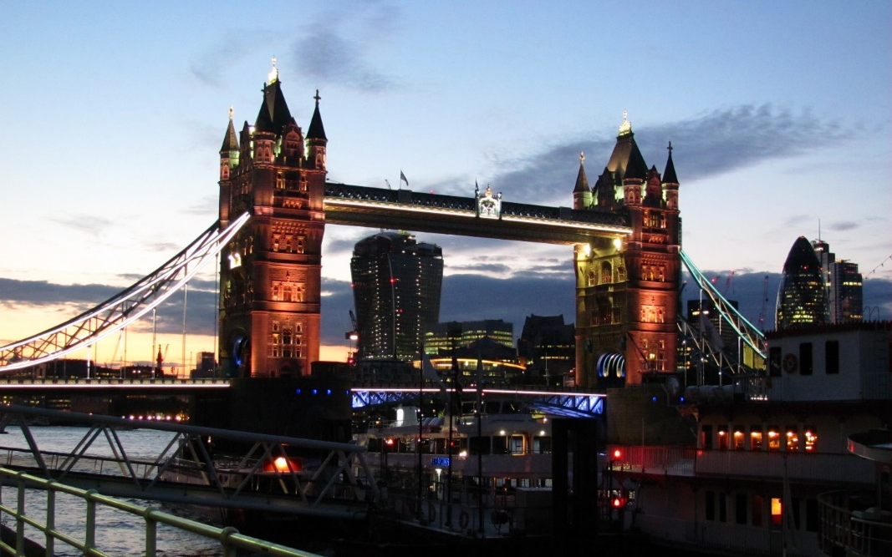
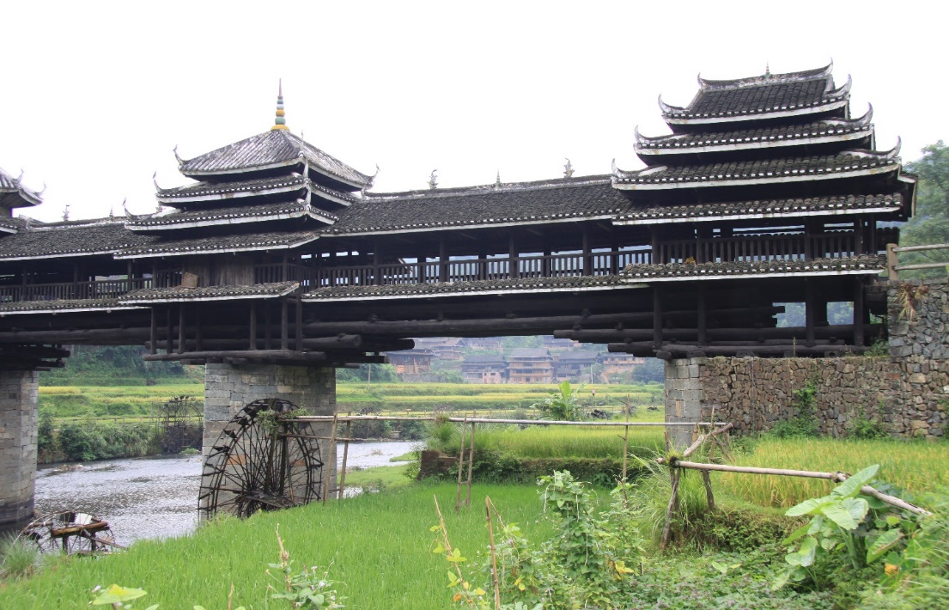
Tower Bridge,
London, England
Chenyang Bridge,
Liuzhou, China

Slide 7
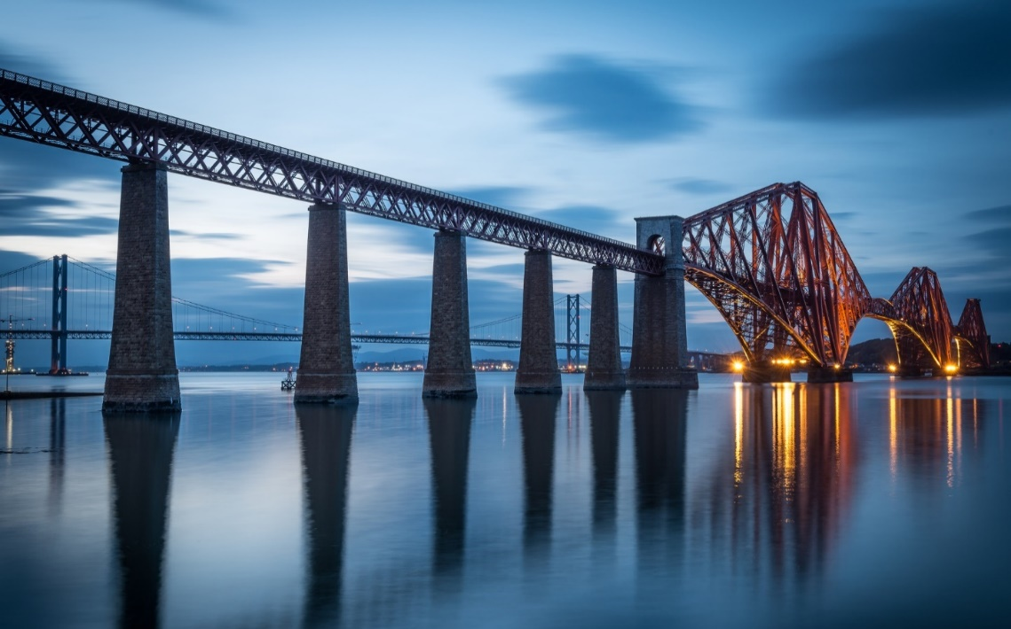
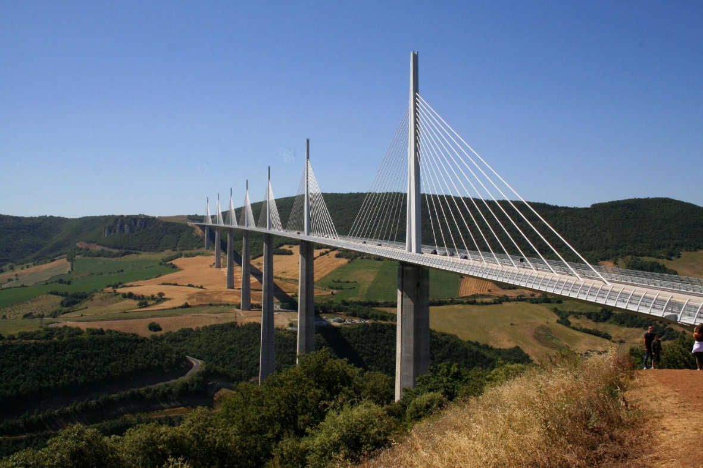
Forth Rail Bridge,
Firth of Forth, Scotland
Millau Viaduct,
Creissels, France

Slide 8
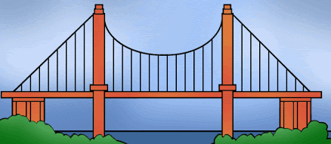
As you can see, bridges can look very different! But, they do have some similarities; strong and stable bases on each end of the bridge, sometimes in the middle, and a flat surface to travel across in the middle, called the deck.
Can you identify the bases of the bridge below? How many are there?

Slide 9


Slide 10
We challenge you to build a bridge, using only paper or thin card, to explore which method of construction can hold the most weight on the bridge.
Materials you need for the challenge:
Thin card or paper.
Two strong and stable bases for each end of your bridge- you could use a pile of books at each end or any other objects which are the same height and flat and stable.
Pencil or pen to mark your paper or card to the same lengths to make the test fair.
A ruler (to ensure all bridges are of equal length and width to make the test fair).
Scissors.
Some coins (of the same type) to test the strength of your bridges to make the test fair.

Slide 11
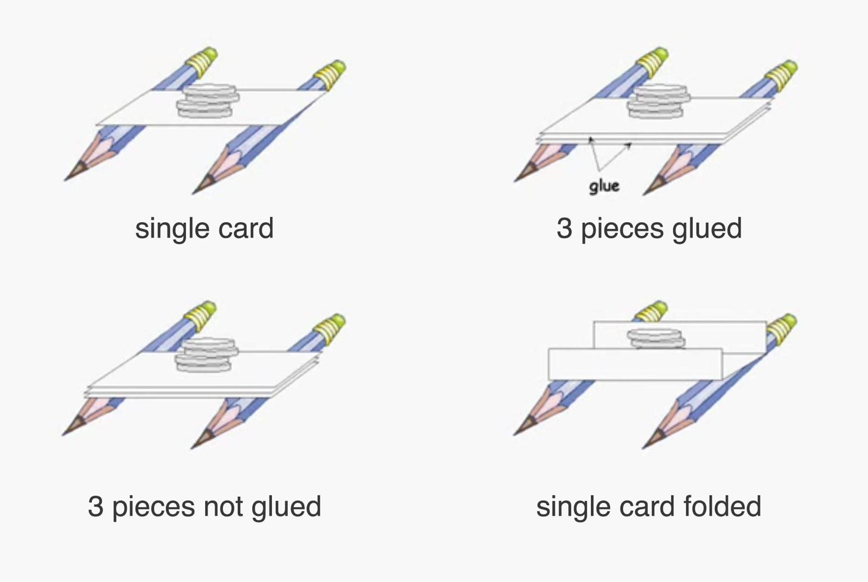
Below are the 4 different bridges we would like you to test the structure of.
Circle which bridge you think will be strongest and hold the most coins.
Which bridge do you think will hold the most coins?
Why?

Slide 12

Here is a video link showing you how to carry out the investigation:
https://youtu.be/taoAYL-54MY
If you can try to build each bridge and carry out each part of the investigation along with the video, so that the strongest bridge isn’t revealed until the end- no cheating!

Slide 13
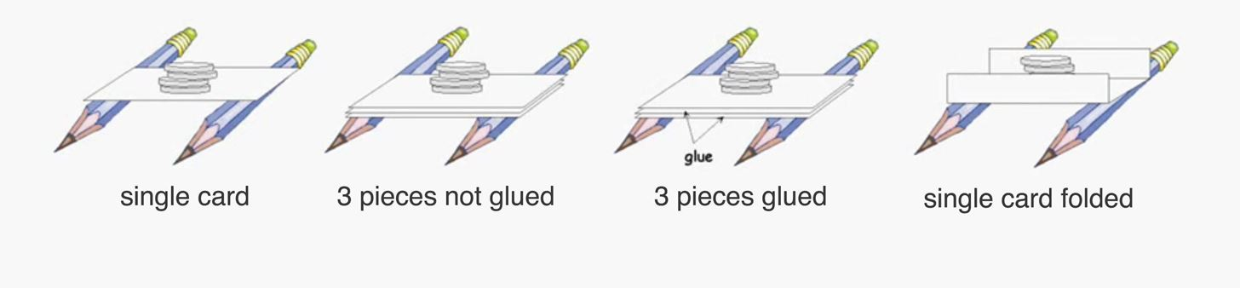
Did you enjoy the investigation? Answer the questions below, telling your adult what happened in your investigation. Write down under each diagram below how many coins each bridge held.
Which bridge was the weakest strongest? How do you know?
Which bridge was the second strongest?
Which bridge was the third strongest?
Which bridge was the strongest? How do you know?

Slide 14
Next week we will be exploring bridges further.
There are many different types of bridges; how many type of bridges are there?
Your extra challenge is to have a try at researching online how many different types of bridges there are and to write the number of types of bridges you fine below:
________________
Extra challenge!

Slide 15
Date: 12/01/2021
L.O. To explore the impact of earthquakes on their immediate environment and the people living there.
Subject: Geography

Slide 16
Last lesson we learnt about one of the natural disasters which can happen on Earth; earthquakes. Can you tell your adult what you remember about earthquakes and what happened in you investigation?
Here are some questions to help you remember.
What is an earthquake?
How does an earthquake start?
What happens to the buildings or objects on or surrounding the earthquake?
How do you think you would feel in an Earthquake

Slide 17
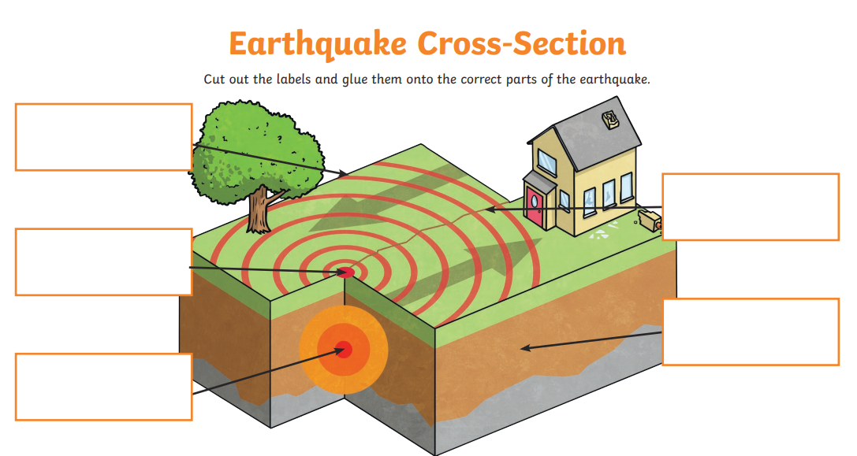
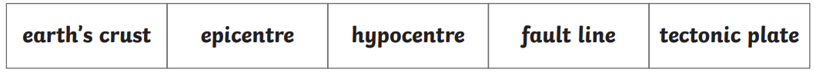
Can you remember the parts of an earthquake from last lesson? Write or cut and stick them to label the diagram below.

Slide 18
Earthquakes are very unlikely to happen here in the UK and if we do have an earthquake it is likely to be very small- so small in fact you may not even notice it! Earthquakes however can have a huge impact on other people who live in places around the world where stronger earthquakes happen more often. People who live in these areas often prepare for earthquakes, if they know it is possible that it may happen near to them.
What you would you do to prepare for an earthquake? Talk to your adult and discuss way in which you could prepare for an earthquake. Here are some questions below to help you.
Where would you go when the earthquake starts and why?
Where would be the safest place to go?
What would you take with you?

Slide 19
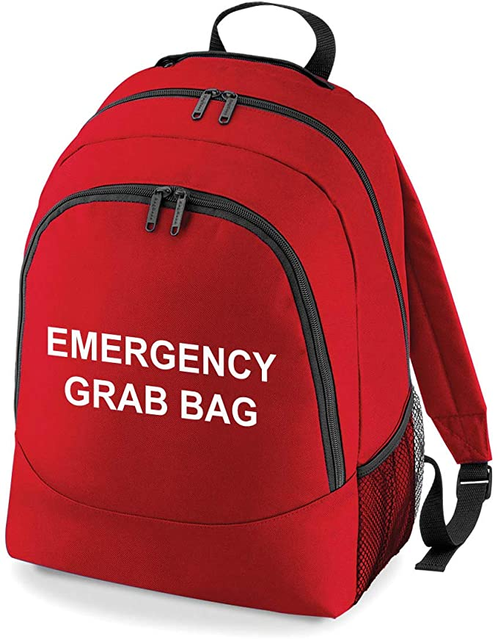
Preparing for an Earthquake
Plan
People who live on or near tectonic plates at high risk of an earthquake will always have a plan! They would plan where they would go and have a bag packed ready to take with them.
Your challenge is to find a bag and in it pack items from your house which you think would be useful and essential during an earthquake, if you had to leave your home to stay safe. Don’t forget, you will have to carry the bag so don’t pack too much as you may have to run fast!

Slide 20
Preparing for an Earthquake
What did you pack in your emergency bag? Draw pictures or write the names of the items you packed in the bag below

Slide 21

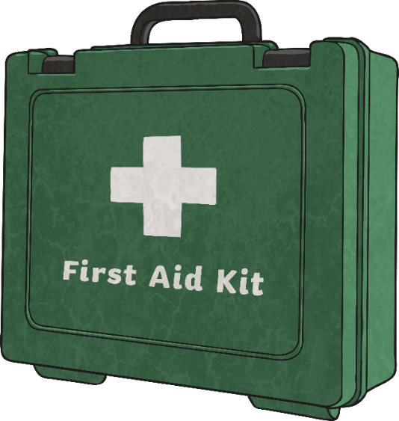
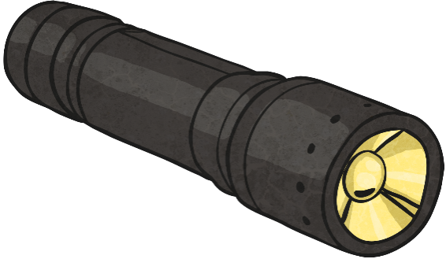
No one can predict when an earthquake will occur. You need an emergency plan and an emergency survival kit.
Packing an Emergency Kit:
Include the following items:
  plenty of water;
  a torch and spare batteries;
  emergency whistles;
  spare shoes and clothes;
  a first aid kit;
  a battery operated radio.
Did you include any of these items in your emergency bag?

Slide 22
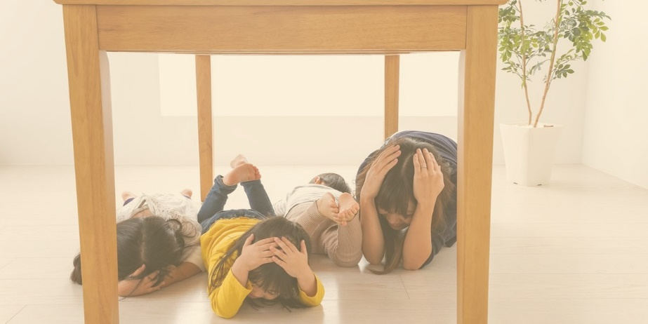
Preparing for an Earthquake
Practise and find somewhere safe!
At school we practise our emergency fire alarm tests.
In countries where earthquakes are frequent, schools and homes would practice what to do in an earthquake too!
Remember:
COVER- find cover so that objects do not fall on you
DROP- get down low so that you do not fall over
HOLD- hold onto something strong and stable so that you don’t get thrown around!
Challenge
Can you practise this at home and video it or take photos?
We can’t wait to see some of your responses!

Slide 23
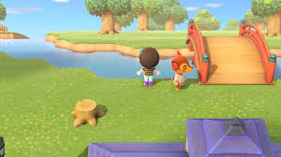
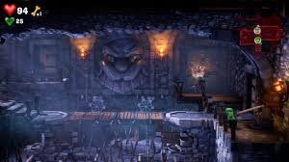
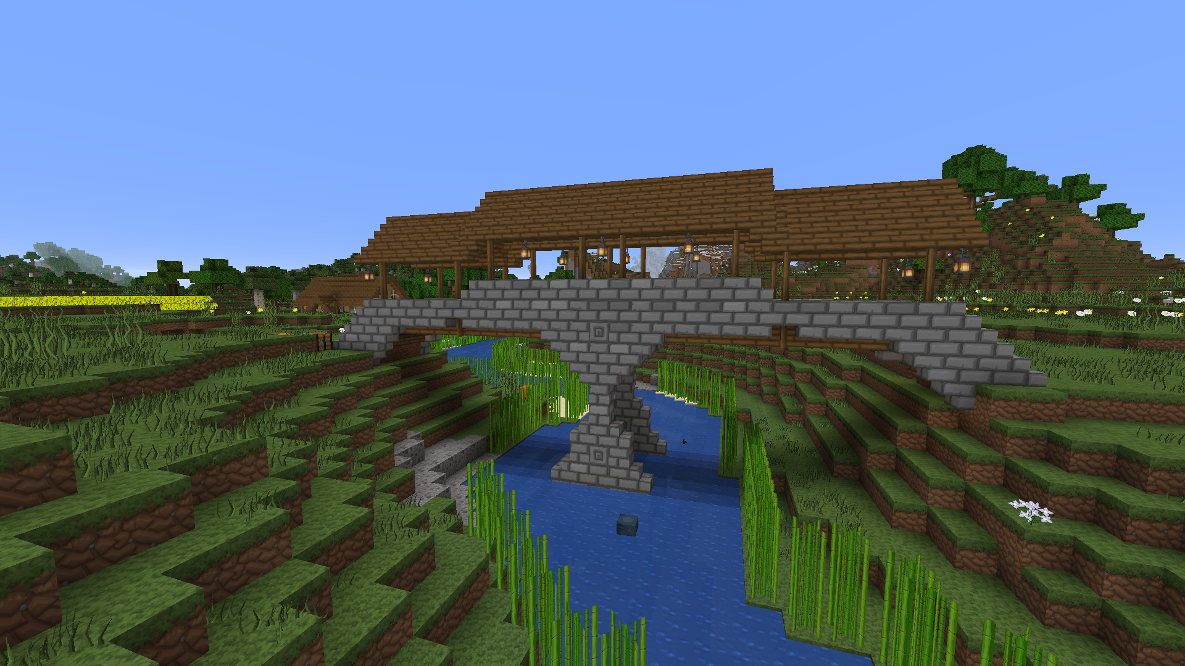
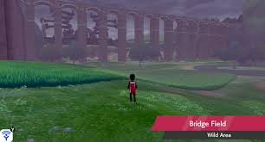
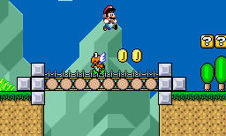
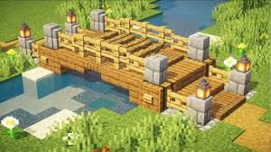
Extra Challenge
When you are next playing on your computer games (when you aren't working hard on your schoolwork of course!) Have a look for bridges in your games and see if you can identify what they are used for? If you are building one in a game, how have you made it strong and stable?
Here of a couple of online bridge building games for you to try, click on the links:
Build the Bridge - Play it now at CoolmathGames.com
Bridge Builder - Play Bridge Builder on Crazy Games

Slide 24
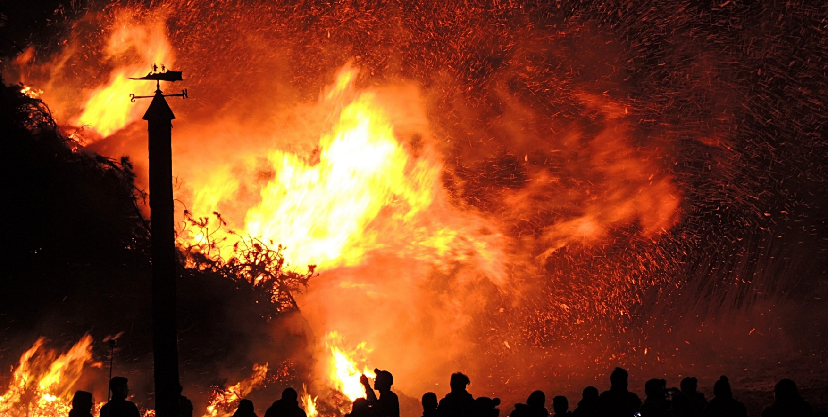
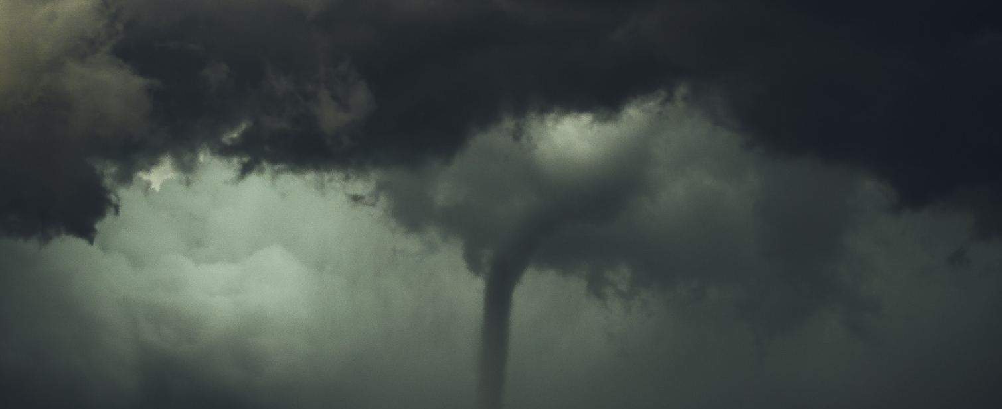
There are at least 10 other types of natural disasters which effect people around the world and some of them in the UK too.
We will be exploring each of these over the next few weeks.
Your final challenge today is to have a look online to see if you can find out the names of the other natural disasters we may be exploring soon. Write the names of them below.
1)_________________________________________________
2)_________________________________________________
3)_________________________________________________
4)_________________________________________________
5)_________________________________________________
6)_________________________________________________
7)_________________________________________________
8)_________________________________________________
9)_________________________________________________
10)________________________________________________

Slide 25
Date: 16/01/21
L.O. To identify different light sources.
Subject: Science

Slide 26


Close your eyes, what can you see? In order for us to see the things around us we need two things; light and for nothing to be blocking the light our vision such as an object or our own eyelids. Have a look around your home and outside (with an adult's permission!) How many sources of light can you find which help us to see?
Here are some examples in the photographs on this page.
Challenge: Can you add 5 of your own by writing the name of and drawing a picture of the light sources you find on the next page?

Slide 27
What light sources did you find? Draw them in the boxes below and write their names.
Lamp

Slide 28
Date: 16/01/21
L.O. To identify parts of the eyeball.
Subject: Science

Slide 29
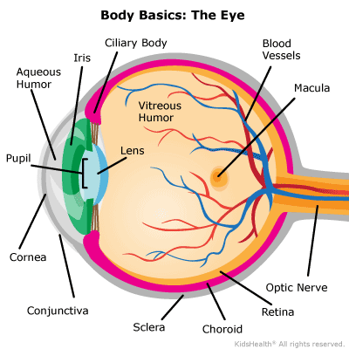
Once light hits an object, it travels back to the eye and allows us to see what we are looking at. The pupil lets in the light to the back of the eye, where it is turned into colour and fine-tuned by the macula. The retina then turns the light into a brain friendly message to the brain through the optic nerve to process the image of what we are looking at- aren't our eyes amazing!
Light

Slide 30

Challenge: Without looking at the last page, can you label the eyeball diagram below using the words around the picture. Write the word in the correct place to label the diagram or cut and stick them.
Ciliary Body | Macula
Iris | Optic Nerve
Blood Vessels | Retina
Choroid | Scelera
Conjunctiva | Cornea
Pupil | Aqueous Humor

Slide 31
Date: 16/01/21
L.O. To sort which materials can and cannot be recycled.
Subject: Science

Slide 32
Watch the video link below about recycling and discuss some of the questions with an adult:
https://www.youtube.com/watch?v=7UuUeoyYmxI
What is recycling?
Why is it so important?
Do you recycle at home?

Slide 33
Can you tell your adult what each of the objects on the next pages are made of? If you aren’t sure of an object, see if you can find something similar at home and have a feel to see what material it is made from. Can it be recycled? Cut the pictures out and move them onto the correct bin. Some of the items could go into more than one bin.
Vegetation?
Card?
Metal?
Plastic?
Paper?
Glass?
textiles?

Slide 34
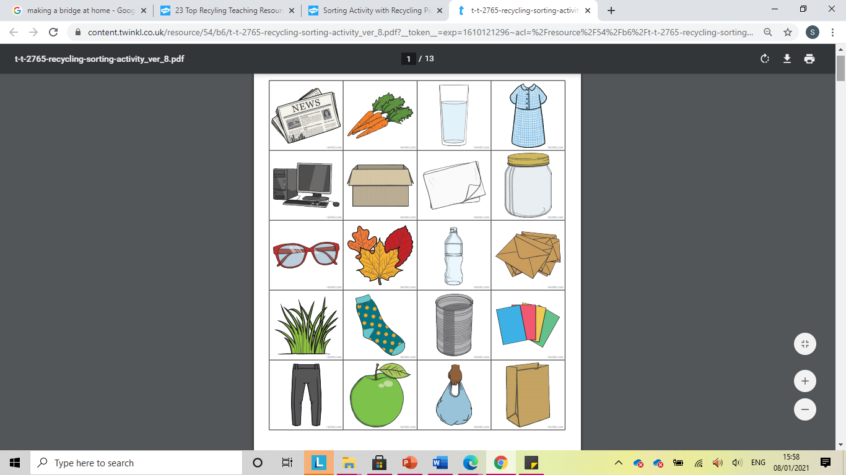

Slide 35
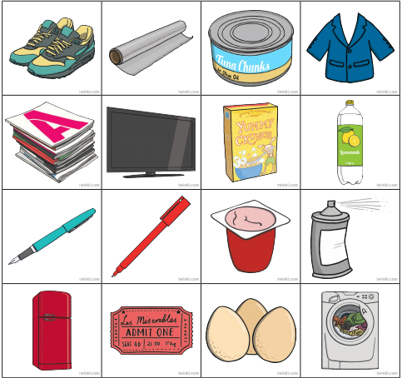

Slide 36
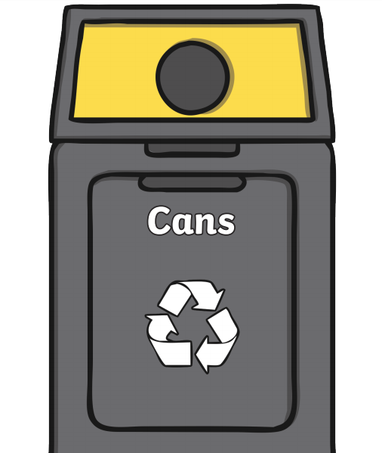
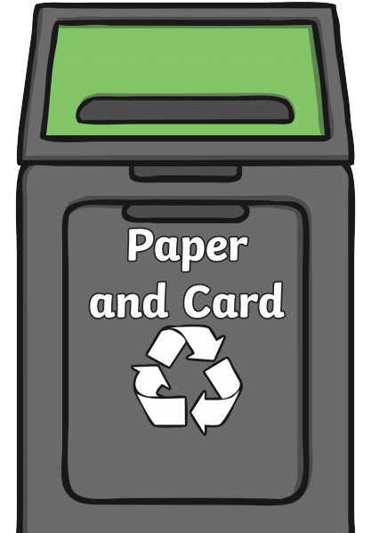

Slide 37
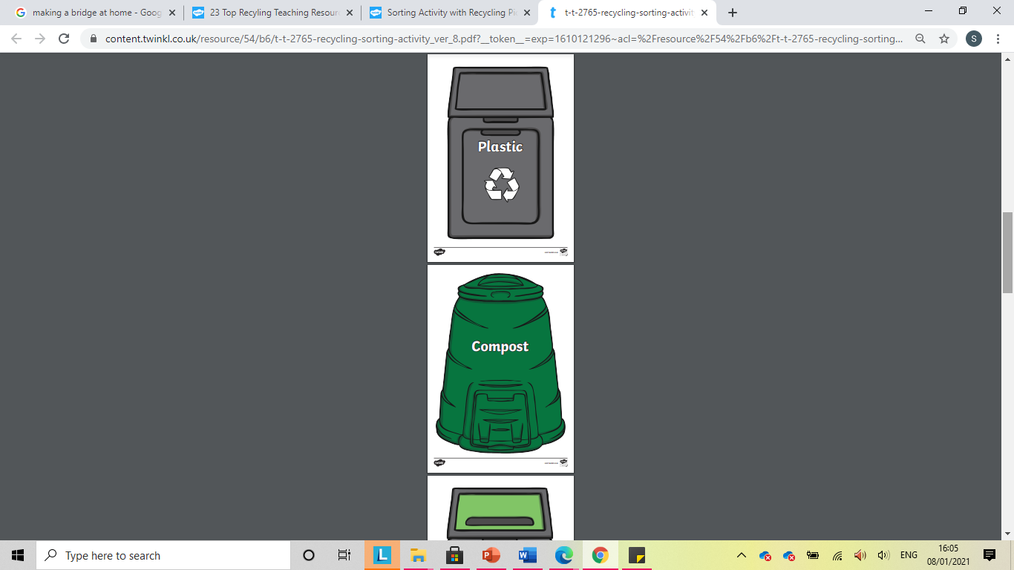

Slide 38
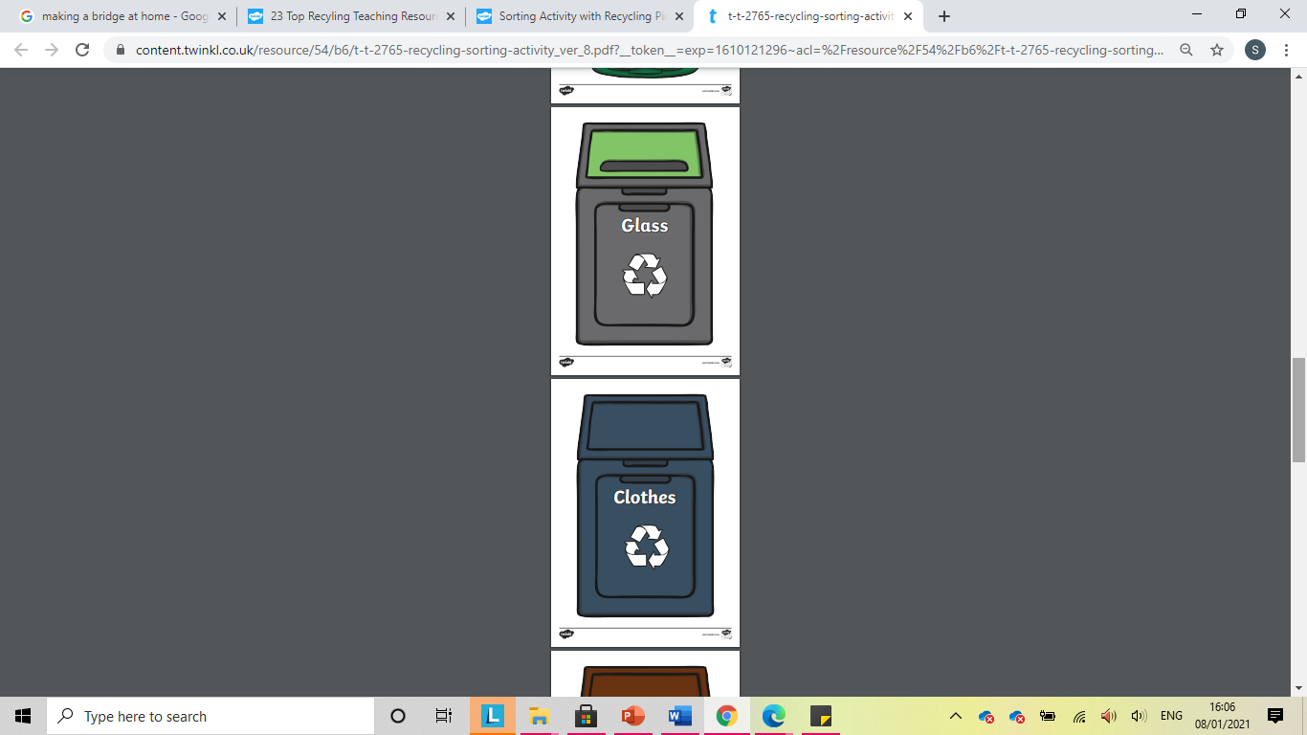

Slide 39
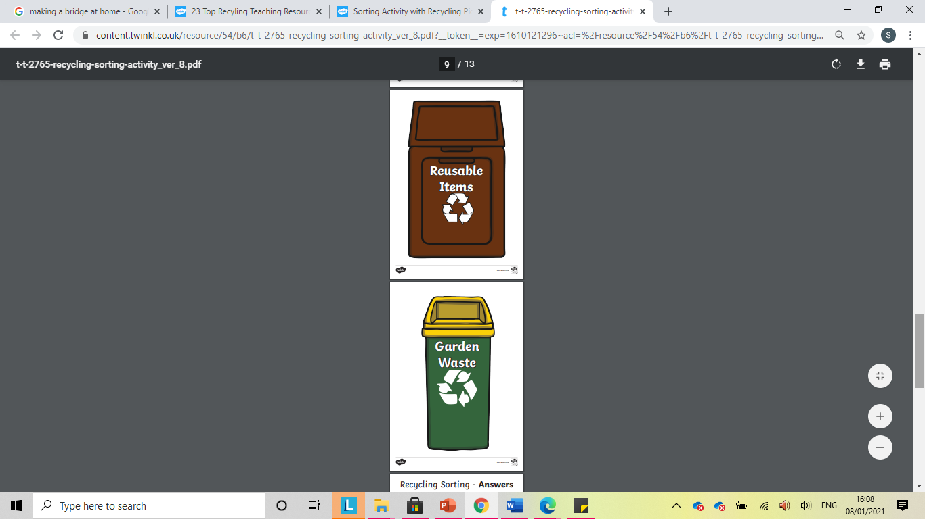

Slide 40
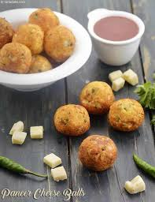
Date: 12/01/2021
L.O. To choose and write the recipe for a starter meal.
Subject: Cookery

Slide 41
In cookery this term you have been challenged to create a delicious three course meal!
Watch the video link below for some ideas for a starters.
Usually, starters are just a very small plate of food designed to leave you wanting more!
After you have watched the video, decide on a starter you would like to make with your adult and research the ingredients you will need and write them on the next page- we look forward to seeing your ideas!
https://www.youtube.com/watch?v=-dnvAUAh1wc

Slide 42
Discuss these questions with your adult before writing you list.
What is your starter going to be?
Are the ingredients going to be easy to get at the shop?
Do you need any non-food items on your shopping list too?

Slide 43
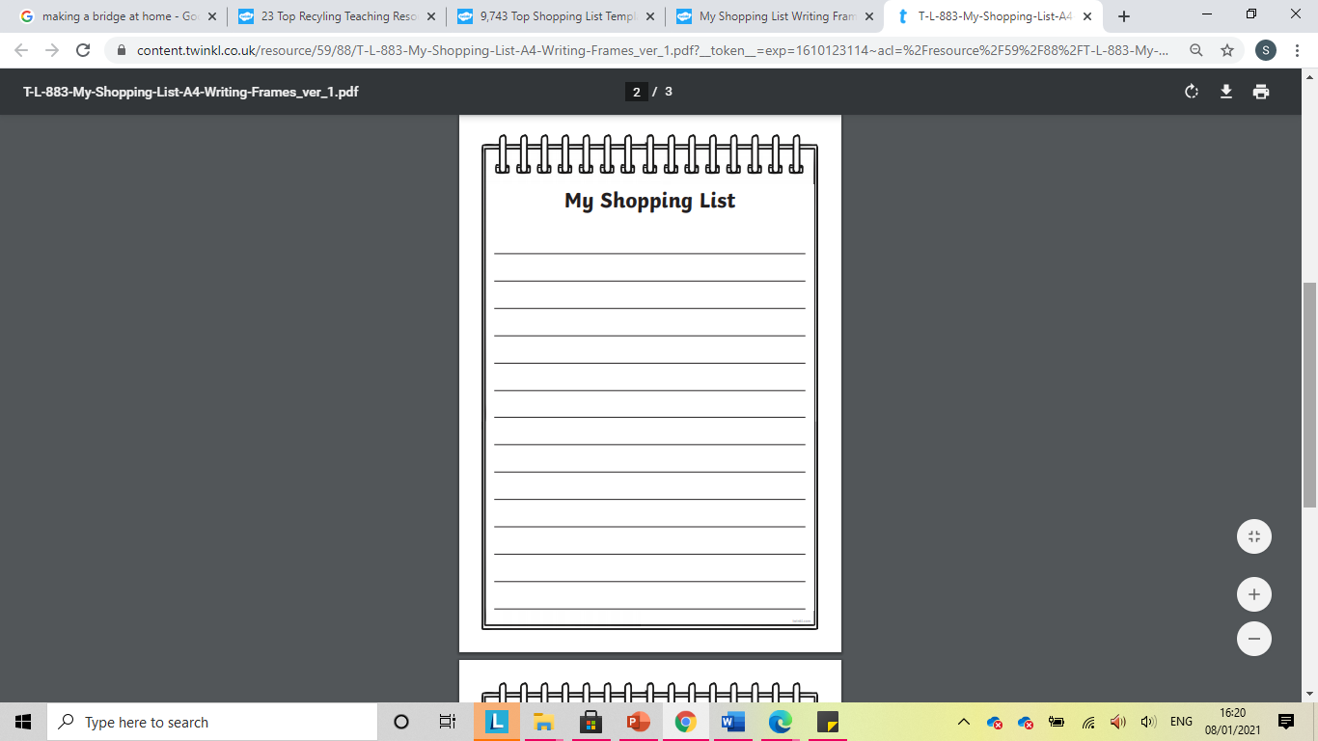

Slide 44
Extra Challenge: Can you research online how much, approximately, your ingredients will cost? Write the ingredients and the costs below to make sure you starter is affordable.
Ingredient | Cost
 | £
 | £
 | £
 | £
 | £
 | £
 | £
 | £
 | £
 | £
 | £

