Slide 1

Pack: C

Slide 2



Date: Tuesday 8th – Friday 12th February
L.O To be able to recognise sounds.
Please practise phonics every day for 20 minutes.
Subject: Phonics

Slide 3
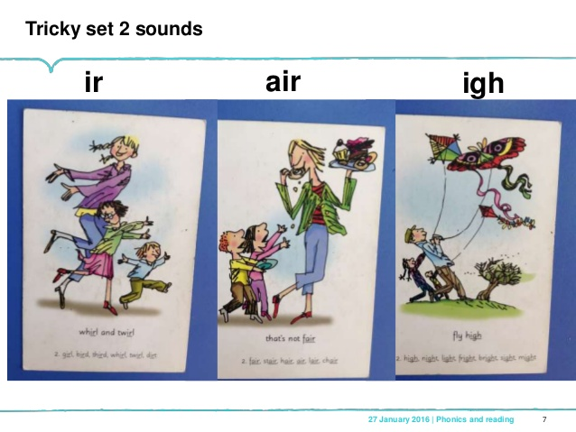

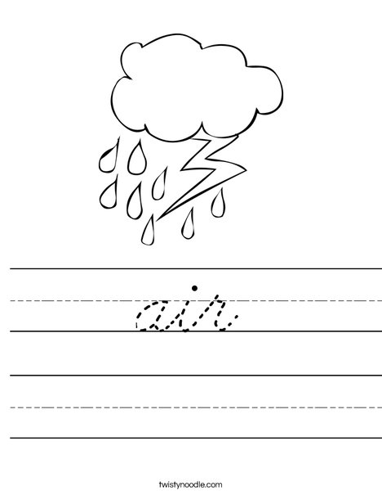


Sound 1 - “air”
Try my turn, your turn with a partner “air” > “air”
Say: air
“that’s not fair ”
Now use your index finger and try forming the sound out in the air.
Once having practiced see if you can form todays sound on paper.

Slide 4



Blending Independently
Fred Talk - Fred Frog can only say words in sounds but not the entire word all at once for example “ch-air”.
Read the Phonics green word car- Fred talk, read the word.
hair
sair
chair
fair
Review the words
Fred Talk, read the word
Fred in your head
Speedy reading
Can you separate the real words from the alien words?

Slide 5
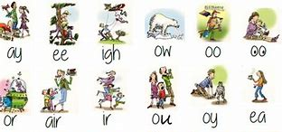
Review and Write
Can you spot todays sound?
Try thinking of some other words that have the sound ‘air’.
Examples - fair, chair, stairs
Challenge! Can you put a word from your list into a sentence?
Example- We must play the game in a fair way.

Slide 6
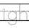
Sound 2 – “igh”
Try my turn, your turn with a partner “igh” > “igh”
Say: “igh”
“fly high”
Now use your index finger and try forming the sound out in the air.
Once having practiced see if you can form todays sound on paper.

Slide 7



Blending Independently – Sound 2
Fred Talk - Fred Frog can only say words in sounds but not the entire word all at once for example .
Read the Phonics green word card- Fred talk, read the word.
high
righ
night
gigh
Review the words
Fred Talk, read the word
Fred in your head
Speedy reading

Slide 8


Review and Write 2
Try and think of other words that have the sound ‘igh’.
Examples – night, sight, tight
Challenge! Can you put a word from your list into a sentence?
Example – The stars always shine bright at night.

Slide 9
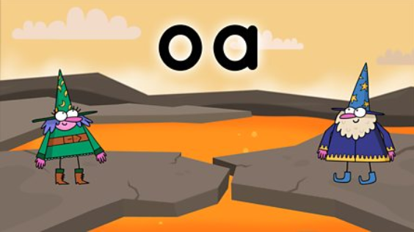

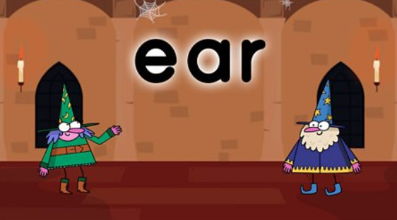
Phonics
BBC Bitesize has lots of 30 second videos focusing on each of the phonics sounds.
https://www.bbc.co.uk/bitesize/topics/zvq9bdm
Copy and paste the link.

Slide 10
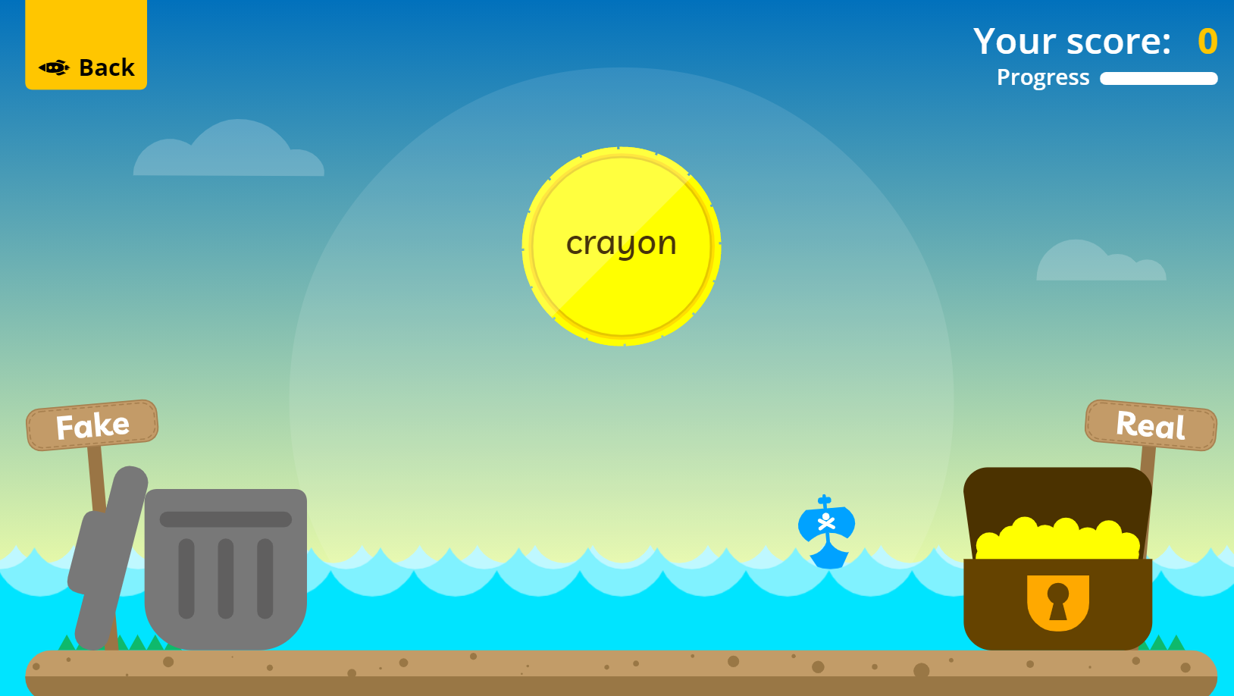
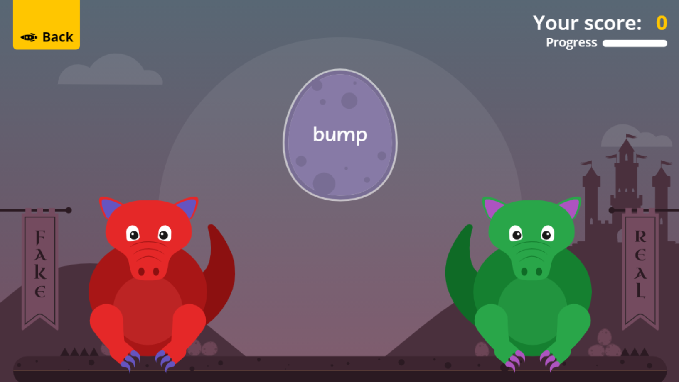

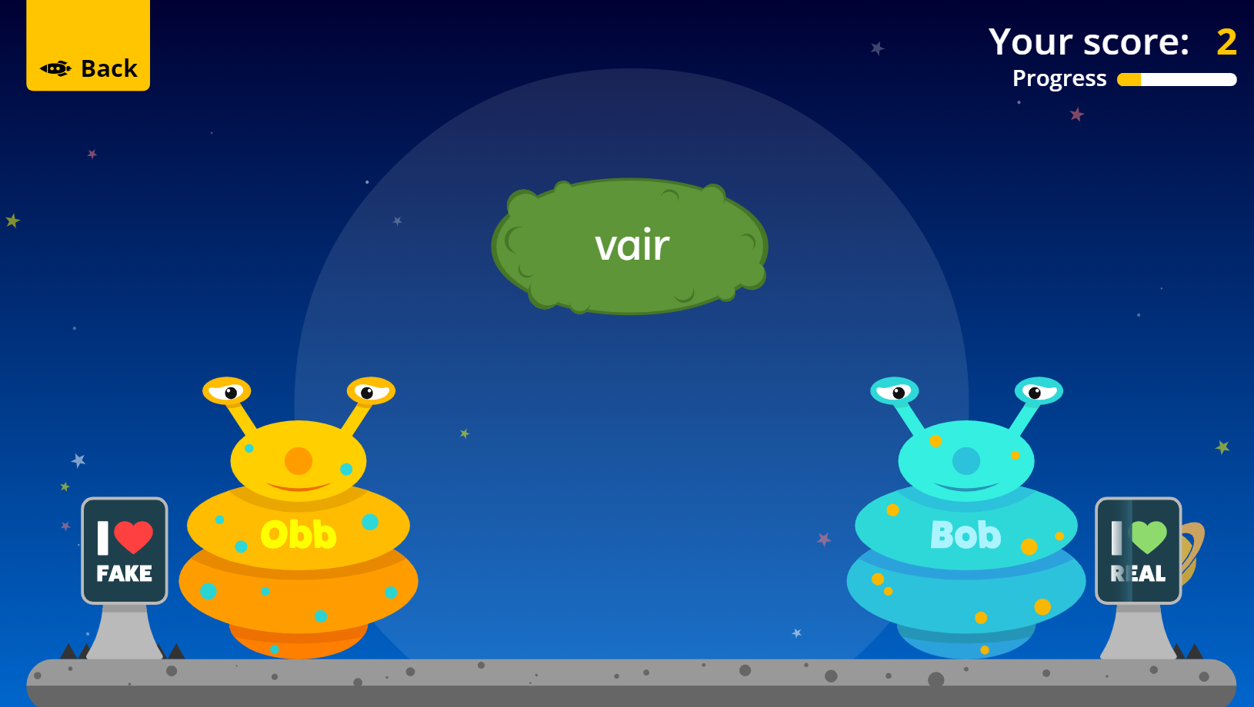
Fun Phonics Games!
Copy and paste the link to play these fun phonics games!
https://www.phonicsplay.co.uk/resources/phase/2/buried-treasure
All phases
https://www.phonicsplay.co.uk/resources/phase/2/dragons-den
All phases
https://www.phonicsplay.co.uk/resources/phase/2/picnic-on-pluto
All phases

