Slide 1
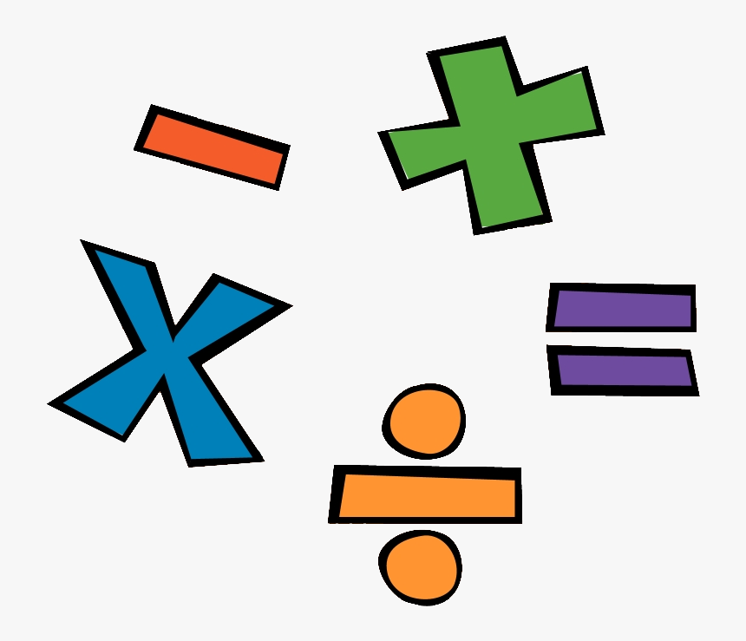
Remote Learning – Base 5
W.B. 04.01.21
Maths

Slide 2
Hello!
This week we will revisit our Number topic, rather than start something new. When we return to school we will begin our next Maths topic! ☺
Please keep any work you complete / photographs and bring them into school when you return so we can add them to your books / journals.
If you have any questions please don’t hesitate to contact school.
Mollie ☺

Slide 3
Date: 5.01.2021
L.O. To be able to understand place value
Subject: Maths

Slide 4
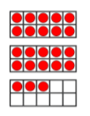
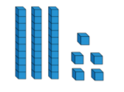
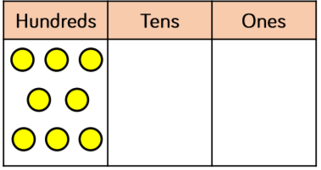
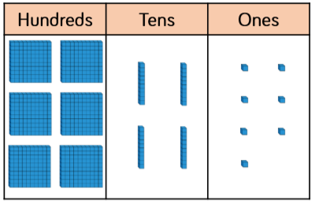
Task 1:
Look at the pictures below – what numbers are being represented?
Write down the answer for each one.
1)
2)
3)
4)
5)
6)
7)

Slide 5
Task 2:
Using your knowledge of place value, order the answers you got from the previous slide from smallest to largest.
smallest
largest
Maths Games - Click here to find some fun place value games!

Slide 6
Date: 6.01.2021
L.O. To be able to add a 2-digit number to a 3-digit number using the column method
Subject: Maths

Slide 7
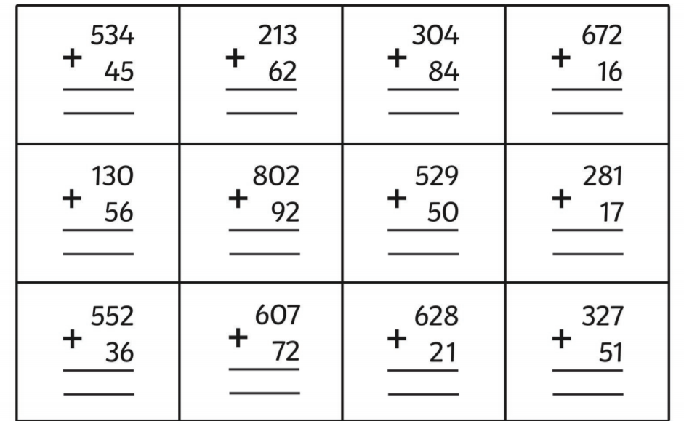
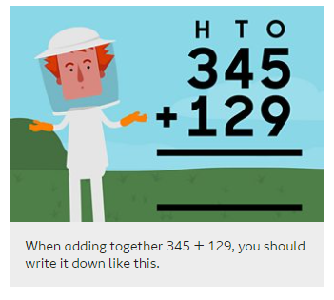
Task 1: Adding a 2-digit number to a 3-digit number using the column method
Copy out the following sums and work out the answer to each one.
When writing down sums, separate the numbers into ones, tens and hundreds. List the numbers in a column and always start adding with the ones first.

Slide 8
Task 2: Adding a 2-digit number to a 3-digit number using the column method (with exchanging)
Watch the video clip, then have a go at completing the following questions using the column method.
Video Link
315 + 47 =
234 + 82 =
Maths Games - Click here to find some fun addition and subtraction games!

Slide 9
Date: 7.01.2021
L.O. To be able to subtract numbers with up to 3 digits, using the column method
Subject: Maths

Slide 10
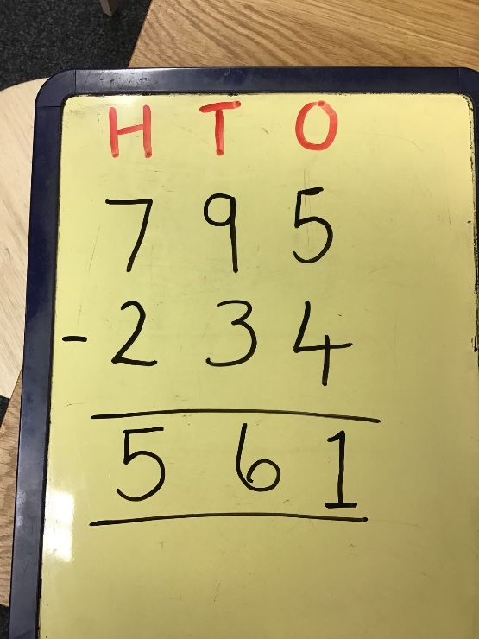
Task 1: Subtracting a 2-digit number from a 3-digit number
Can you write out the following questions and work out the answer using the column method like I have in the example?
Example:
795 – 234 = 561
654 – 21 =
342 – 31 =
739 – 26 =
524 – 23 =
656 – 21 =
483 – 51 =
987 – 75 =
543 – 122 =
453 – 343 =
Maths Games - Click here to find some fun addition and subtraction games!

Slide 11
Task 2 – Subtracting a 2-digit number from a 3-digit number (with exchanging)
Click here
Watch the videos, then have a go at these challenges! You will need to use the column method.
37 – 28 =
45 – 17 =

Slide 12
Date: 8.01.2021
L.O. To know my 4 times tables
Subject: Maths

Slide 13
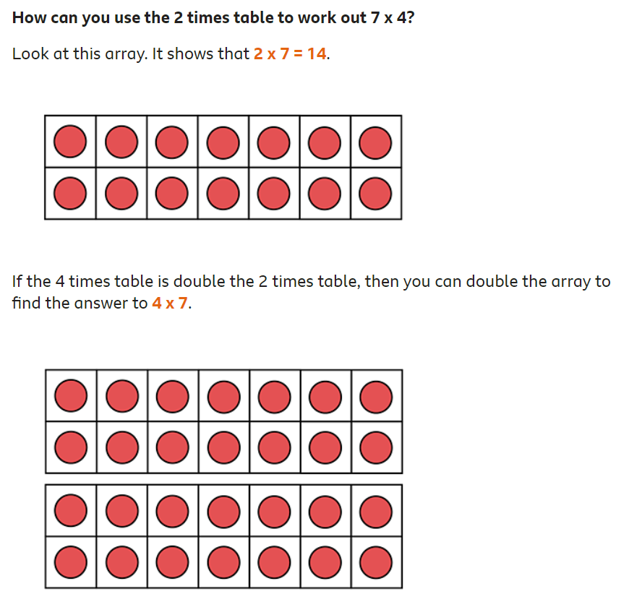
Look at the 2 times table and the 4 times table below. Can you see the relationship between them?
In each case the 4 times table is double the number in the 2 times table.

Slide 14
Maths Games - Click here to find some fun times tables games!
Can you work out the answers to the questions below? Use the spots on the dice to help you.
0 x 4
1 x 4
2 x 4
3 x 4
4 x 4
5 x 4
6 x 4
7 x 4
8 x 4
9 x 4
10 x 4

Slide 15
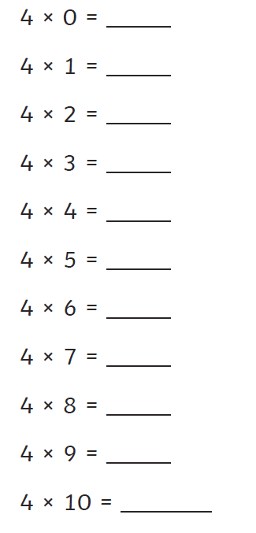
Can you work out the answers to the following questions? Write out the number sentence e.g. 4 x 0 = 0 Once you have completed this, practice reciting your 4 times tables to someone in your family. Challenge: ask a family member to test you!
Interactive Activities 4 Times Tables

