Slide 1
Date: Monday 28th June
LO To be able to identify the features of an advert.
Subject: English

Slide 2
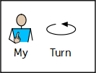
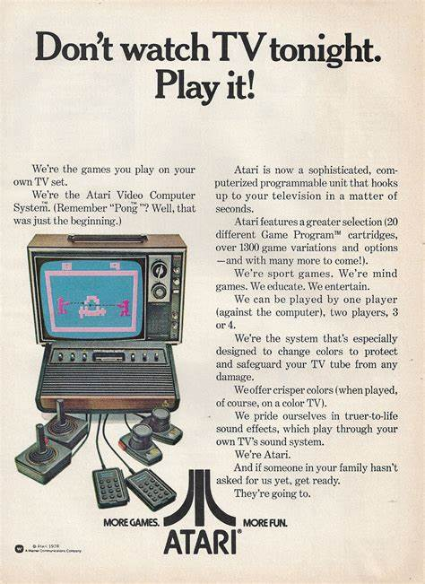
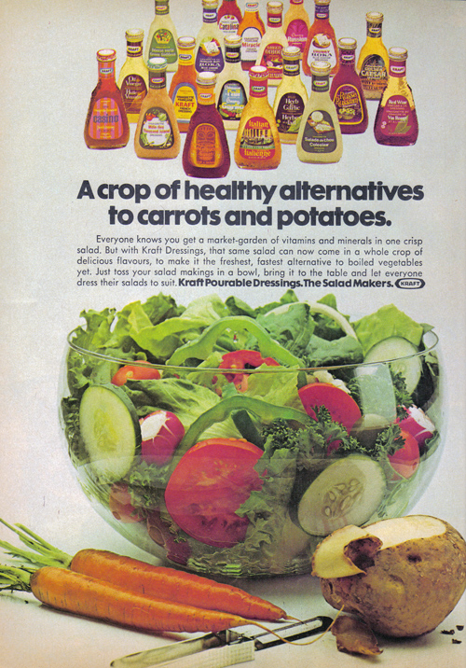
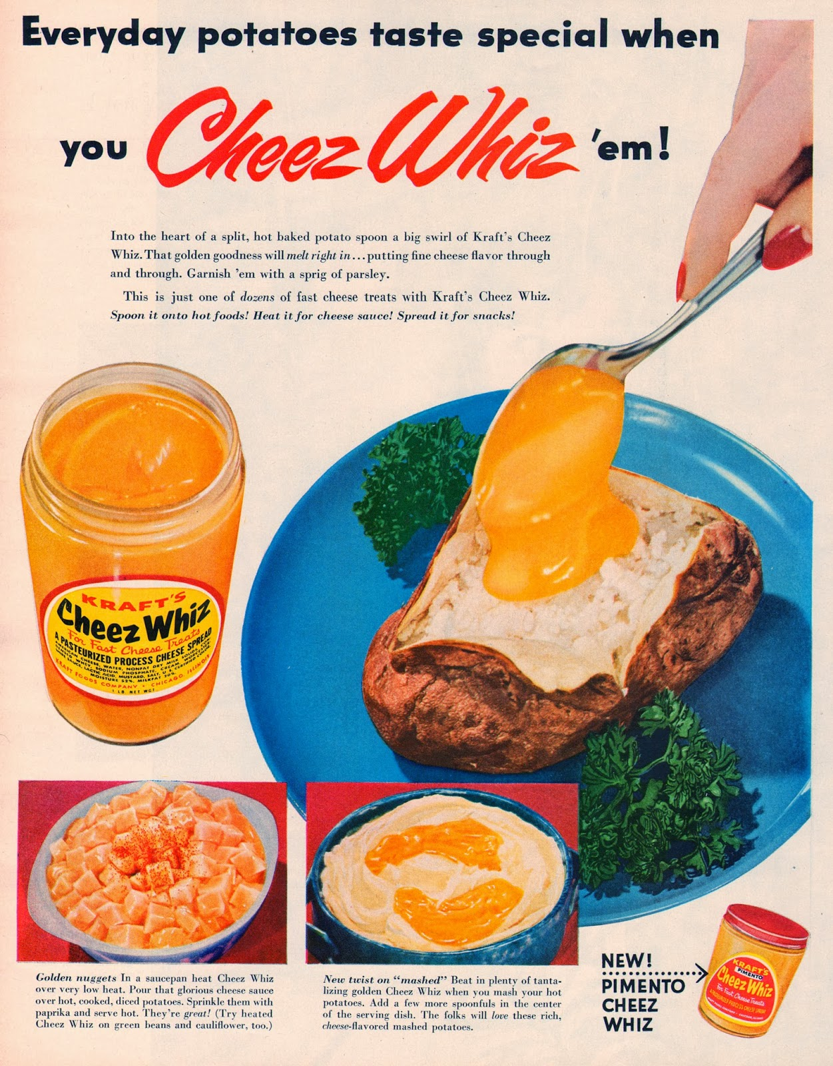
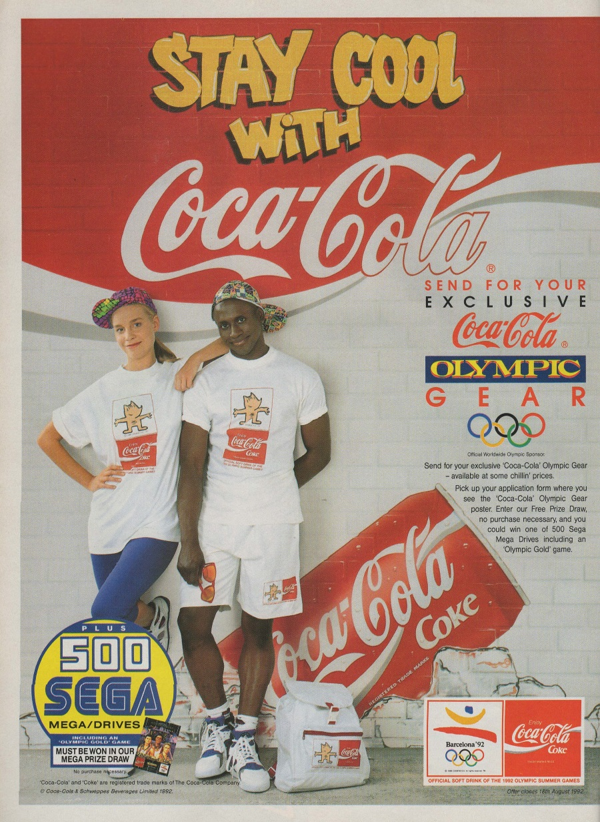
Adverts
This week we are going to look at adverts. Adverts are designed to make people want to buy a product.
Here are some examples:
Health benefits
Descriptions to make the product sound good
Catchy slogans
Eye catching pictures
Rhetorical questions

Slide 3
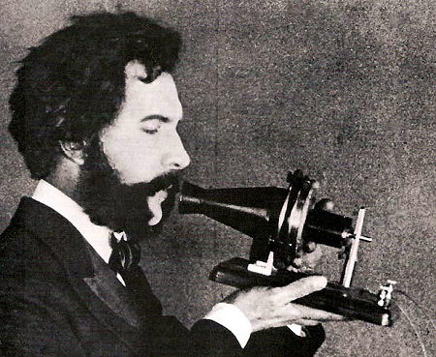
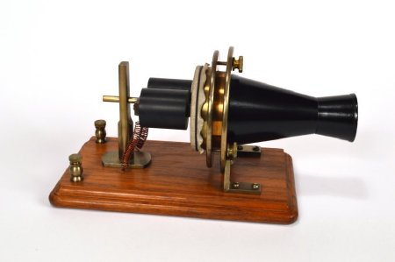
The Practical, Precious Phone!
Over the next three days, we are going to be looking at writing an advert for the first ever phone! Although this phone is very basic compared to phones now at the time it was amazing!
So when writing your advert you need to pretend this is the best phone ever! Nobody would want to buy the phone if you say it doesn’t do much! Imagine you were alive when this phone was made and at that time it was the best piece of technology available.

Slide 4
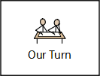
Read my advert!
The Practical, Precious Phone!
A product like no other! This phone will change your life for the better! Specially designed and handcrafted by one of Britain’s best inventors, this practical phone will make communicating with family and friends extremely easy. Forget spending hours handwriting a letter or walking for miles to speak to your best friend, this spectacular piece of technology allows you to speak to your friends at the push of a small button – literally!
You can use this reliable device to support your job, book appointments or enjoy an engaging conversation with your friends. As well as being practical, this little, black phone has been designed and finished to an extraordinarily high quality and will add great value and décor to your home!
Can you resist the temptation of purchasing this practical, precious phone? Why wait, buy your phone today!
Not only is this phone practical, it will making communicating much easier helping to improve your well being as well as your communication!

Slide 5
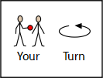
Now find the features!
The Practical, Precious Phone!
A product like no other! This phone will change your life for the better! Specially designed and handcrafted by one of Britain’s best inventors, this practical phone will make communicating with family and friends extremely easy. Forget spending hours handwriting a letter or walking for miles to speak to your best friend, this spectacular piece of technology allows you to speak to your friends at the push of a small button – literally!
You can use this reliable device to support your job, book appointments or enjoy an engaging conversation with your friends. As well as being practical, this little, black phone has been designed and finished to an extraordinarily high quality and will add great value and décor to your home!
Can you resist the temptation of purchasing this practical, precious phone? Why wait, buy your phone today!
Not only is this phone practical, it will making communicating much easier helping to improve your well being as well as your communication!
Remember adjectives are describing words!
Use the key to highlight/ underline the key features in the correct colour
title
picture
adjectives
question
exclamation mark

Slide 6
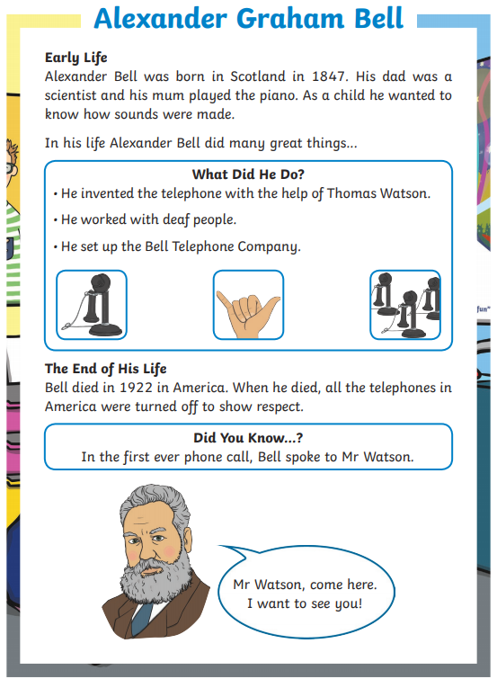
Reading Task:
To help you learn more about the first ever phone, read the information about Alexander Graham Bell. He was the inventor who created the first ever phone.
Once you have read the text, answer the questions on the next slide.

Slide 7
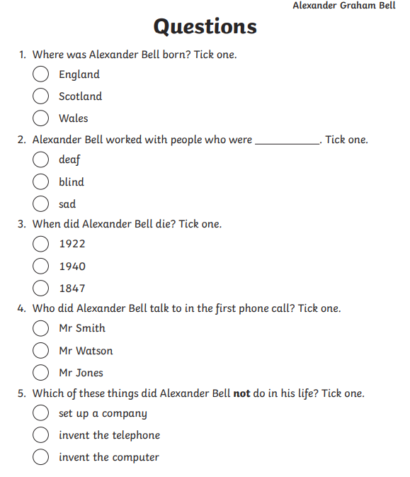
Reading Task:
Answer the questions

Slide 8
Well done for all of your hard work today! We can’t wait to see your completed work.
Could any completed work / photographic evidence of completed work please be sent to pioneerspupils@gmail.com
Thank you!

Slide 9
Date: Tuesday 29th June
LO To be able to use present tense verbs.
Subject: English

Slide 10
Pre-recorded Teaching
Access the online teaching video below that will support you to complete the work in this lesson. This video will act as a support but all of the work can still be successfully understood & completed using paper-based versions of this pack. If you need further support to understand / complete work then please contact school via e-mail or telephone.
Play Video
To use the present tense (thenational.academy)

Slide 11
Verbs are doing words
Present tense verbs
Present tense – means something that is happening NOW
So present tense verbs are actions that are happening NOW
For example:
I am sitting on a chair.
I am working from home.
I am looking at a powerpoint on my laptop.

Slide 12
Verbs are doing words
Past tense verbs
Past tense – means something that has ALREADY HAPPENED
So past tense verbs are actions that have already happened.
For example:
I was sat on the chair.
I stayed at home.
I played on my laptop.
I ate my lunch.

Slide 13
Read the verbs
jump
eat
run
clap
draw
Verbs
talk
cut
sing
laugh
cry
These words are all actions that people can do.

Slide 14
Verbs
Can you do the actions to represent these verbs?
While you were doing the actions they were present tense but now you have already completed the action it is in the past.

Slide 15
Match the present tense verbs to the past tense verbs (1)
Example

Slide 16
Match the present tense verbs to the past tense verbs (2)

Slide 17
Present tense verbs
The following verbs are all actions that can be done whilst using a phone

Slide 18
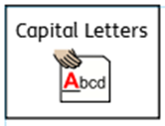
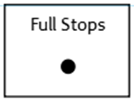
Sentences using present tense verbs…
Using the symbols to help you, write 4 sentences about the phone including present tense verbs.
Don’t forget:
If you are finding this task a bit tricky, you can have a go at the sentence building activity on the next few slides.
You can use this amazing new phone to talk to your friends!
Keep your sentences safe, you will be able to use them in your advert tomorrow!

Slide 19
Sentence building
Read and order the cards to build the sentence. Remember the capital letter goes at the start of the sentence and the full stop goes at the end. Use the symbols to help you work out the word if you are finding it tricky to read.
You can cut and stick the pictures in the correct order or drag them into the correct boxes on your computer.

Slide 20
Sentence building
Read and order the cards to build the sentence. Remember the capital letter goes at the start of the sentence and the full stop goes at the end. Use the symbols to help you work out the word if you are finding it tricky to read.
You can cut and stick the pictures in the correct order or drag them into the correct boxes on your computer.
Once you have ordered the sentence cards, copy the words to write your sentence.
For example:
The phone can ring your friends.

Slide 21
Sentence building
Read and order the cards to build the sentence. Remember the capital letter goes at the start of the sentence and the full stop goes at the end. Use the symbols to help you work out the word if you are finding it tricky to read.
You can cut and stick the pictures in the correct order or drag them into the correct boxes on your computer.

Slide 22
Sentence building
Read and order the cards to build the sentence. Remember the capital letter goes at the start of the sentence and the full stop goes at the end. Use the symbols to help you work out the word if you are finding it tricky to read.
You can cut and stick the pictures in the correct order or drag them into the correct boxes on your computer.

Slide 23
Sentence building
Read and order the cards to build the sentence. Remember the capital letter goes at the start of the sentence and the full stop goes at the end. Use the symbols to help you work out the word if you are finding it tricky to read.
You can cut and stick the pictures in the correct order or drag them into the correct boxes on your computer.

Slide 24
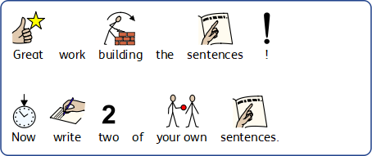
Sentence building
You can write your sentences neatly on a piece of paper or type them on the lines below.

Slide 25
Well done for all of your hard work today! We can’t wait to see your completed work.
Could any completed work / photographic evidence of completed work please be sent to pioneerspupils@gmail.com
Thank you!

Slide 26
Date: Wednesday 30th June
LO To be able to write an advert for a historic phone.
Subject: English

Slide 27
The Practical, Precious Phone!
Re read my advert to get it back in your head!
A product like no other! This phone will change your life for the better! Specially designed and handcrafted by one of Britain’s best inventors, this practical phone will make communicating with family and friends extremely easy. Forget spending hours handwriting a letter or walking for miles to speak to your best friend, this spectacular piece of technology allows you to speak to your friends at the push of a small button – literally!
You can use this reliable device to support your job, book appointments or enjoy an engaging conversation with your friends. As well as being practical, this little, black phone has been designed and finished to an extraordinarily high quality and will add great value and décor to your home!
Can you resist the temptation of purchasing this practical, precious phone? Why wait, buy your phone today!
Not only is this phone practical, it will making communicating much easier helping to improve your well being as well as your communication!

Slide 28
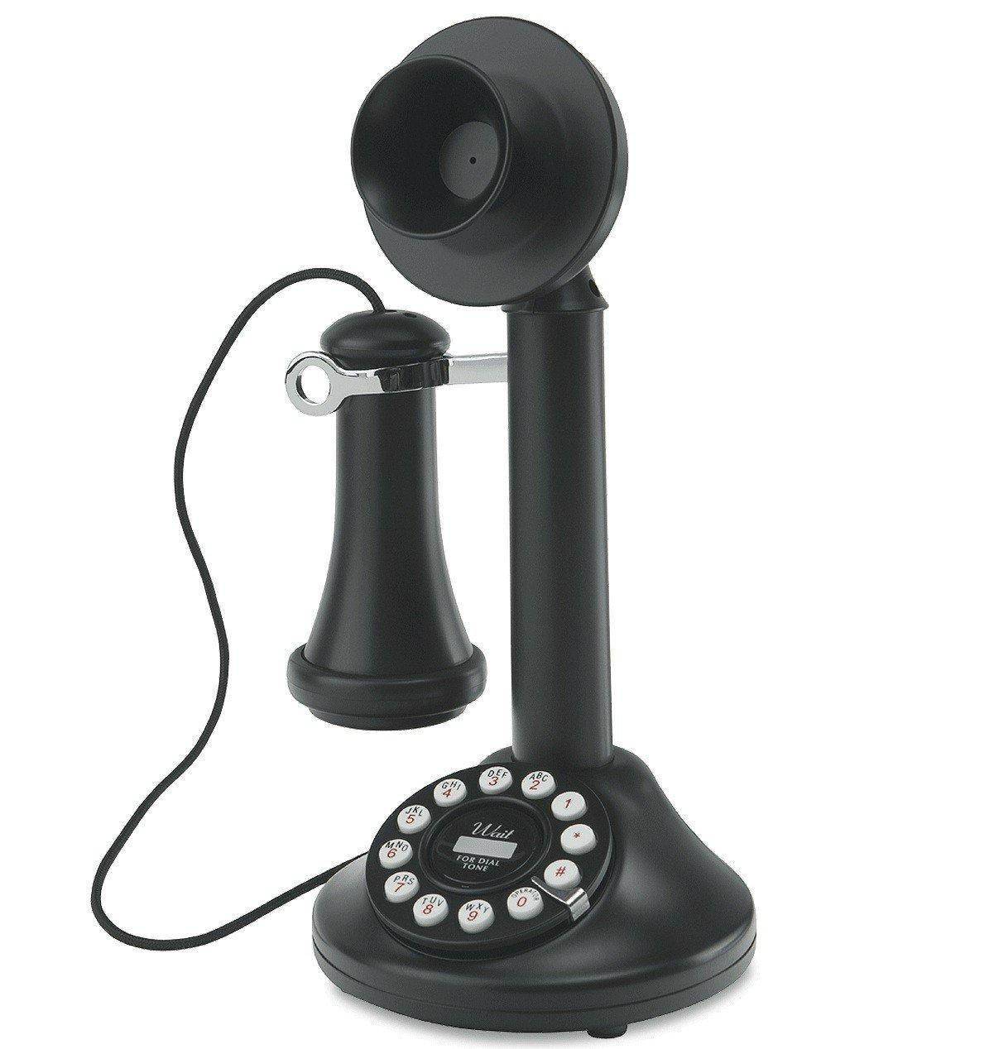
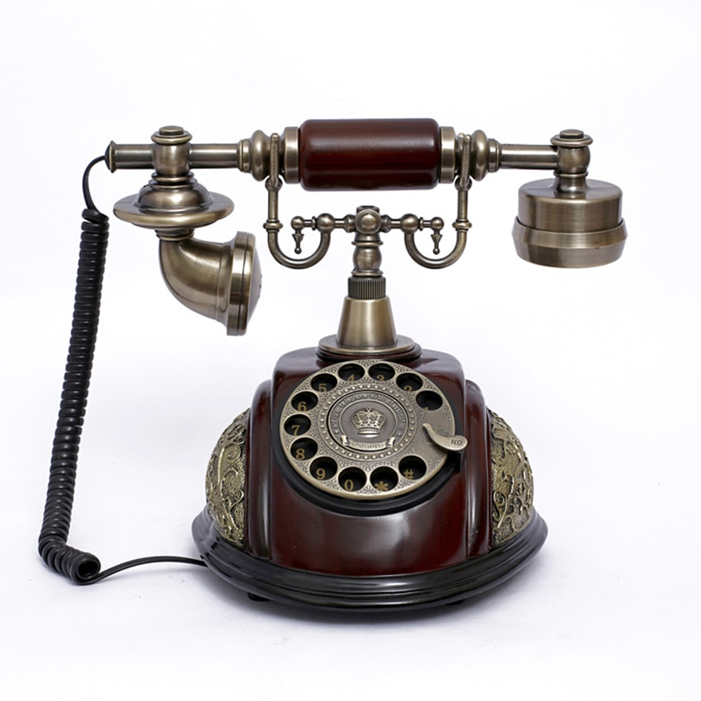
The Practical, Precious Phone
Before you write your advert, click on the links to watch adverts designed to sell historic phones. Although the adverts are not for the first ever phone, they advertise historic phones with very little features.
Old Cell Phone Ad 1980's - YouTube
Old Cell Phone commercial - YouTube
1960 EXTENSION PHONE COMMERCIAL - Bell Telephone - YouTube

Slide 29
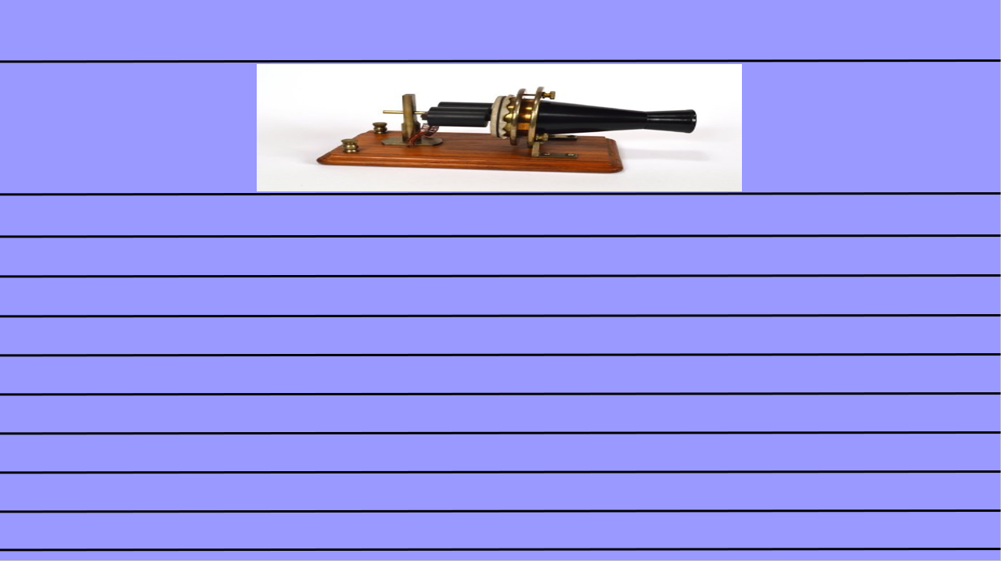
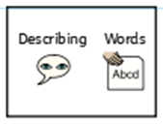
Writing an advert
Today you are going to write an advert for ‘The Practical Precious Phone’.
Your aim is to make people want to buy the phone! Describe the benefits of having the phone and how it will improve peoples lives!
If you are finding this task a bit tricky, you can have a go at the sentence building activity on slides 30 - 36.
Your advert must include:
At least 6 sentences
Present tense language
Exclamations (at least 1)
Questions (at least 1)
Pictures
You can use the blank template on the next slide to type your advert or you can write your advert on paper.
Title
Pictures
This piece of writing should take approximately 45 minutes
Advert - writing

Slide 31
Sentence building
Read and order the cards to build the sentence. Remember the capital letter goes at the start of the sentence and the full stop goes at the end. Use the symbols to help you work out the word if you are finding it tricky to read.
You can cut and stick the pictures in the correct order or drag them into the correct boxes on your computer.

Slide 32
Sentence building
Read and order the cards to build the sentence. Remember the capital letter goes at the start of the sentence and the full stop goes at the end. Use the symbols to help you work out the word if you are finding it tricky to read.
You can cut and stick the pictures in the correct order or drag them into the correct boxes on your computer.
Once you have ordered the sentence cards, copy the words to write your sentence.
For example:
The phone can ring your friends.

Slide 33
Sentence building
Read and order the cards to build the sentence. Remember the capital letter goes at the start of the sentence and the full stop goes at the end. Use the symbols to help you work out the word if you are finding it tricky to read.
You can cut and stick the pictures in the correct order or drag them into the correct boxes on your computer.

Slide 34
Sentence building
Read and order the cards to build the sentence. Remember the capital letter goes at the start of the sentence and the full stop goes at the end. Use the symbols to help you work out the word if you are finding it tricky to read.
You can cut and stick the pictures in the correct order or drag them into the correct boxes on your computer.

Slide 35
Sentence building
Read and order the cards to build the sentence. Remember the capital letter goes at the start of the sentence and the full stop goes at the end. Use the symbols to help you work out the word if you are finding it tricky to read.
You can cut and stick the pictures in the correct order or drag them into the correct boxes on your computer.

Slide 36
Sentence building
Read and order the cards to build the sentence. Remember the capital letter goes at the start of the sentence and the full stop goes at the end. Use the symbols to help you work out the word if you are finding it tricky to read.
You can cut and stick the pictures in the correct order or drag them into the correct boxes on your computer.

Slide 37
Sentence building
You can write your sentences neatly on a piece of paper or type them on the lines below.

Slide 38
Well done for all of your hard work today! We can’t wait to see your completed work.
Could any completed work / photographic evidence of completed work please be sent to pioneerspupils@gmail.com
Thank you!

Slide 39
Date: Thursday 1st July
LO To be able to use adjectives.
Subject: English

Slide 40
Pre-recorded Teaching
Access the online teaching video below that will support you to complete the work in this lesson. This video will act as a support but all of the work can still be successfully understood & completed using paper-based versions of this pack. If you need further support to understand / complete work then please contact school via e-mail or telephone.
Play Video
To use adjectives to describe (thenational.academy)

Slide 41
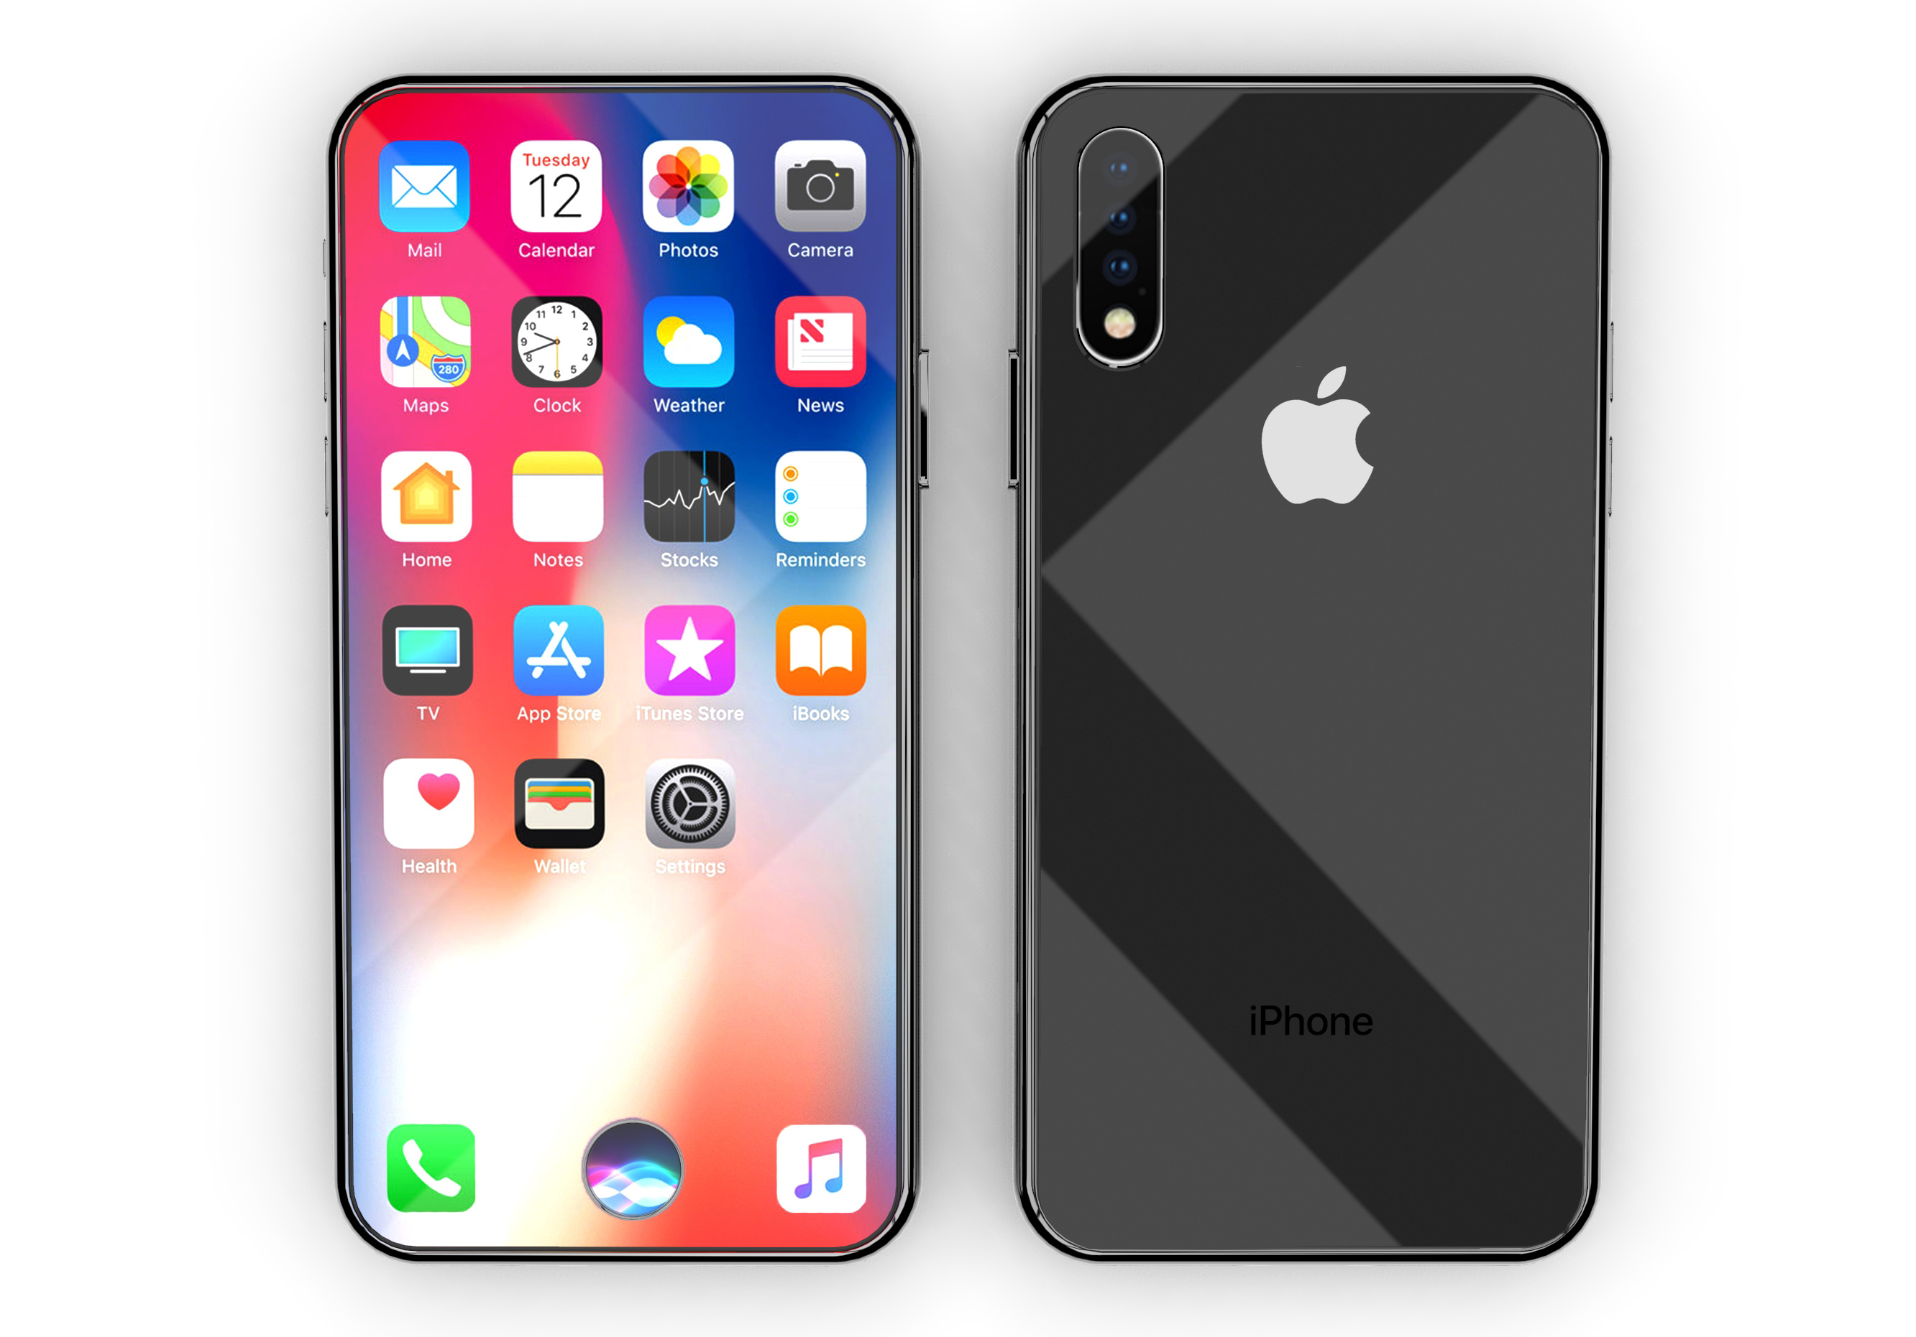
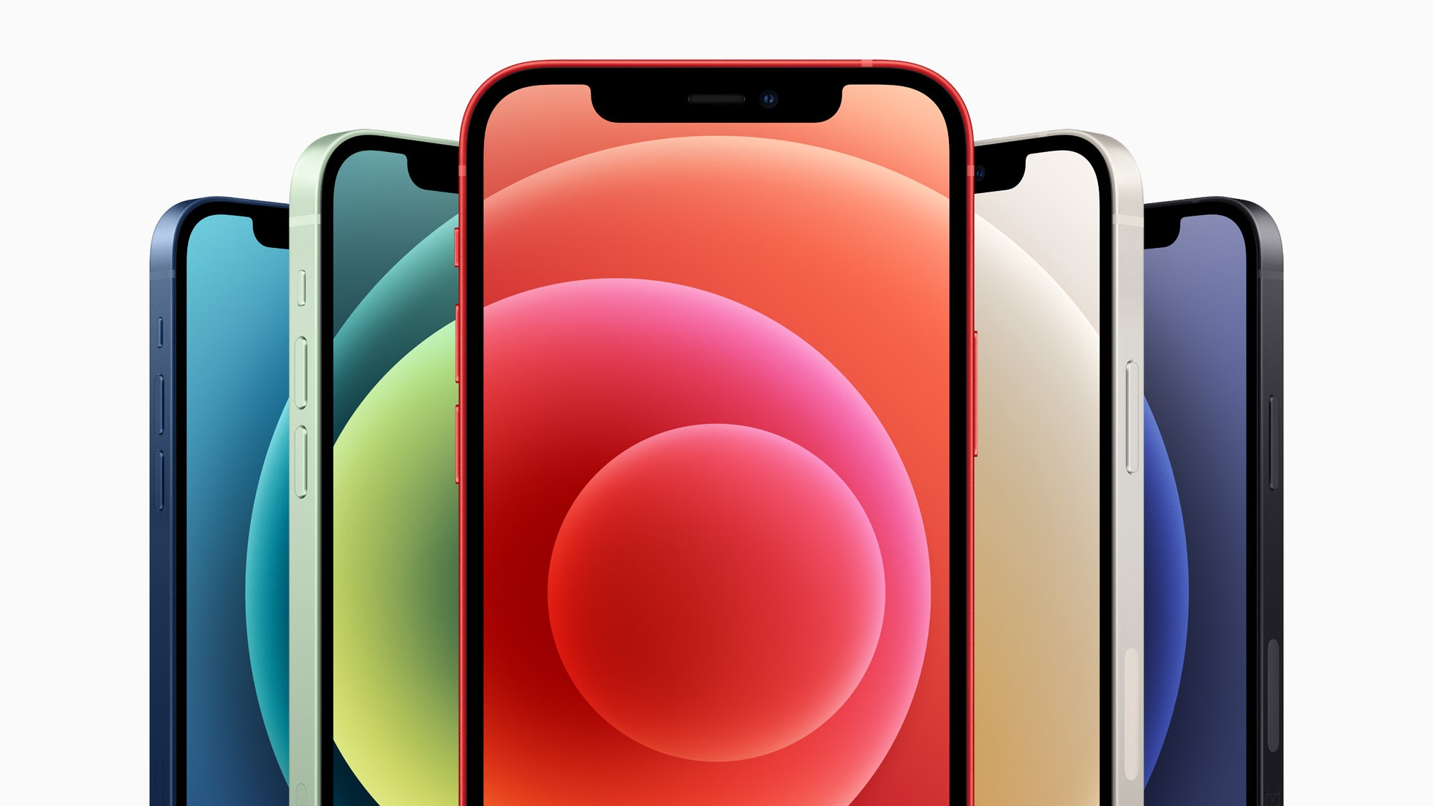
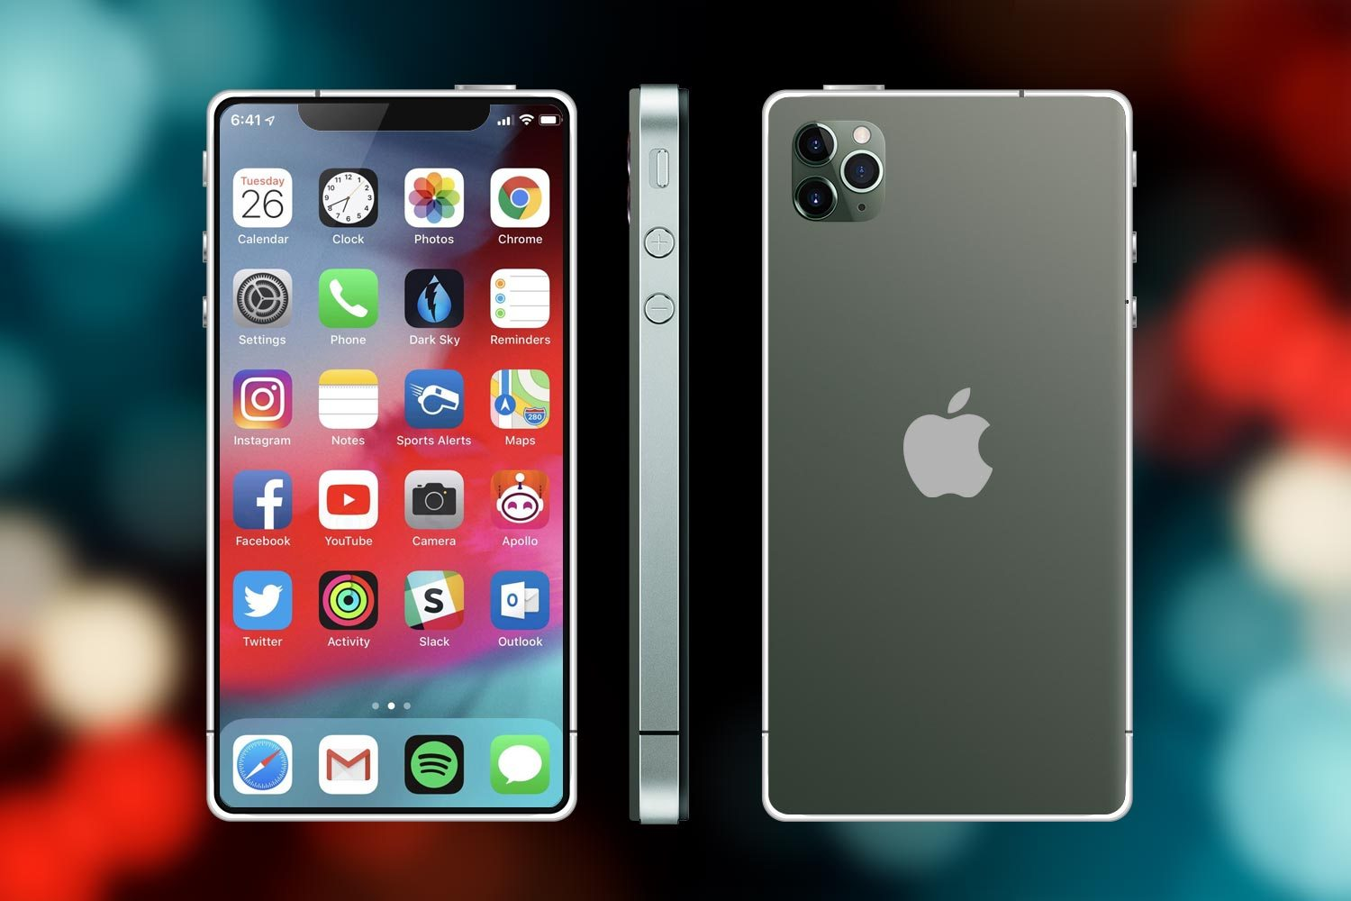
The Immense Iconic Iphone 12
Over the next two days, we are going to be looking at writing an advert for the latest iPhone! Unlike the last phone, this phone has lots of exciting features!
You might be able to borrow an adults phone and look at some of the features to help you with your advert!

Slide 42
Read my advert!
The Immense Iconic Iphone 12
This immense iPhone 12, is the latest piece of ground breaking technology that will enhance your life for the better!
This phone’s technology and software has been upgraded since the last phone was released, meaning the phone will run quicker, has more storage and a better battery life so that you can use your phone for longer! The appearance of the iphone12 has been improved making the phone slimmer and the screen size larger. The iPhone 12 has a fantastic camera. You can record high quality videos and can take live shot photos. This way you can capture all of your favourite memories. You can use your amazing new phone to socialise with friends, for work and to relax listening to your favourite music. You can personalise the phone to ensure it meets all of your needs. You can download fun games. You can listen to relaxing music. You can chat with your friends on social media and you can even use the clever map if you get lost!
What are you waiting for? Buy your iPhone 12 today, you won’t regret it!
Enhance your life, with a device small enough to fit in your pocket!

Slide 43
Recap on adjectives
Here are some examples…
light
colourful
An adjective is a describing word.
amazing
slim
black
small
relaxing
fun
large
ground breaking
silver

Slide 44
Adjectives are describing words…
round camera
colourful back
fun apps
slim device
small buttons
High quality camera
large screen
Can you think of any others to describe the pictures?

Slide 45
Adjectives are describing words…
Complete the noun phrases by
adding an adjective before the noun.
colourful screen
Lightweight device
_____________ apps
_____________ camera
______________ device
_____________ home screen
______________ buttons

Slide 46
Re read my advert and highlight/underline the adjectives
The Immense Iconic Iphone 12
This immense iPhone 12, is the latest piece of ground breaking technology that will enhance your life for the better!
This phone’s technology and software has been upgraded since the last phone was released, meaning the phone will run quicker, has more storage and a better battery life so that you can use your phone for longer! The appearance of the iphone12 has been improved making the phone slimmer and the screen size larger. The iPhone 12 has a fantastic camera. You can record high quality videos and can take live shot photos. This way you can capture all of your favourite memories. You can use your amazing new phone to socialise with friends, for work and to relax listening to your favourite music. You can personalise the phone to ensure it meets all of your needs. You can download fun games. You can listen to relaxing music. You can chat with your friends on social media and you can even use the clever map if you get lost!
What are you waiting for? Buy your iPhone 12 today, you won’t regret it!
Enhance your life, with a device small enough to fit in your pocket!

Slide 47
Using adjectives…
Using the pictures to help you, write 6 sentences about the latest Iphone including adjectives.
Don’t forget:
Challenge include an exclamation mark.
If you are finding this task a bit tricky, you can have a go at the sentence building activity on slides 46 - 51.
You can use this slim device to take fantastic photos!
Keep your sentences safe, you will be able to use them in your advert tomorrow!

Slide 48
Sentence building
Read and order the cards to build the sentence. Remember the capital letter goes at the start of the sentence and the full stop goes at the end. Use the symbols to help you work out the word if you are finding it tricky to read.
You can cut and stick the pictures in the correct order or drag them into the correct boxes on your computer.

Slide 49
Sentence building
Read and order the cards to build the sentence. Remember the capital letter goes at the start of the sentence and the full stop goes at the end. Use the symbols to help you work out the word if you are finding it tricky to read.
You can cut and stick the pictures in the correct order or drag them into the correct boxes on your computer.
Once you have ordered the sentence cards, copy the words to write your sentence.
For example:
The phone can ring your friends.

Slide 50
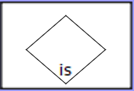
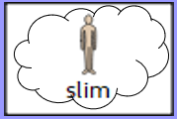
Sentence building
Read and order the cards to build the sentence. Remember the capital letter goes at the start of the sentence and the full stop goes at the end. Use the symbols to help you work out the word if you are finding it tricky to read.
You can cut and stick the pictures in the correct order or drag them into the correct boxes on your computer.

Slide 51
Sentence building
Read and order the cards to build the sentence. Remember the capital letter goes at the start of the sentence and the full stop goes at the end. Use the symbols to help you work out the word if you are finding it tricky to read.
You can cut and stick the pictures in the correct order or drag them into the correct boxes on your computer.

Slide 52
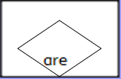
Sentence building
Read and order the cards to build the sentence. Remember the capital letter goes at the start of the sentence and the full stop goes at the end. Use the symbols to help you work out the word if you are finding it tricky to read.
You can cut and stick the pictures in the correct order or drag them into the correct boxes on your computer.

Slide 53
Sentence building
You can write your sentences neatly on a piece of paper or type them on the lines below.

Slide 54
Well done for all of your hard work today! We can’t wait to see your completed work.
Could any completed work / photographic evidence of completed work please be sent to pioneerspupils@gmail.com
Thank you!

Slide 55
Date: Friday 2nd July
LO To be able to write an advert for the latest Iphone.
Subject: English

Slide 56
Re read my advert to get it back in your head!
The Immense Iconic Iphone 12
This immense iPhone 12, is the latest piece of ground breaking technology that will enhance your life for the better!
This phone’s technology and software has been upgraded since the last phone was released, meaning the phone will run quicker, has more storage and a better battery life so that you can use your phone for longer! The appearance of the iphone12 has been improved making the phone slimmer and the screen size larger. The iPhone 12 has a fantastic camera. You can record high quality videos and can take live shot photos. This way you can capture all of your favourite memories. You can use your amazing new phone to socialise with friends, for work and to relax listening to your favourite music. You can personalise the phone to ensure it meets all of your needs. You can download fun games. You can listen to relaxing music. You can chat with your friends on social media and you can even use the clever map if you get lost!
What are you waiting for? Buy your iPhone 12 today, you won’t regret it!
Enhance your life, with a device small enough to fit in your pocket!

Slide 57
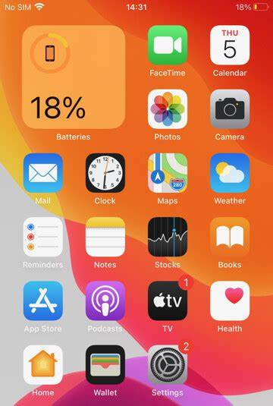
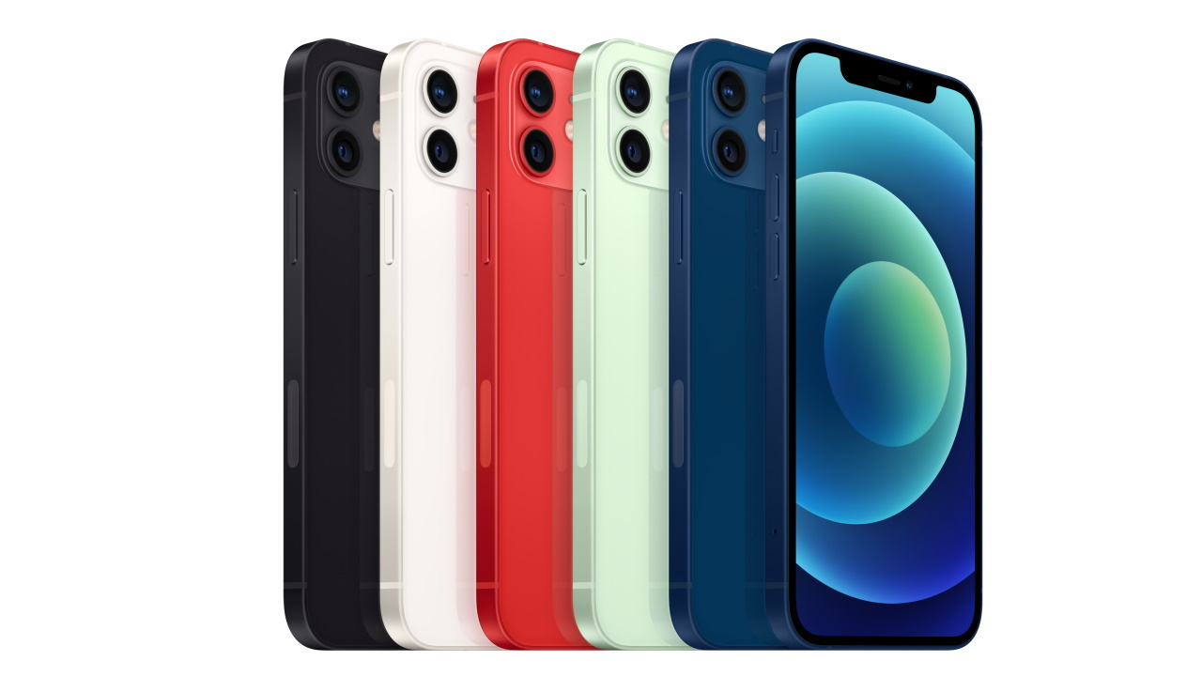
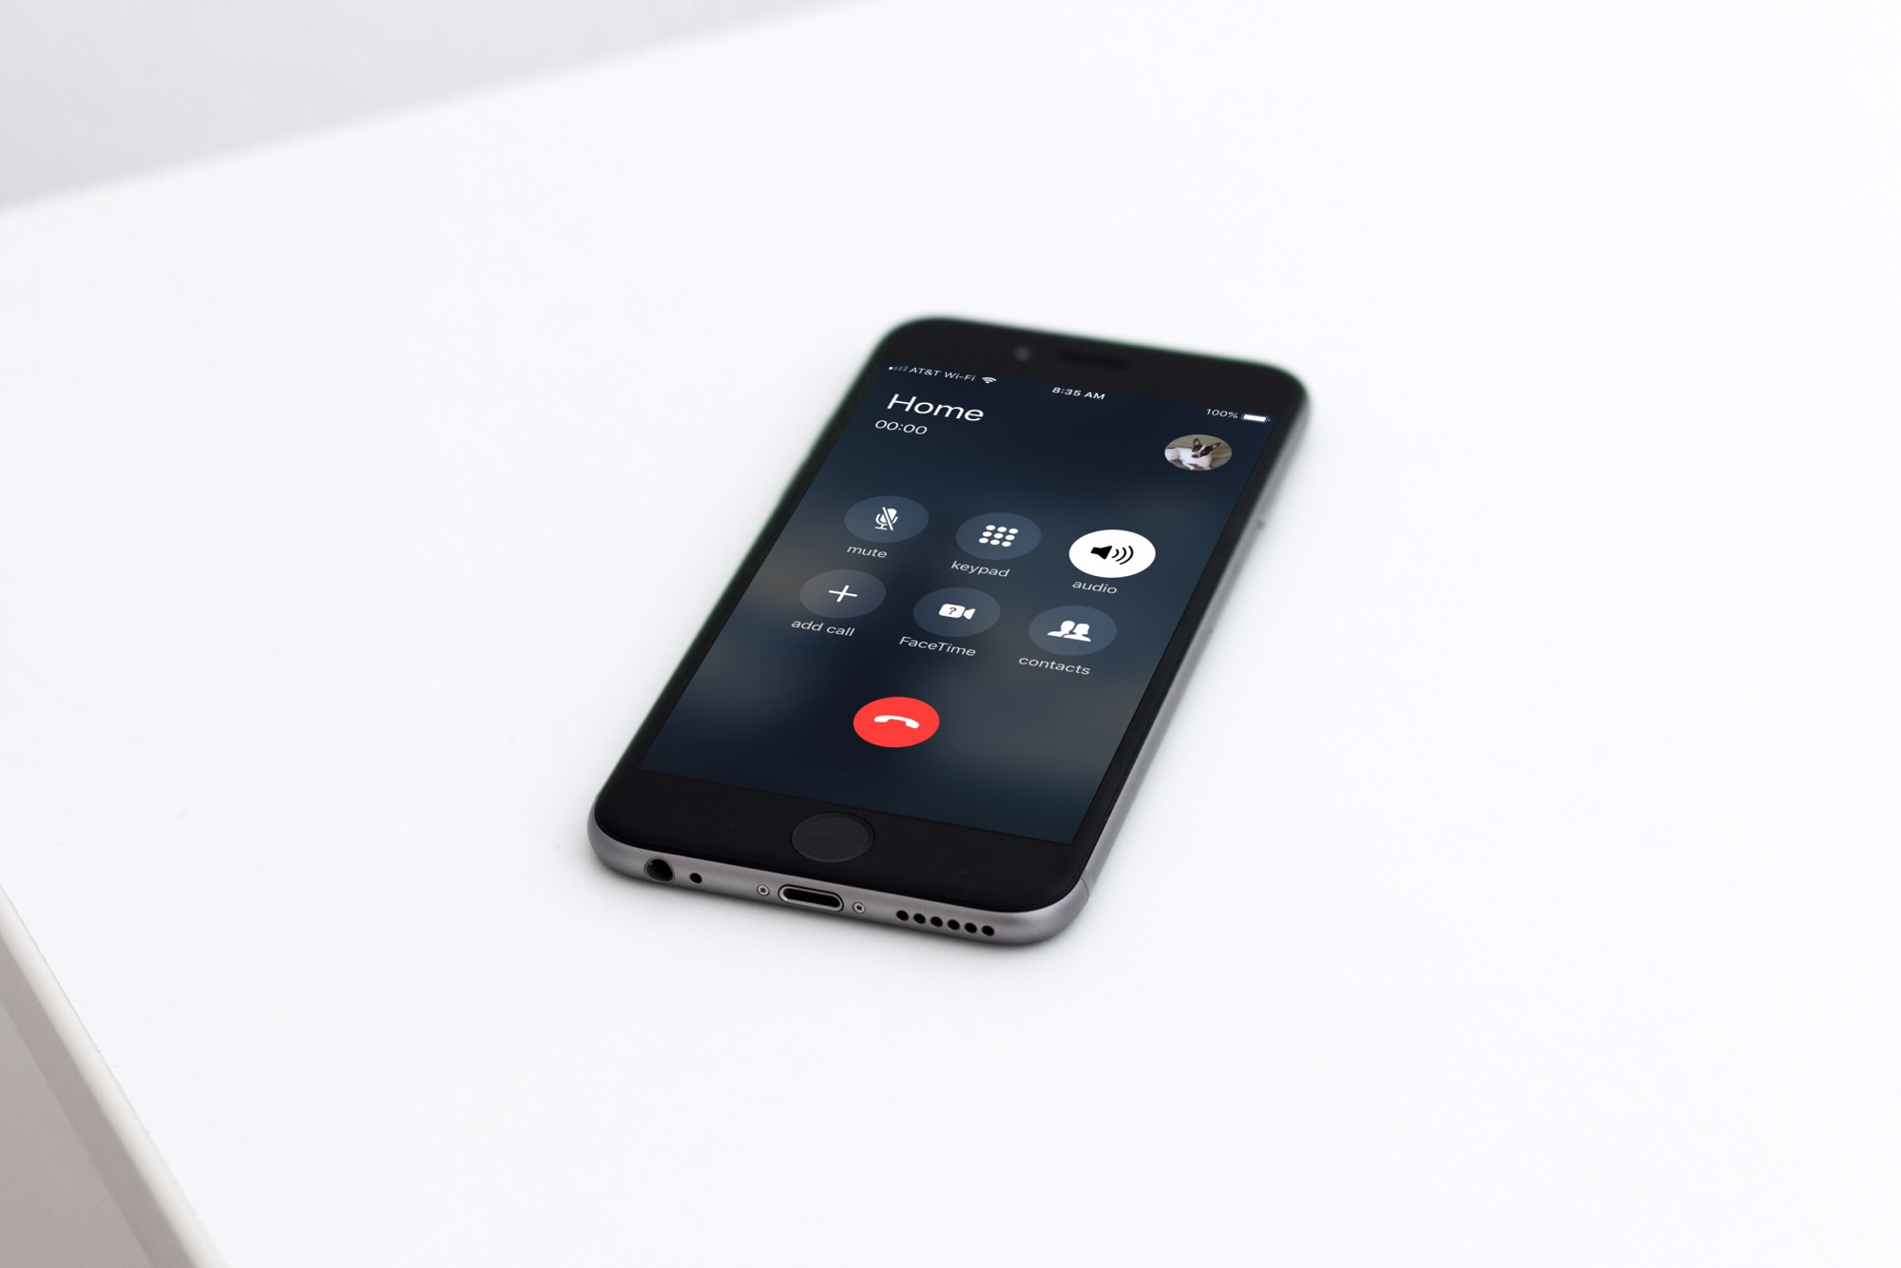
Immense Iconic Iphone 12
Before you write your advert, click on the links to watch the adverts created by Apple to try and sell their latest phone. This will help you get some ideas of what to include in your advert!
Meet iPhone 12 — Apple - YouTube
This is iPhone 12 Pro — Apple - YouTube

Slide 58
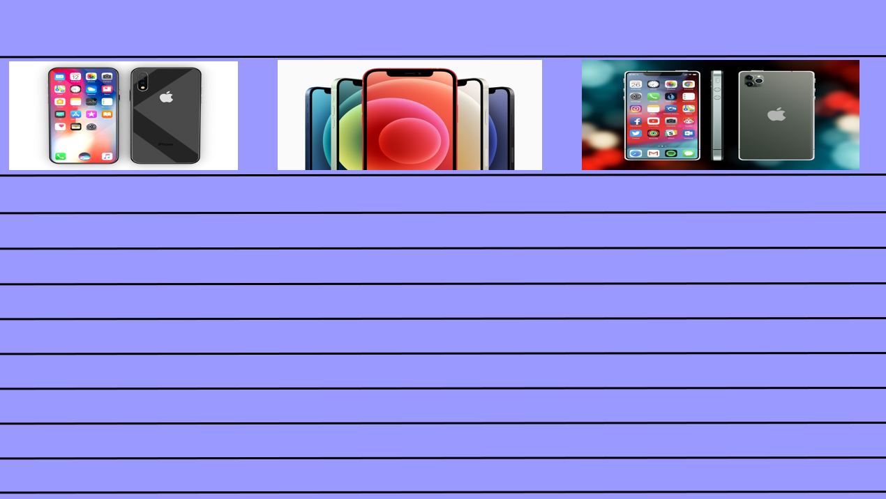
Writing an advert
Today you are going to write an advert for the latest Iphone.
Your aim is to make people want to buy the phone! Describe all of the benefits, the different apps and what you can use the phone for.
Your advert must include:
At least 6 sentences
Present tense language
Adjectives (at least 5)
Exclamations (at least 2)
Questions (at least 1)
Pictures
A title
You can use the blank template on the next slide to type your advert or you can write your advert on paper.
Title
If you are finding this task a bit tricky, you can have a go at the sentence building activity on slides 58 - 63.
Pictures
This piece of writing should take approximately 45 minutes
Advert - writing

Slide 60
Sentence building
Read and order the cards to build the sentence. Remember the capital letter goes at the start of the sentence and the full stop goes at the end. Use the symbols to help you work out the word if you are finding it tricky to read.
You can cut and stick the pictures in the correct order or drag them into the correct boxes on your computer.

Slide 61
Sentence building
Read and order the cards to build the sentence. Remember the capital letter goes at the start of the sentence and the full stop goes at the end. Use the symbols to help you work out the word if you are finding it tricky to read.
You can cut and stick the pictures in the correct order or drag them into the correct boxes on your computer.
Once you have ordered the sentence cards, copy the words to write your sentence.
For example:
The phone can ring your friends.

Slide 62
Sentence building
Read and order the cards to build the sentence. Remember the capital letter goes at the start of the sentence and the full stop goes at the end. Use the symbols to help you work out the word if you are finding it tricky to read.
You can cut and stick the pictures in the correct order or drag them into the correct boxes on your computer.

Slide 63
Sentence building
Read and order the cards to build the sentence. Remember the capital letter goes at the start of the sentence and the full stop goes at the end. Use the symbols to help you work out the word if you are finding it tricky to read.
You can cut and stick the pictures in the correct order or drag them into the correct boxes on your computer.

Slide 64
Sentence building
Read and order the cards to build the sentence. Remember the capital letter goes at the start of the sentence and the full stop goes at the end. Use the symbols to help you work out the word if you are finding it tricky to read.
You can cut and stick the pictures in the correct order or drag them into the correct boxes on your computer.

Slide 65
Sentence building
You can write your sentences neatly on a piece of paper or type them on the lines below.

Slide 66
Well done for all of your hard work today! We can’t wait to see your completed work.
Could any completed work / photographic evidence of completed work please be sent to pioneerspupils@gmail.com
Thank you!

