Slide 1



Date: Monday 11th January – Friday 15th January
LO To be able to practise phonics sounds and tricky words.
Please practise phonics every day for 20 minutes.
Subject: Phonics

Slide 2
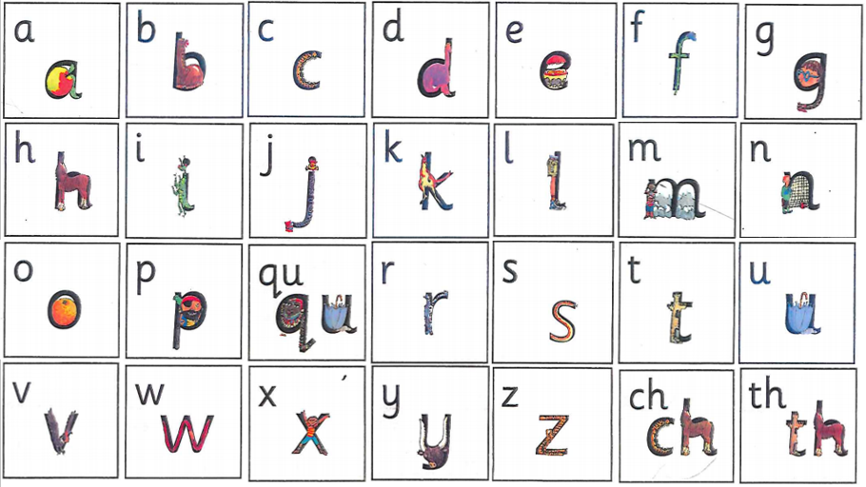

Slide 3
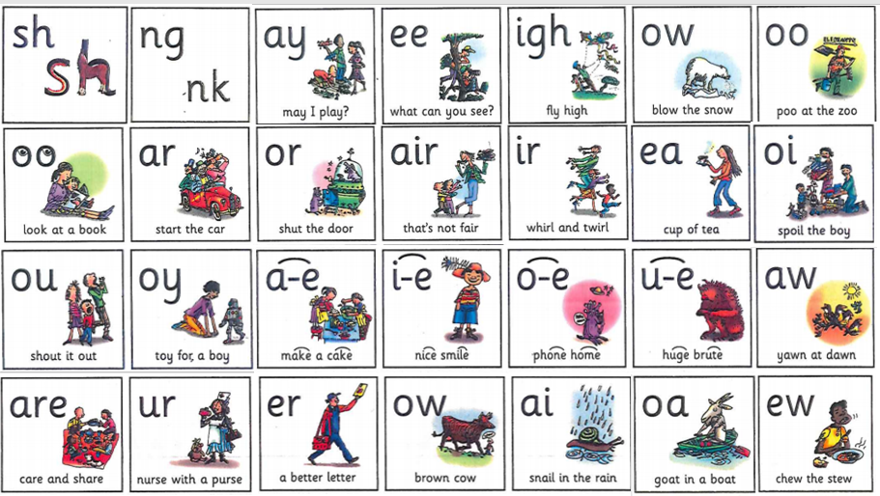

Slide 4

Your child may not know all of these sounds, but please practise the ones that they do know.

Slide 5

Daily Phonics Videos
Click the below link, copy and paste into the internet or search ‘Ruth Miskin Training’ in YouTube to see daily phonics videos.
Read Write Inc are offering free phonics lessons on YouTube. Videos for all abilities are available.
They are posted at 9.30am and are available for 24 hours.
https://www.youtube.com/channel/UCo7fbLgY2oA_cFCIg9GdxtQ

Slide 6

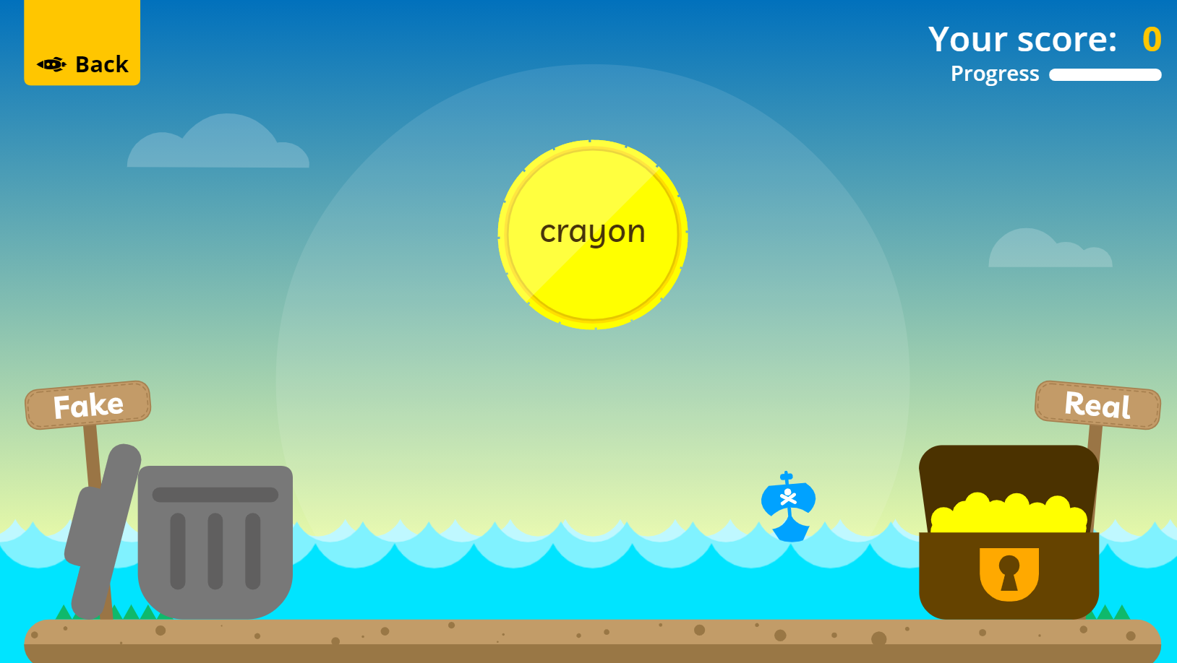
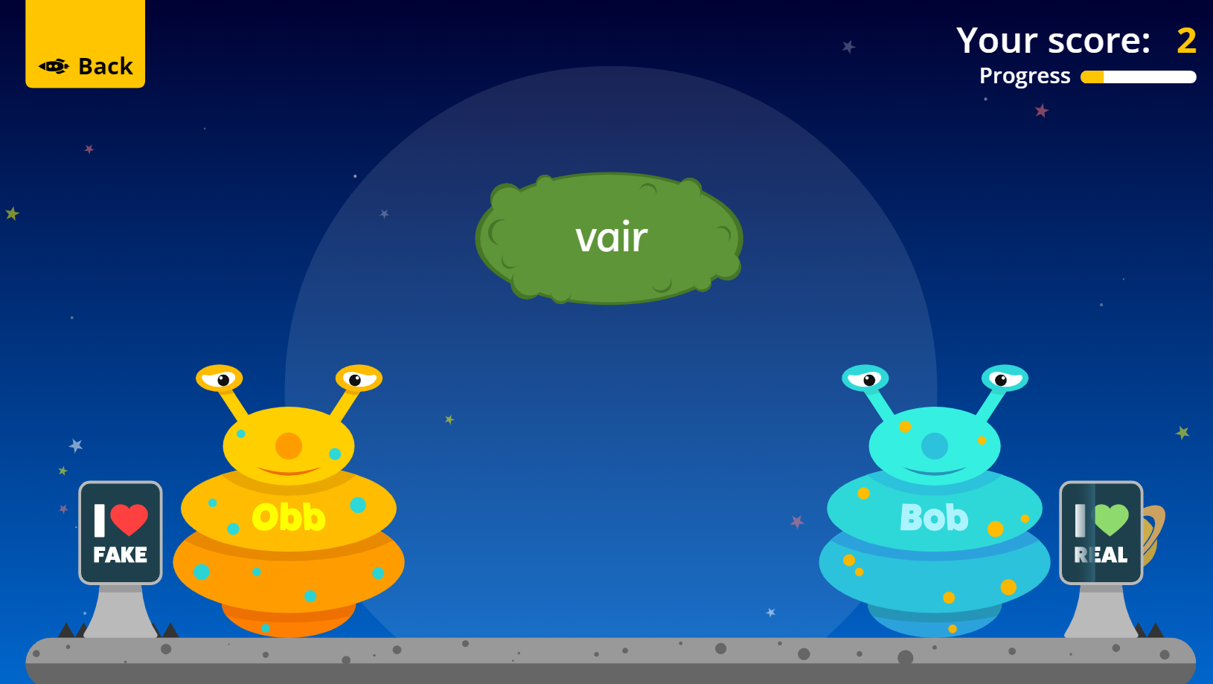
PhonicsPlay are now offering a free log in whilst children are learning from home.
Please search for the website or copy and paste the link into the internet. There are lots of fun games children can play to practise their phonics.
https://www.phonicsplay.co.uk/resources
Username: jan21
Password: home

Slide 7


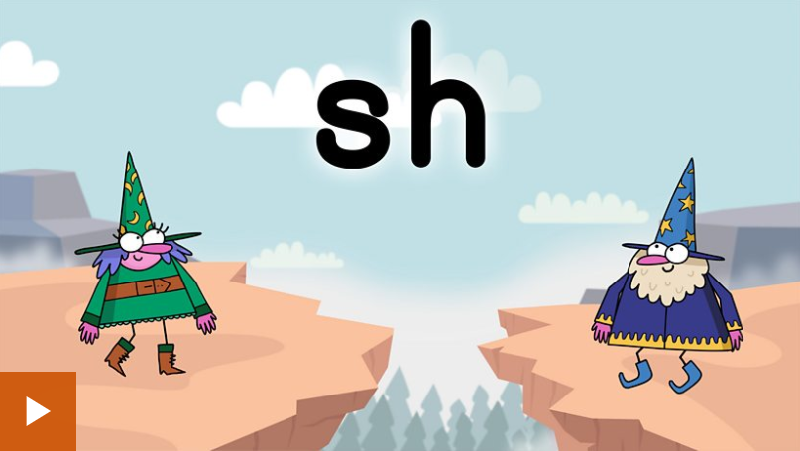

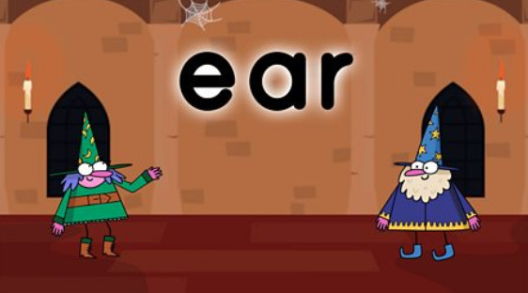
BBC Bitesize has lots of 30 second videos focusing on each of the phonics sounds.
https://www.bbc.co.uk/bitesize/topics/zcqqtfr
Or search ‘BBC bitesize phonics’ on the internet.

Slide 8


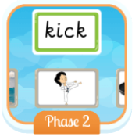
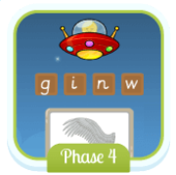
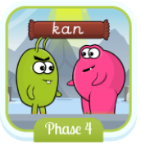


Phonics Bloom have some free phonics games for all phases.
https://www.phonicsbloom.com/

Slide 9

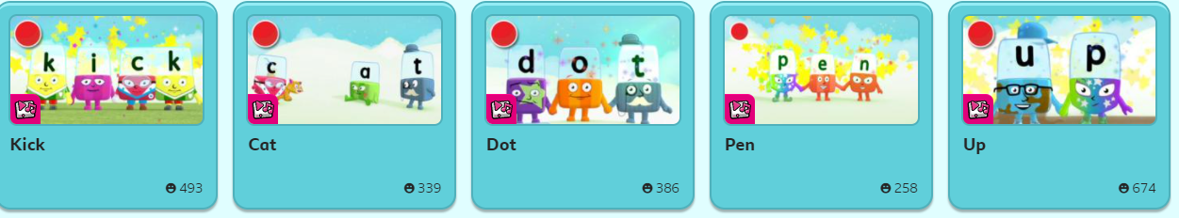
Alphablocks have games and videos to watch to practise phonics.
https://www.bbc.co.uk/cbeebies/shows/alphablocks
https://www.youtube.com/channel/UC_qs3c0ehDvZkbiEbOj6Drg

Slide 10

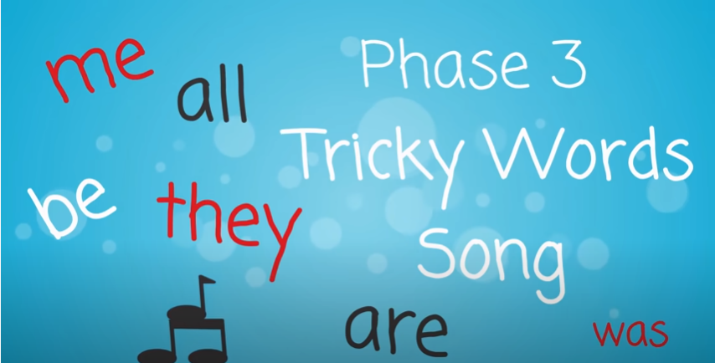
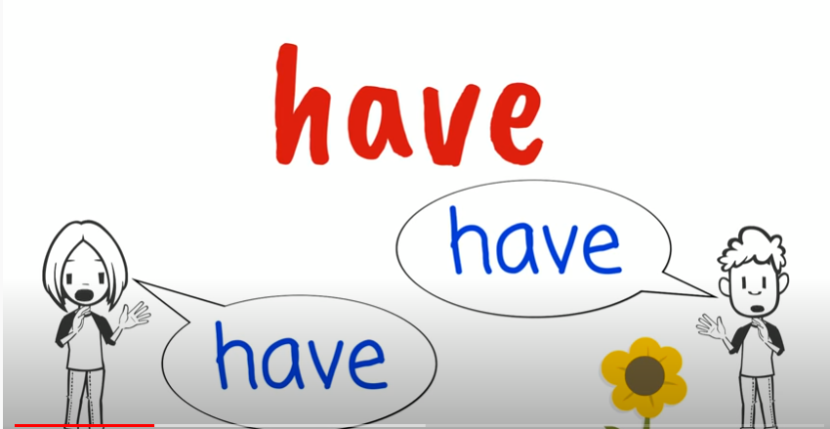
Tricky Words!
Pause the video on each word. How many times can you write that word in 1 minute?
Go!
https://www.youtube.com/watch?v=TvMyssfAUx0
‘Tricky Words and Sight Words Song’ - YouTube
https://www.youtube.com/watch?v=R087lYrRpgY&t=2s
‘Phase 3 Say Hello To’ - YouTube
https://www.youtube.com/watch?v=3NOzgR1ANc4
‘Phase 4 Tricky Words Song’ - YouTube

