Slide 1



Date: Monday 11th January
LO To be able to identify features of a story.
Subject: English

Slide 2

We are going to continue looking at Winnie and Wilbur under the sea.
https://www.youtube.com/watch?v=D5YE4rxQJhg
You can re watch the video to remind you of the story.

Slide 3
Retell of the story …
One summers day, Winnie and Wilbur packed their suitcase ready for a holiday on a remote desert island surrounded by shark infested waters. Winnie packed her colourful swimsuit, blue flippers and her snorkel so that she could practice her swimming in the deep, cold sea.
Wilbur was terrified of the water and sat on the broken, wooden jetty watching Winnie as she swam. He could see all of the delicious, colourful fish as they swam by and wished he could catch one for his lunch. He slowly reached out his paw to test the water but he thought it was nasty and wet! Suddenly, Winnie had an idea. She waved her magic wand in a gigantic circle, shouted abracadabra and WHOOSH Wilbur turned into a cat-fish!
Wilbur loved being a cat-fish! He spent the day chasing little fish, hiding behind sea weed and swimming through secret tunnels under the water. Winnie watched Wilbur having so much fun and wished she could become a fish too! Winnie thought long and hard about the spell she would need. Then with a wave of her magic wand she turned into a huge, yellow octopus with pink, slimy tentacles!
All of a sudden, a giant, black sea lion with long, grey whiskers swam past knocking Winnie’s want out of her hand! She tried to catch it but she missed. The wand tumbled quickly down to the bottom of the ocean and landed in the wreck of an old sailing ship. They searched under the ropes, under the anchor and behind the crab but it was nowhere to be seen! Eventually, they found the want inside an old, rusty treasure chest and cast a spell to turn back to normal.

Slide 4
Retell of the story …
Now find the features!
One summers day, Winnie and Wilbur packed their suitcase ready for a holiday on a remote desert island surrounded by shark infested waters. Winnie packed her colourful swimsuit, blue flippers and her snorkel so that she could practice her swimming in the deep, cold sea.
Wilbur was terrified of the water and sat on the broken, wooden jetty watching Winnie as she swam. He could see all of the delicious, colourful fish as they swam by and wished he could catch one for his lunch. He slowly reached out his paw to test the water but he thought it was nasty and wet! Suddenly, Winnie had an idea. She waved her magic wand in a gigantic circle, shouted abracadabra and WHOOSH Wilbur turned into a cat-fish!
Wilbur loved being a cat-fish! He spent the day chasing little fish, hiding behind sea weed and swimming through secret tunnels under the water. Winnie watched Wilbur having so much fun and wished she could become a fish too! Winnie thought long and hard about the spell she would need. Then with a wave of her magic wand she turned into a huge, yellow octopus with pink, slimy tentacles!
All of a sudden, a giant, black sea lion with long, grey whiskers swam past knocking Winnie’s want out of her hand! She tried to catch it but she missed. The wand tumbled quickly down to the bottom of the ocean and landed in the wreck of an old sailing ship. They searched under the ropes, under the anchor and behind the crab but it was nowhere to be seen! Eventually, they found the want inside an old, rusty treasure chest and cast a spell to turn back to normal.
Use the key to highlight/ underline the key features in the correct colour
Remember an expanded noun phrase is: adjective , adjective noun
Capital letters
Commas
Expanded noun phrases
Full stops
Exclamation marks

Slide 5
Date: Tuesday 12th January
LO To be able to use commas in a list.
Subject: English

Slide 6
Commas in a list
What is a comma?
A comma is a piece of punctuation and it looks like this ,
What are commas in a list?
Commas are used to separate things in a list. For example this could include: colours, objects, names and places.

Slide 7
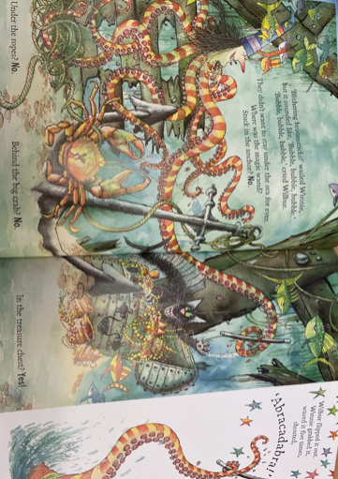
Commas in a list
Example
Use of commas in a list
Winnie’s octopus tentacles are yellow, orange and pink.
Key:
Colour
Comma
Commas are used to separate things in a list.
The last two things in the list are separated by the word ‘and’
and

Slide 8
Commas in a list
Punctuate the sentences correctly
First add the ,
1. Winnie’s octopus tentacles are orange ___ yellow ________ pink.
2. Winnie is surrounded by crabs ___ fish ________ seaweed.
3. Under the water Winnie found pots ___ an anchor ________ and a treasure chest.
4. Winnie had two eyes ___ a nose ________ a purple hat.
Then add the word and

Slide 9





Using commas in a list
Use the picture to help you write your own sentences using commas in a list.
Don’t forget:
Winnie is surrounded by fish, a crab and slimy seaweed.

Slide 10
Re read my story and highlight/underline the commas in a list.
Identify commas in a list
One summers day, Winnie and Wilbur packed their suitcase ready for a holiday on a remote desert island surrounded by shark infested waters. Winnie packed her colourful swimsuit, blue flippers and her snorkel so that she could practice her swimming in the deep, cold sea.
Wilbur was terrified of the water and sat on the broken, wooden jetty watching Winnie as she swam. He could see all of the delicious, colourful fish as they swam by and wished he could catch one for his lunch. He slowly reached out his paw to test the water but he thought it was nasty and wet! Suddenly, Winnie had an idea. She waved her magic wand in a gigantic circle, shouted abracadabra and WHOOSH Wilbur turned into a cat-fish!
Wilbur loved being a cat-fish! He spent the day chasing little fish, hiding behind sea weed and swimming through secret tunnels under the water. Winnie watched Wilbur having so much fun and wished she could become a fish too! Winnie thought long and hard about the spell she would need. Then with a wave of her magic wand she turned into a huge, yellow octopus with pink, slimy tentacles!
All of a sudden, a giant, black sea lion with long, grey whiskers swam past knocking Winnie’s want out of her hand! She tried to catch it but she missed. The wand tumbled quickly down to the bottom of the ocean and landed in the wreck of an old sailing ship. They searched under the ropes, under the anchor and behind the crab but it was nowhere to be seen! Eventually, they found the want inside an old, rusty treasure chest and cast a spell to turn back to normal.

Slide 11
Date: Wednesday 13th January
LO To be able to retell the beginning of ‘Winnie and Wilbur under the sea’.
Subject: English

Slide 12
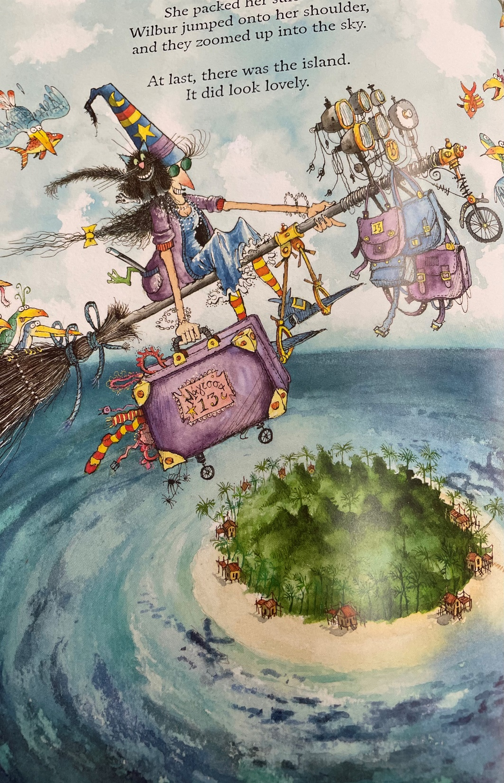
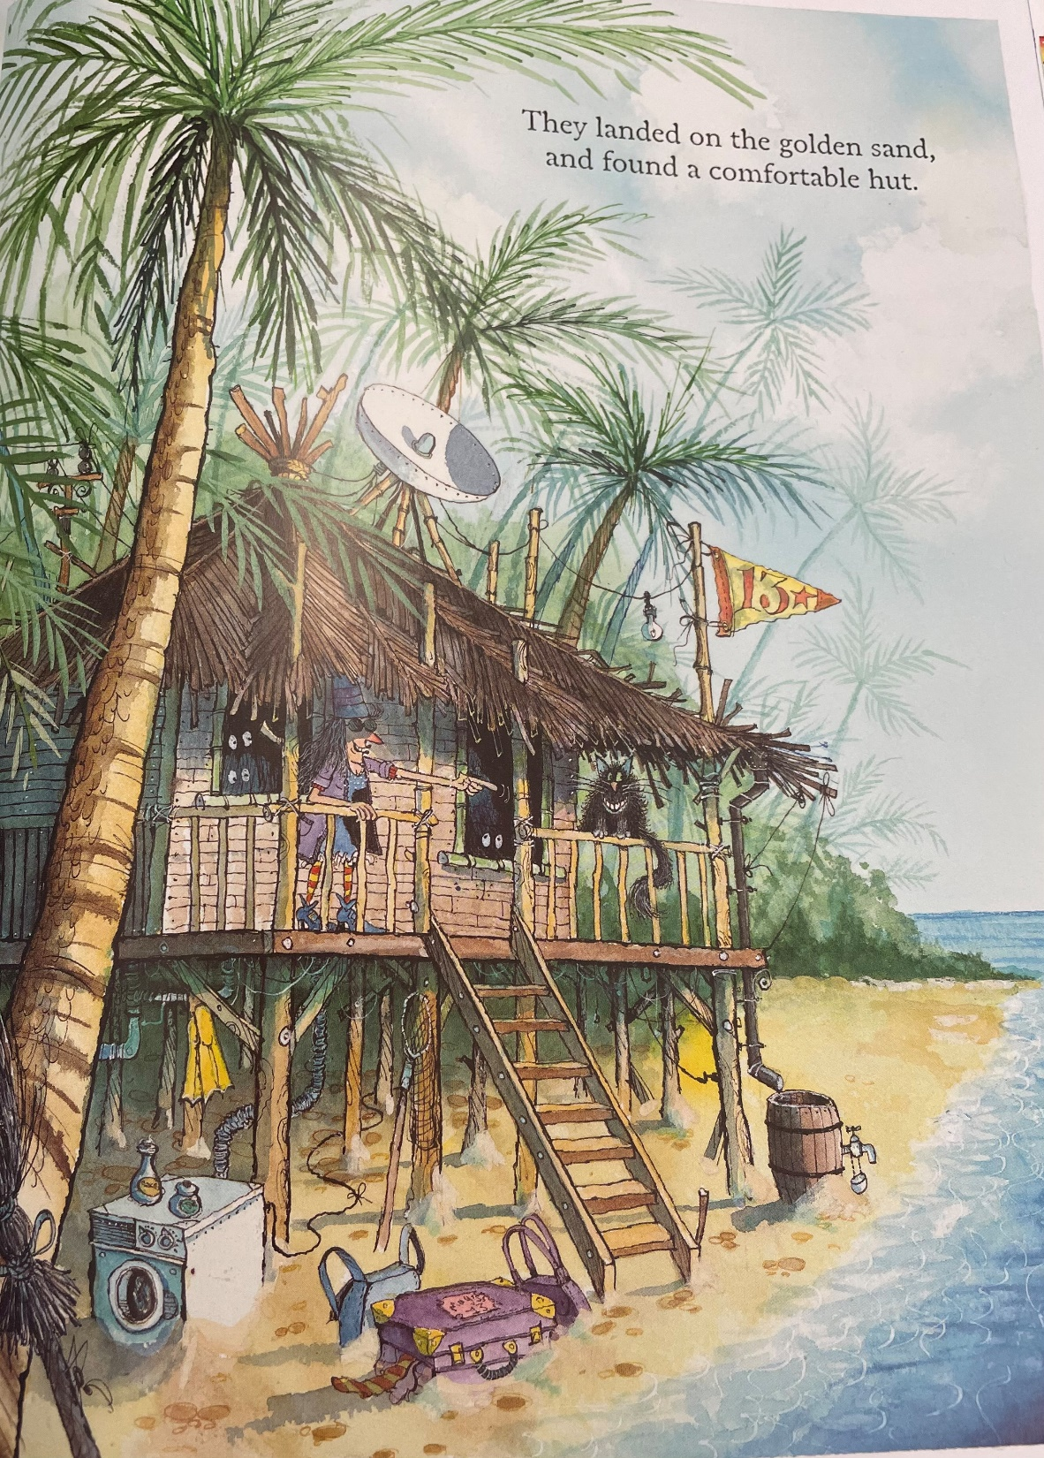
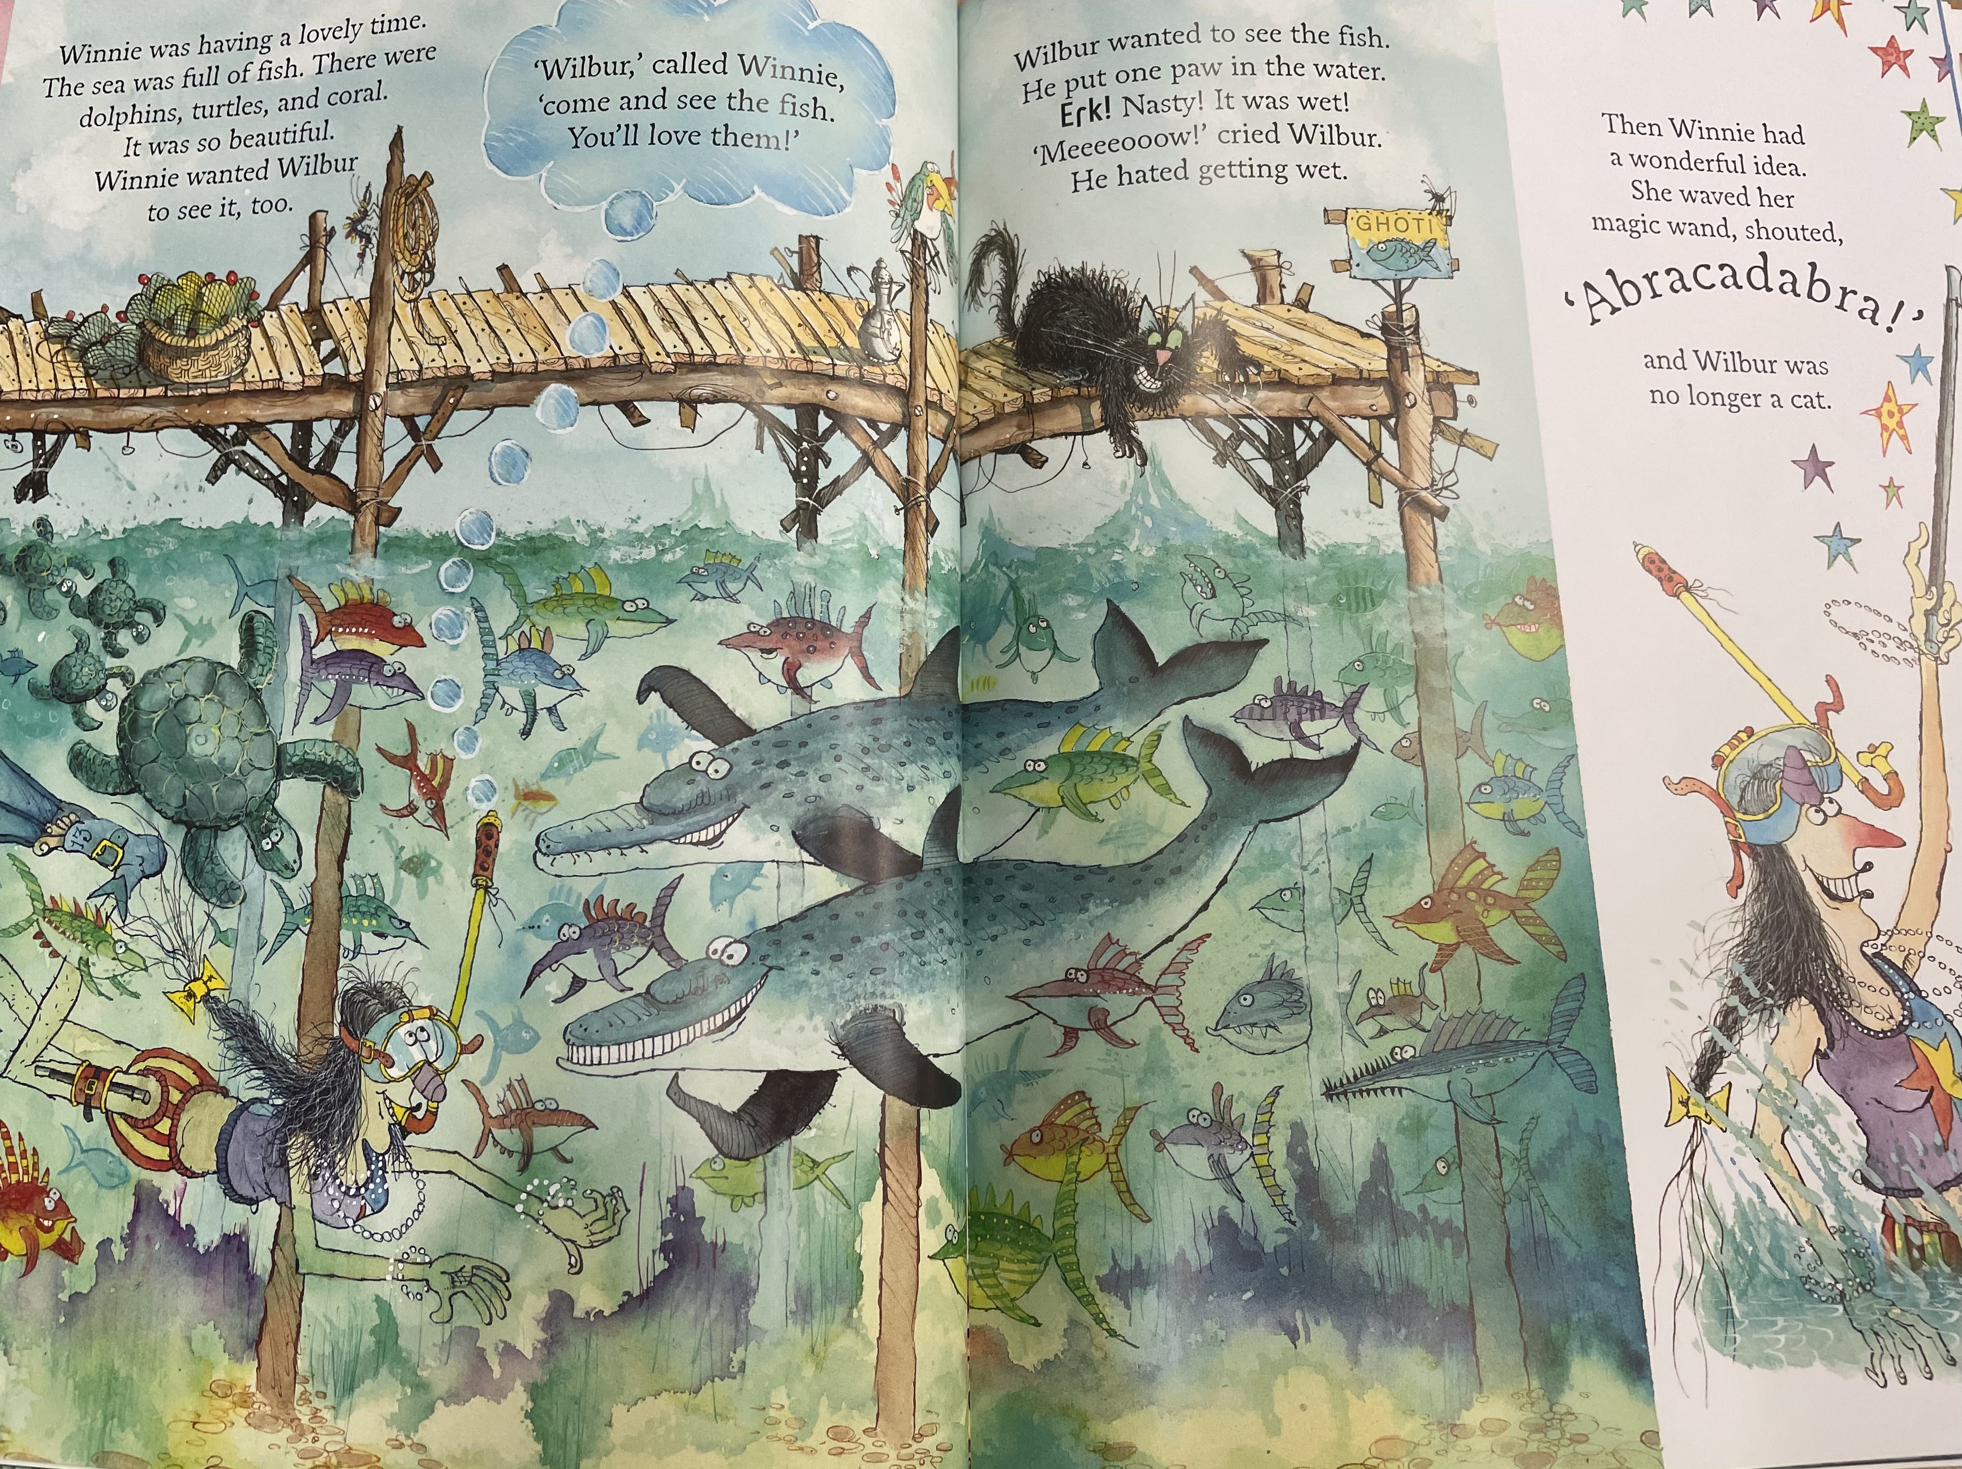
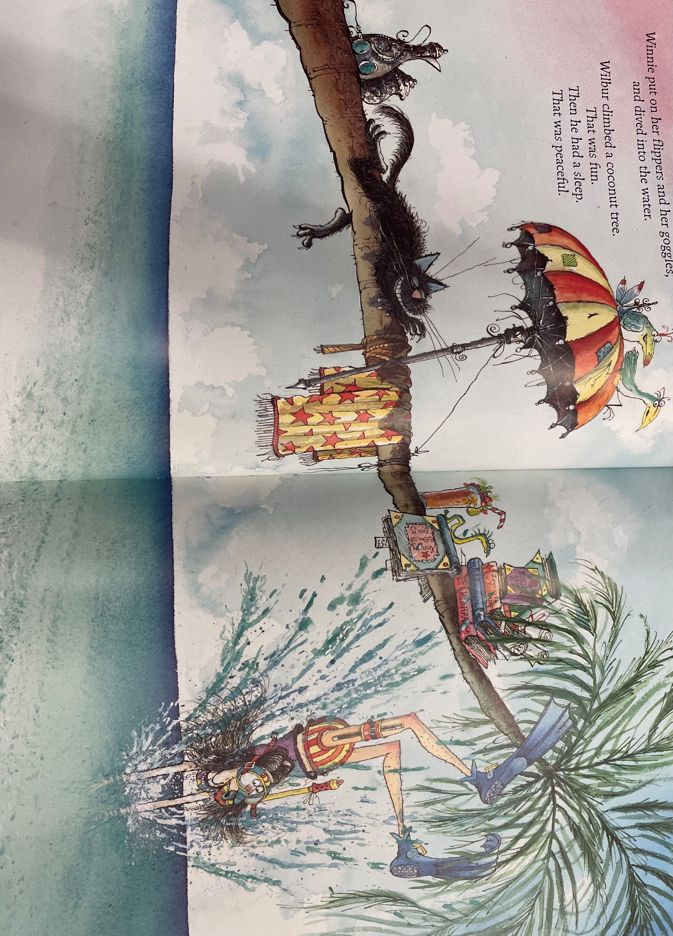
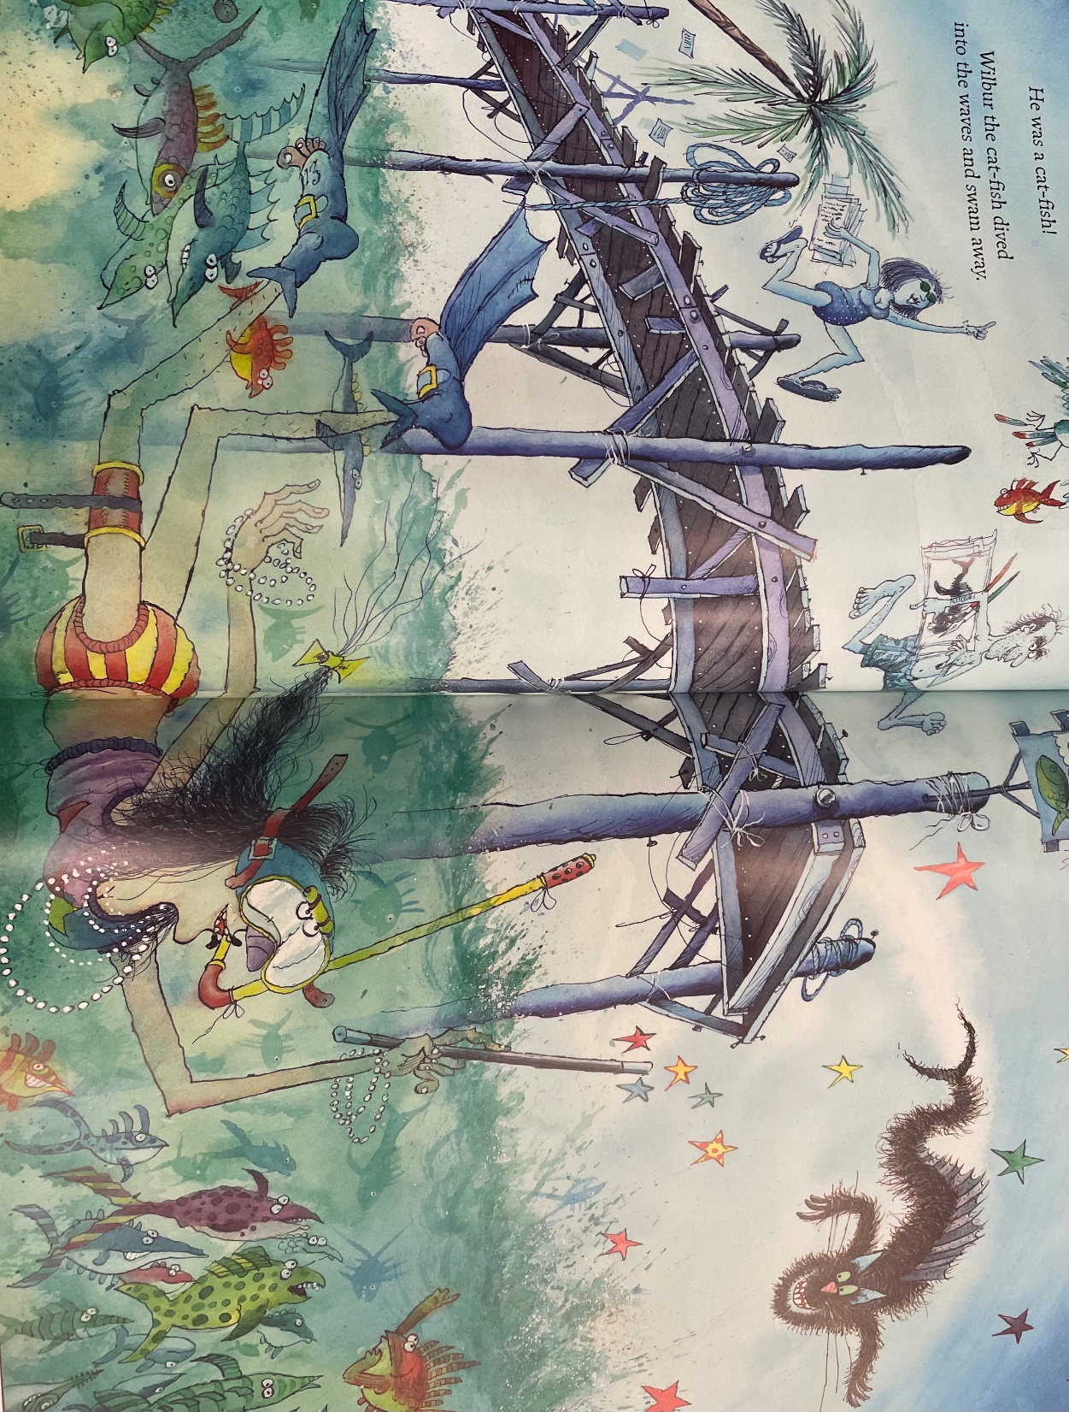
Beginning of the story …
Read my beginning of the story.
One summers day, Winnie and Wilbur packed their suitcase ready for a holiday on a remote desert island surrounded by shark infested waters. Winnie packed her colourful swimsuit, blue flippers and her snorkel so that she could practice her swimming in the deep, cold sea.
Wilbur was terrified of the water and sat on the broken, wooden jetty watching Winnie as she swam. He could see all of the delicious, colourful fish as they swam by and wished he could catch one for his lunch. He slowly reached out his paw to test the water but he thought it was nasty and wet! Suddenly, Winnie had an idea. She waved her magic wand in a gigantic circle, shouted abracadabra and WHOOSH Wilbur turned into a cat-fish!

Slide 13
Commas in a list
Remember commas are used to separate things in a list. For example this could include: colours, objects, names and places.
Example
Winnie packed her swimsuit, snorkel and flippers in her huge suitcase.
Now it is your turn…
Remember
First add the , then add ‘and’
1. Wilbur has black fur ___ sharp claws ________ a long tail.
2. The island has trees ___ sand ________ a wooden hut.

Slide 14
Examples of commas in a list
Winnie’s suitcase is purple, pink and yellow.
The hut is surrounded by trees, sand and water.
A washing machine, old barrel and brown rocks are on the sand.
The hut is surrounded by trees, sand and water.
Winnie is wearing a purple coat, stripy tights and a pointy hat.

Slide 15
Write your own beginning of the story
Make sure you include 3 examples of commas in a list
Don’t forget:
Use these pictures to help you write your story
One summers day, Winne packed her swimsuit, snorkel and sunglasses ready for her holiday on a remote desert island.

Slide 16
Date: Thursday 14th January
LO To be able to retell the ending of ‘Winnie and Wilbur under the sea’.
Subject: English

Slide 17
Nouns are things…
Recap on expanded noun phrases
An expanded noun phrase is adjective , adjective noun
Adjectives are describing words…

Slide 18
Nouns are things…
clouds
sky
Winnie
Wilbur
trees
hut
sand
suitcase
barrel
sea
Washing machine
Can you think of any others?

Slide 19
Adjectives are describing words…
Complete the expanded noun phrases by
adding 2 adjectives before the noun.
deep , clear water
old , wooden barrel
_____________ _____________ hut
_____________ _____________ sand
______________ _____________ trees
_____________ _______________ clouds
______________ _____________ sky
______________ _____________ Wilbur
Don’t forget!! Have you put a comma between your two describing words?

Slide 20
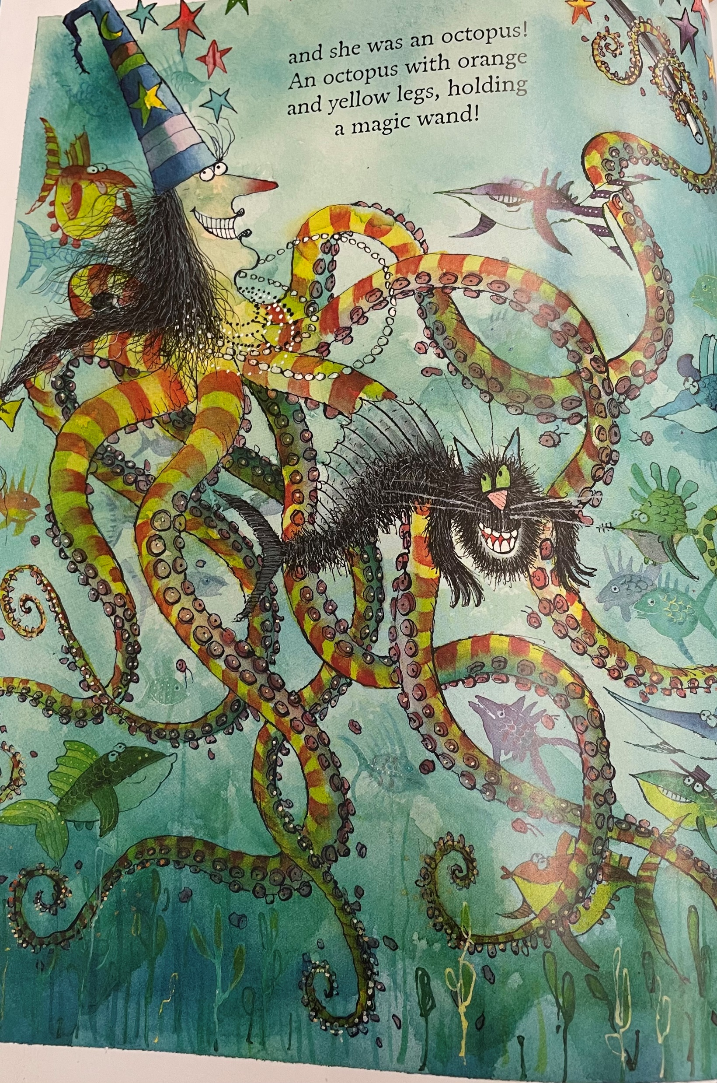
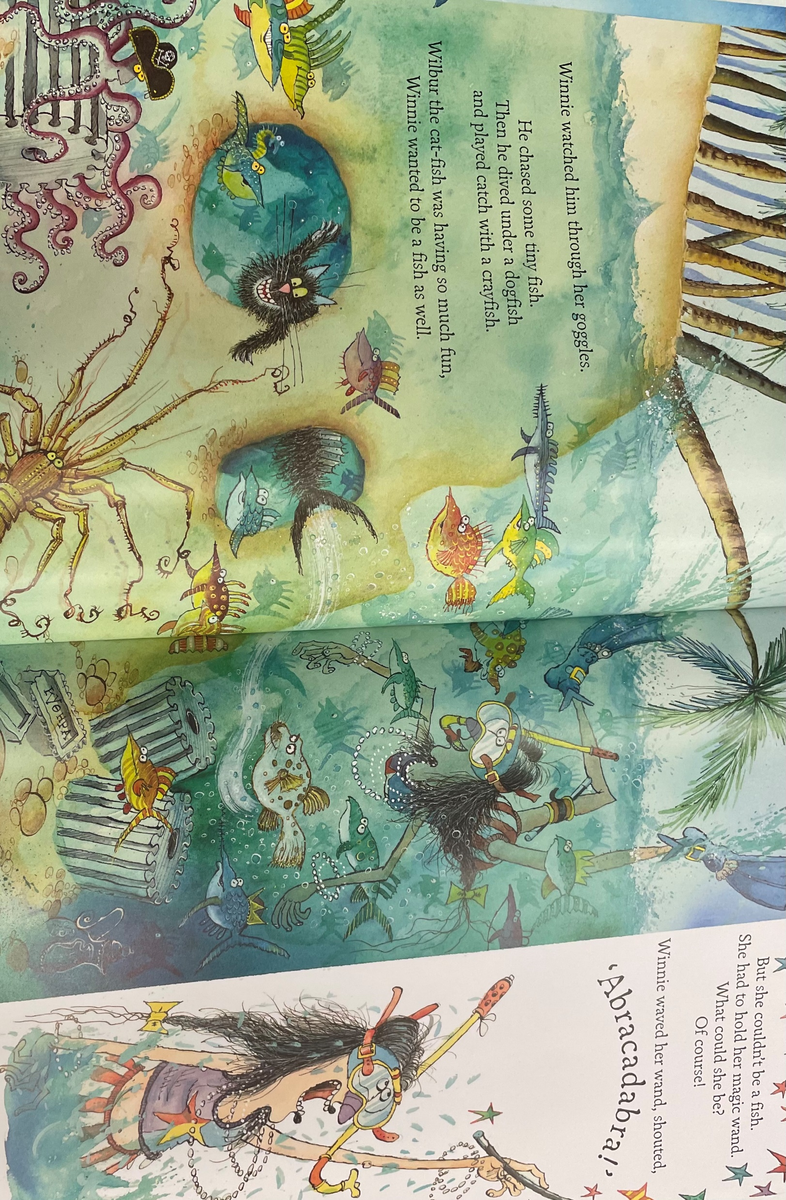
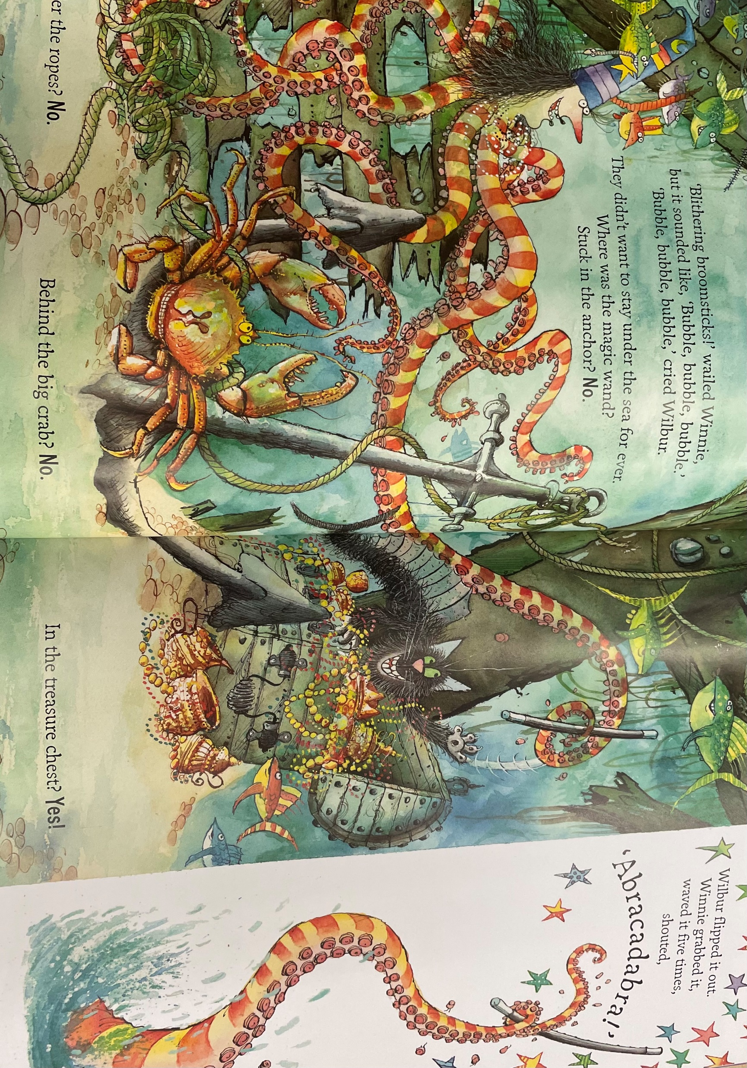
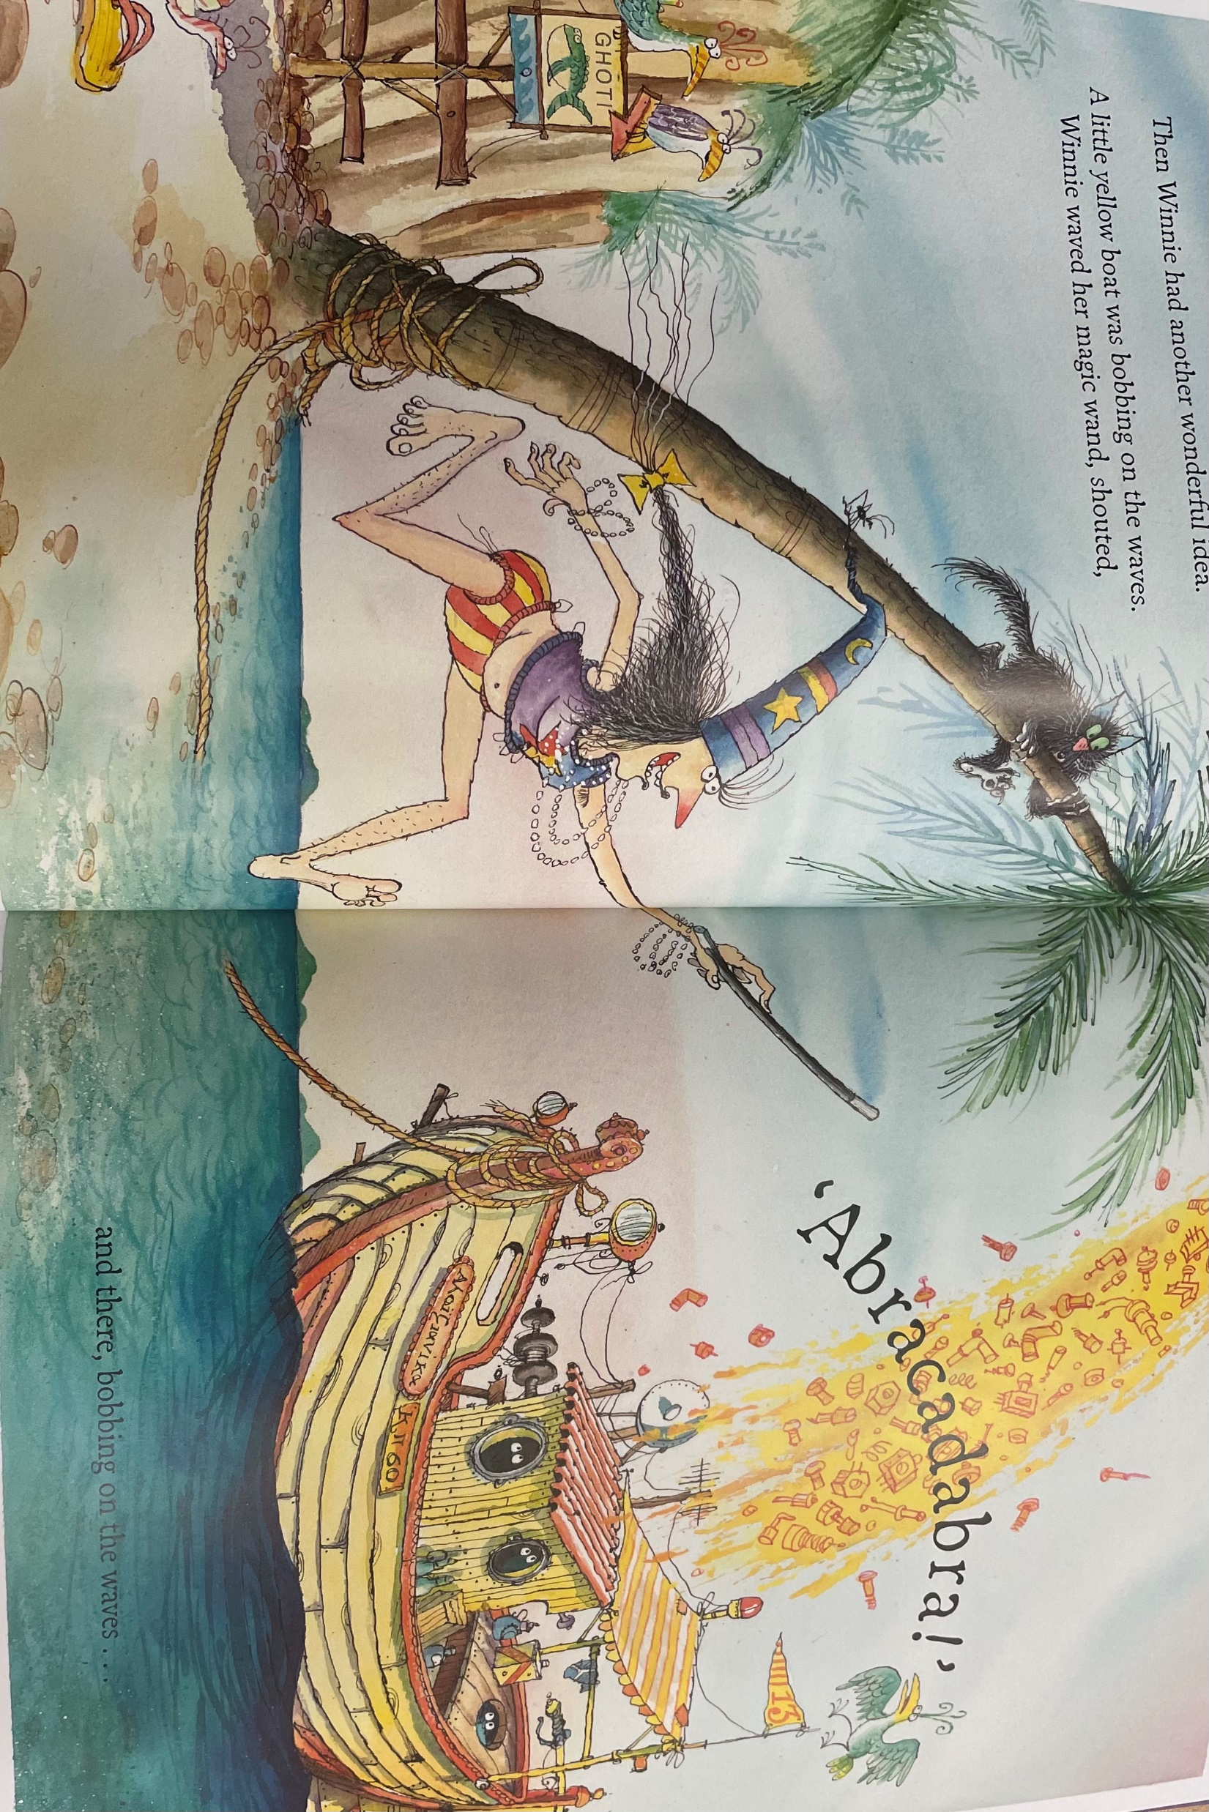
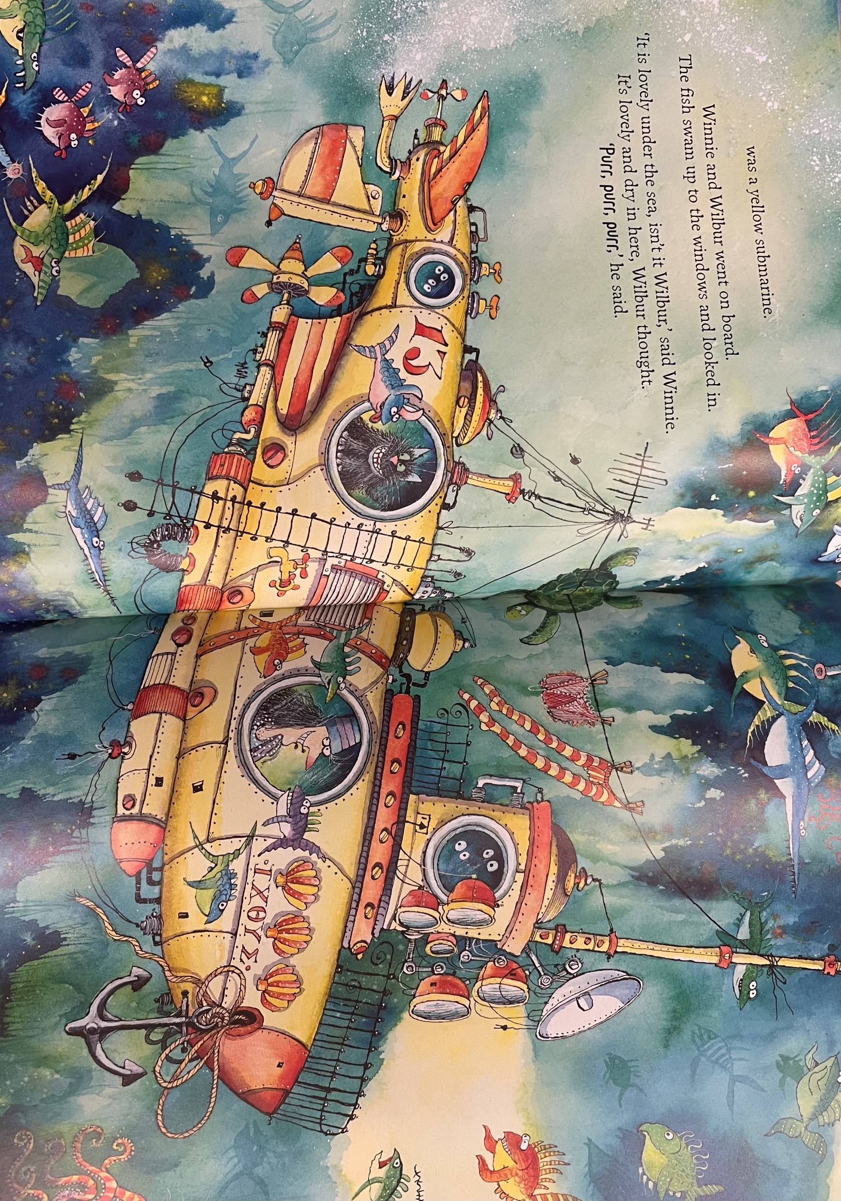
Write your own ending of the story
Make sure you include 4 expanded noun phrases
Don’t forget:
Use these pictures to help you write your story
All of a sudden, Winnie waved her magical wand and turned into a huge, colourful octopus with hundreds of small, round
tentacles.

Slide 21
Date: Friday 15th January
LO To be able to read and spell common exception words.
Subject: English

Slide 22
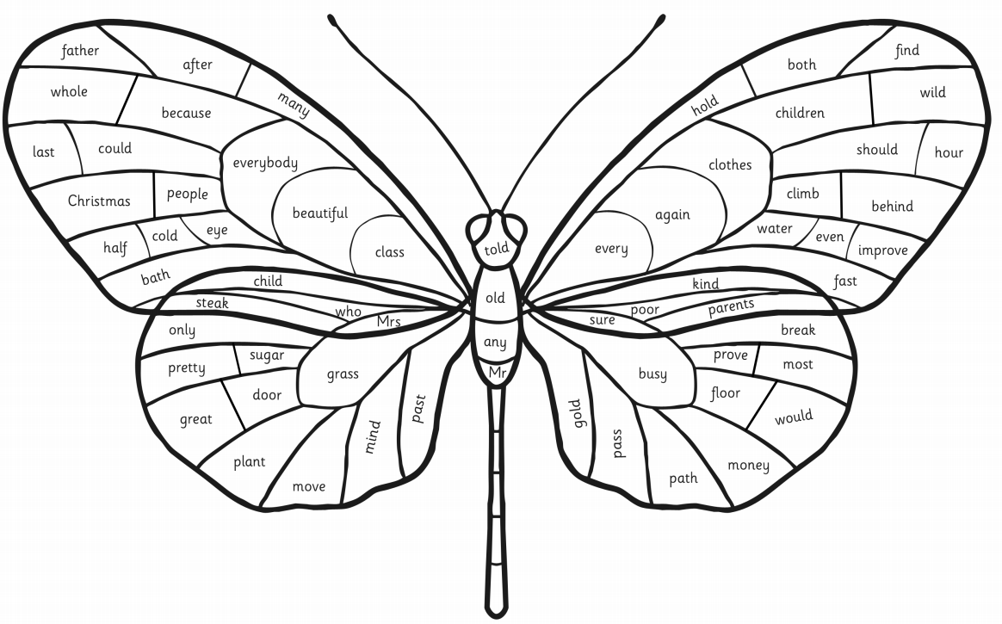
Read the common exception words
These are some of the words we need to know how to spell

Slide 23
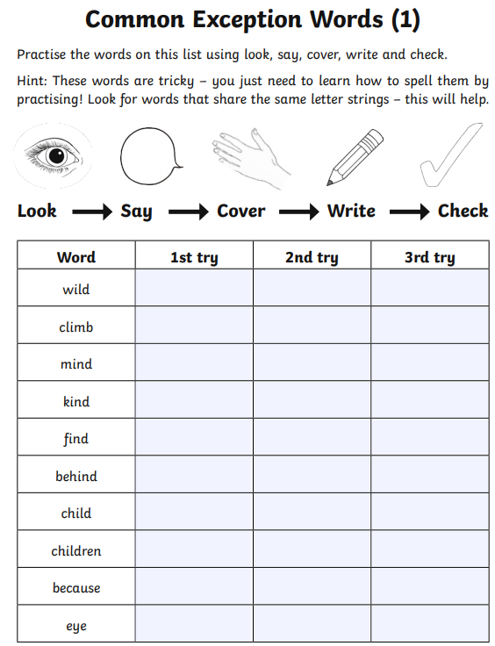
Look, cover, write and check!

Slide 24
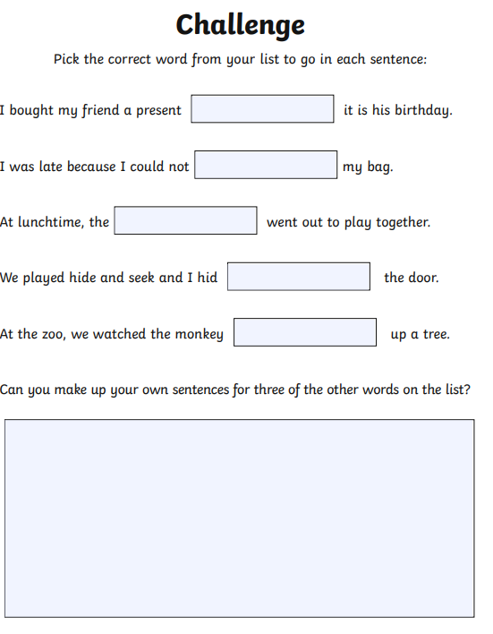
Don’t forget your sentences need capital letters, finger spaces and a full stop.

Slide 25
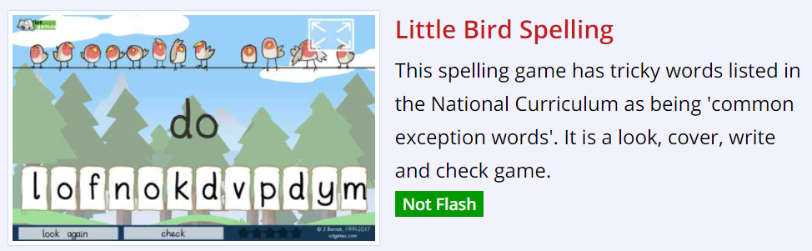
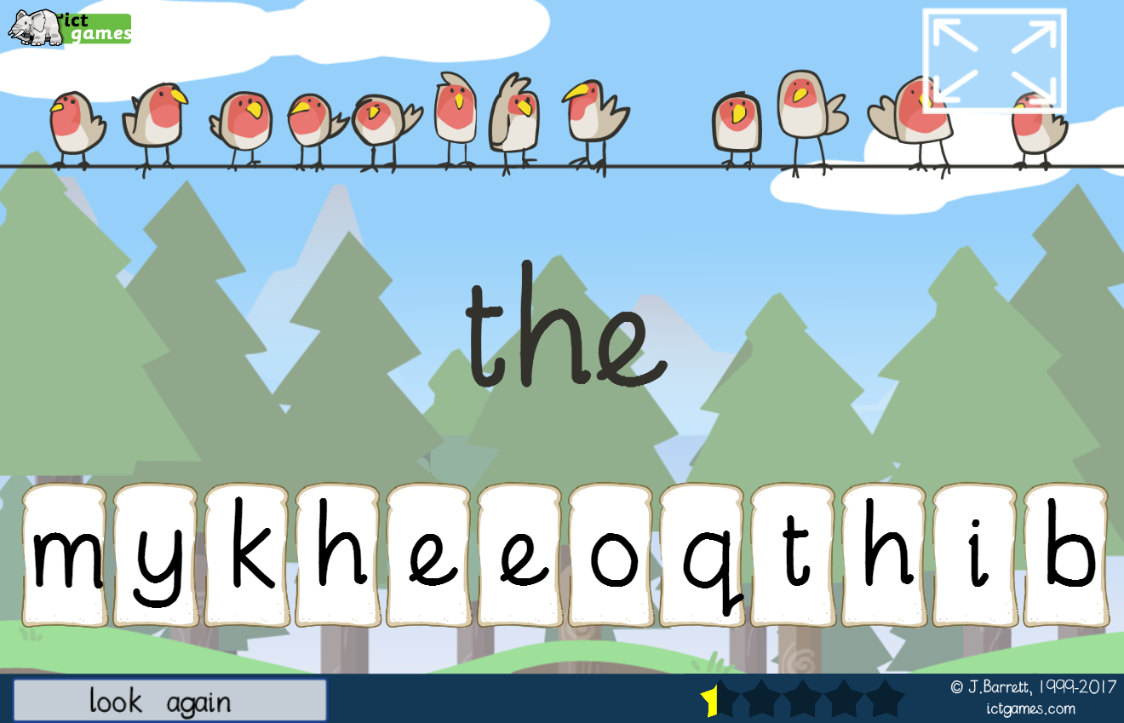
Spelling game!
Use the link to play the game and practice spelling the common exception words
Little Bird Spelling || Practise spelling Common Exception Words (ictgames.com)

Slide 26
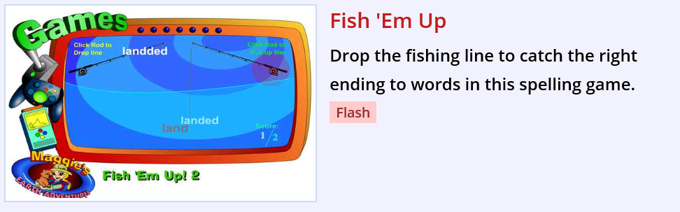
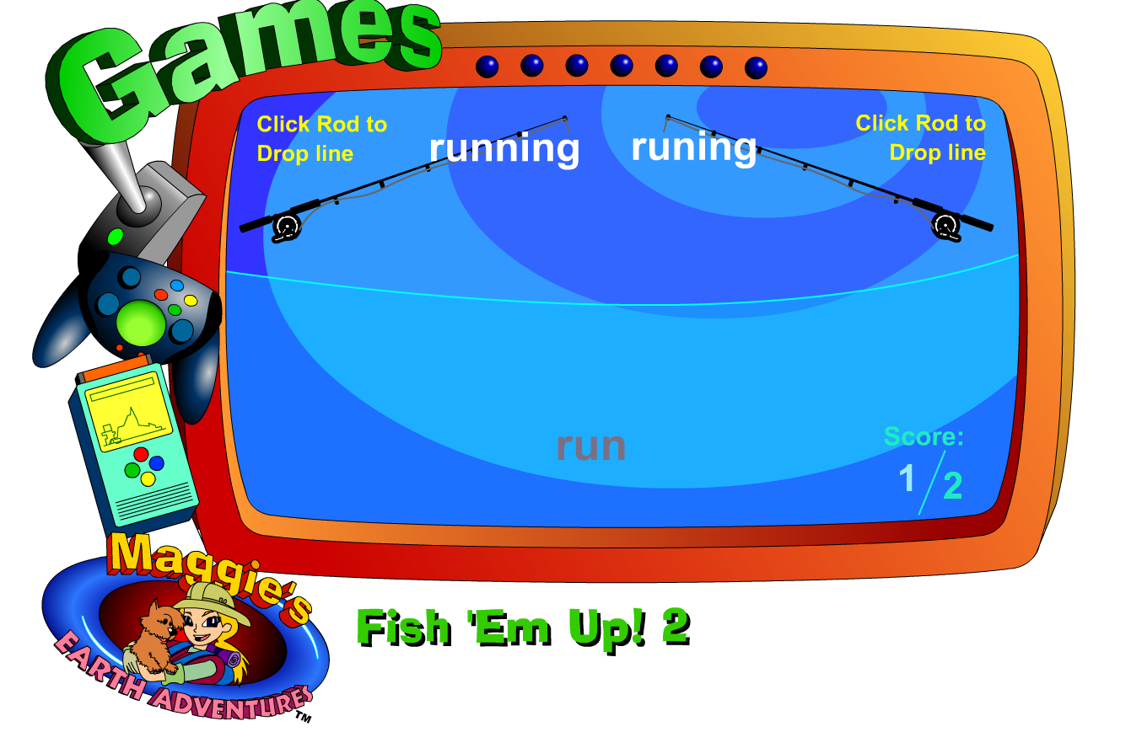
Spelling game!
Use the link to play the game and practice adding the suffixes ‘ing’ and ‘ed’.
https://www.topmarks.co.uk/english-games/5-7-years/words-and-spelling

Slide 27
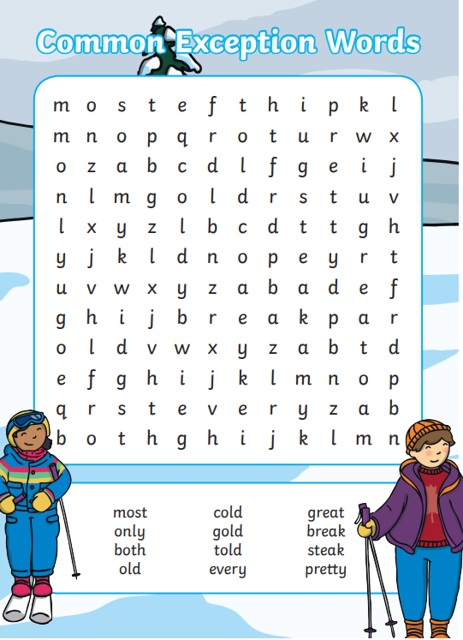
Word search
Find the common exception words in the word search

Slide 28

Well done for all of your hard work this week! We cant wait to see your completed work.
Could any completed work / photographic evidence of completed work please be sent to pioneerspupils@gmail.com
Thank you!

