Slide 1
Date: Monday 8th February
LO To be able to practise phonics sounds.
LO To be able to answer questions about a text.
Please practise phonics every day for 20 minutes.
Subject: Phonics/Guided Reading

Slide 2
Each day we are going to focus on a different sound.
Please choose from set 1, set 2, set 3 or guided reading. Each day, for phonics, there will be a video to watch and some words to read linked to the taught sound. For guided reading, there will be a text to read and some questions to answer.
Here are the sounds which are in each set.
Please contact the school if you are not sure which set your child should be focusing on, or whether you’re unsure if your child does guided reading rather than phonics.
Then, play some phonics games!
Guided Reading
For those children who know all of the phonics sounds from set 1, set 2 and set 3 and are confident readers.

Slide 3
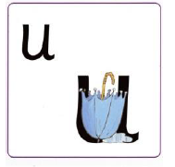
Set 1 Sounds
Skip this slide if your child is not focusing on this set.
Today’s sound:
Please click the link or copy the below link into the internet:
https://www.youtube.com/watch?v=n7I3Uh0ofco&list=PLPVrkr0oJX1tBTpbocNce93WUH8G-um6A&index=13
Or copy the below into YouTube:
‘Phonic Lesson - Set 1 Sound - Learning to Read and Write “u" for Reception and Year 1’ – Early Years Learning is Fun
Scavenger Hunt!
What can you find in your house that begins with u?

Slide 4
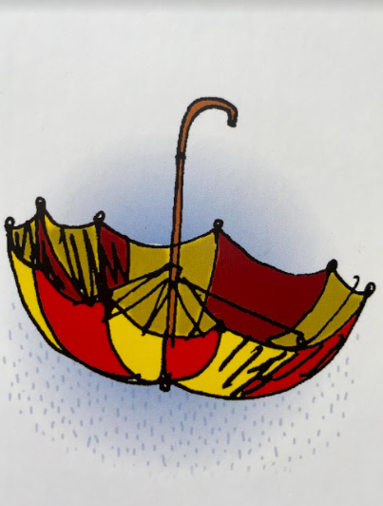
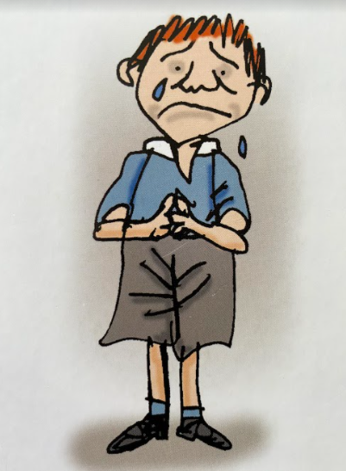
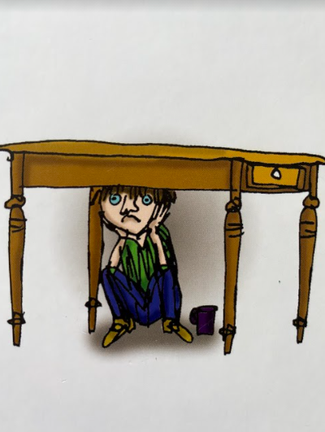
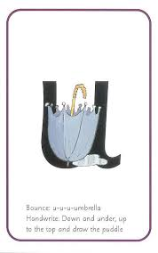
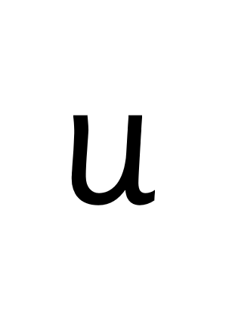
Today’s sound is u. Can you say u, u, uto your adult?
I have some pictures of things that begin with the sound u.
Try saying them out loud to your adult.
u u umbrella
u u upset
u u under
Hiding behind the umbrella is the grapheme u. Can you point to it and say u?
When you see this side of the card say u.
Look at the picture on the left.
That is an
umbrella.
When you see this picture, as quick as you can say umbrella.

Slide 5
Below, I have given you some cards. Point to each one and say umbrella or u.
Now let’s have a go at writing the sound u. Use your finger and move it over the picture card saying, “Down and under, up to the top and draw the puddle” or u u u u until you have traced the whole grapheme.
Now have a turn on your own. Keep practising until you get it right.

Slide 6
Set 1 Sounds
Now its time to Fred talk, read the word. Let me show you.
Here is my green word.
I am going to point to the button below each sound and say it out loud. This is Fred Talk.
u p, after sounding out the word remember to read the word, up. I have now read the word.
Now time to read some words including ‘u’. You could even practise writing these words!

Slide 7
Recap: Set 2 Sounds
Skip this slide if your child is not focusing on this set.
Today’s sound:
Please click the link or copy the below link into the internet:
https://www.youtube.com/watch?v=WL_-QHxJnFQ&list=PLPVrkr0oJX1sBGLJU2hNbPE2neuhezWSu
Or copy the below into YouTube:
‘Phonic Lesson - Set 2 ‘ay’ sound for Reception and Year 1’ – Early Years Learning is Fun
Can you think of any words with the ‘ay’ sound in it?

Slide 8
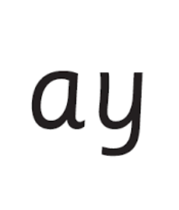
Today’s sound is ay. Can you say ay, ay, ay to your adult?
Look at the picture on your left. What can you see?
Can you see that the girls and boys are playing? Yes that’s right they are saying,
“ay, may I play?”
Let’s Fred Talk some ‘ay’ words.
s t ay p l ay s ay.
On the other side of the card is the digraph, ay.
These letters are
special friends.
They are two letters that make one sound. When we see them we say,
ay.
When we see the picture side we say,
“ay,
may I play?”

Slide 9
Below, I have given you some cards. Point to each one and say ay or may I play.
Now let’s have a go at writing the sound ay. You already know how to form each letter. Now we simply put them together to write the sound ay
Now have a turn on your own. Keep practising until you get it right.

Slide 10
Set 2 Sounds
Now its time to Fred talk, read the word. Let me show you.
Here is my green word.
I am going to point to the button below each sound and say it out loud. This is Fred Talk.
p l ay, after sounding out the word remember to read the word, play.
I have now read the word.
Now it’s your turn. Fred talk, read the words below.

Slide 11
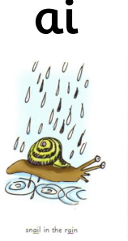
Set 3 Sounds
Skip this slide if your child is not focusing on this set.
Today’s sound:
Please click the link or copy the below link into the internet:
https://www.youtube.com/watch?v=FEkHEvgJulE&list=PLPVrkr0oJX1smTl2RWUHKgvupRrMZkKEE&index=13
Or copy the below into YouTube:
Phonics Lesson - Set 3 sound ‘ai' for Foundation Stage and Year 1
Can you think of any words with the ‘ai’ sound in it?

Slide 12
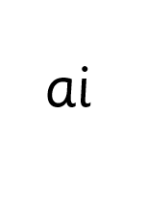
Today’s sound is ew. Can you say ai, ai, ai to your adult?
Look at the picture on your left. What can you see?
Can you see the snail in the rain?
“snail in the rain.”
Let’s Fred Talk some ‘er’ words.
r ai n s n ai l p ai d
On the other side of the card is the digraph, ai.
These letters are
special friends.
They are two letters that make one sound. When we see them we say,
ai.
When we see the picture side we say,
“snail in the rain”

Slide 13
Below, I have given you some cards. Point to each one and say ai or snail in the rain.
Now let’s have a go at writing the sound ai. You already know how to form each letter. Now we simply put them together to write the sound ai
Now have a turn on your own. Keep practising until you get it right.

Slide 14
Set 3 Sounds
Now its time to Fred talk, read the word. Let me show you.
Here is my green word.
I am going to point to the button below each sound and say it out loud. This is Fred Talk.
p ai d, after sounding out the word remember to read the word, paid. I have now read the word.
Now time to read some words including ‘ai’. You could even practise writing these words!

Slide 15
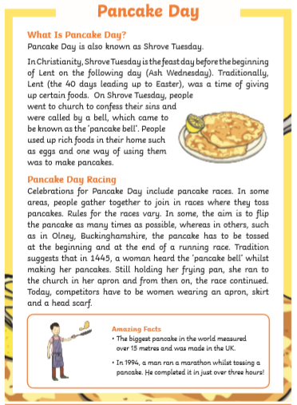
Guided Reading
Page 1
Read the text below before answering the questions on the following slides.

Slide 16
Guided Reading
Page 2
Read the text below before answering the questions on the following slides.

Slide 17
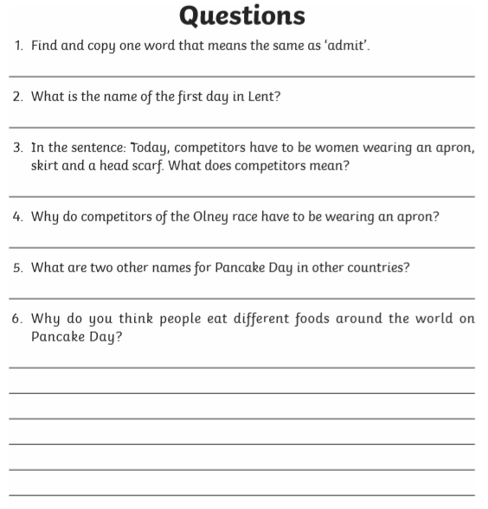
Guided Reading
Page 2
Read the text below before answering the questions on the following slides.

Slide 18
Date: Tuesday 9th February
LO To be able to practise phonics sounds.
LO To be able to answer questions about a text.
Please practise phonics every day for 20 minutes.
Subject: Phonics

Slide 19
Set 1 Sounds
Skip this slide if your child is not focusing on this set.
Today’s sound:
Please click the link or copy the below link into the internet:
https://www.youtube.com/watch?v=5jiP_FiY8MA&list=PLPVrkr0oJX1tBTpbocNce93WUH8G-um6A&index=14
Or copy the below into YouTube:
‘Phonic Lesson - Set 1 Sound - Learning to Read and Write “f" for Reception and Year 1’ – Early Years Learning is Fun
Scavenger Hunt!
What can you find in your house that begins with f?

Slide 20
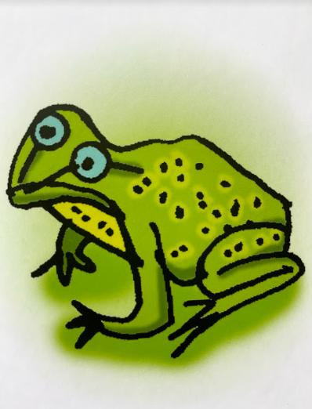
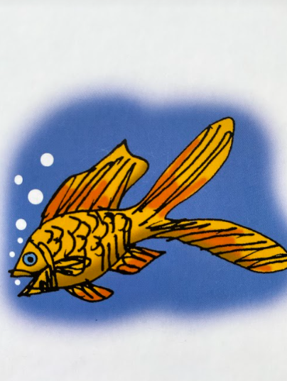
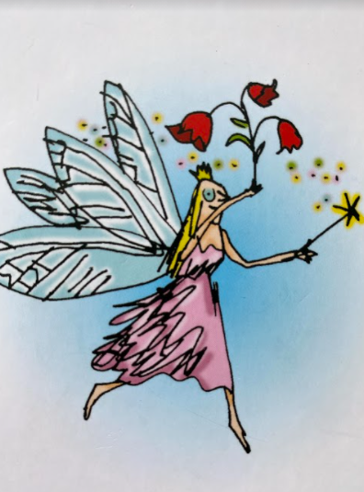
Today’s sound is f. Can you say ffffffff to your adult?
I have some pictures of things that begin with the sound f.
Try saying them out loud to your adult.
f f flower
f f frog
f f fish
f f fairy
Hiding behind the flower is the grapheme f. Can you point to it and say f?
When you see this side of the card say f.
Look at the picture on the left.
That is a
ffffflower.
When you see this picture, as quick as you can say flower.

Slide 21
Below, I have given you some cards. Point to each one and say flower or f.
Now let’s have a go at writing the sound f. Use your finger and move it over the picture card saying, “down the stem and draw the leaves” or fffffffff until you have traced the whole grapheme.
Now have a turn on your own. Keep practising until you get it right.

Slide 22
Set 1 Sounds
Now its time to Fred talk, read the word. Let me show you.
Here is my green word.
I am going to point to the button below each sound and say it out loud. This is Fred Talk.
f a n, after sounding out the word remember to read the word, fan. I have now read the word.
Now time to read some words including ‘f’. You could even practise writing these words!

Slide 23
Recap: Set 2 Sounds
Skip this slide if your child is not focusing on this set.
Today’s sound:
Please click the link or copy the below link into the internet:
https://www.youtube.com/watch?v=M1uW4OtU7aU&list=PLPVrkr0oJX1sBGLJU2hNbPE2neuhezWSu&index=2
Or copy the below into YouTube:
‘Phonic Lesson - Set 2 ‘ee’ sound for Reception and Year 1’ – Early Years Learning is Fun
Can you think of any words with the ‘ee’ sound in it?

Slide 24
Today’s sound is ee. Can you say ee, ee, ee to your adult?
Look at the picture on your left. What can you see?
Can you see what they are looking at? Yes that’s right they are saying,
“ee, what can you see”
Let’s Fred Talk some ‘ee’ words.
Feet meet sleep.
ee
On the other side of the card is the digraph, ee.
These letters are
special friends.
They are two letters that make one sound. When we see them we say,
ee.
When we see the picture we say,
“ee,
What can
you see”

Slide 25
Below, I have given you some cards. Point to each one and say ee or what can you see.
ee
ee
ee
Now let’s have a go at writing the sound ee. You already know how to form each letter. Now we simply put them together to write the sound ee.
Now have a turn on your own. Keep practising until you get it right.

Slide 26
Set 2 Sounds
Now its time to Fred talk, read the word. Let me show you.
Here is my green word.
I am going to point to the button below each sound and say it out loud. This is Fred Talk.
s ee n, after sounding out the word remember to read the word, seen.
I have now read the word.
Now time to read some words including ‘ee’. You could even practise writing these words!

Slide 27
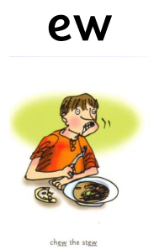
Set 3 Sounds
Skip this slide if your child is not focusing on this set.
Today’s sound:
Please click the link or copy the below link into the internet:
https://www.youtube.com/watch?v=cwWIKw98LZ4&list=PLPVrkr0oJX1smTl2RWUHKgvupRrMZkKEE&index=14
Or copy the below into YouTube:
Phonics Lesson - Set 3 sound ‘ew' for Foundation Stage and Year 1
Can you think of any words with the ‘ew’ sound in it?

Slide 28
Today’s sound is ew. Can you say ew, ew, ew to your adult?
Look at the picture on your left. What can you see?
Can you see the boy chewing his stew?
“Chew the stew”
Let’s Fred Talk some ‘are’ words.
ch ew n ew f l ew
On the other side of the card is the digraph, ew.
These letters are
special friends.
They are three letters that make one sound. When we see them we say,
ew.
When we see the picture side we say,
“chew the stew”

Slide 29
Below, I have given you some cards. Point to each one and say ew or chew the stew.
Now let’s have a go at writing the sound ew. You already know how to form each letter. Now we simply put them together to write the sound are
Now have a turn on your own. Keep practising until you get it right.

Slide 30
Set 3 Sounds
Now its time to Fred talk, read the word. Let me show you.
Here is my green word.
I am going to point to the button below each sound and say it out loud. This is Fred Talk.
ch ew, after sounding out the word remember to read the word, chew. I have now read the word.
Now time to read some words including ‘ew’. You could even practise writing these words!

Slide 31
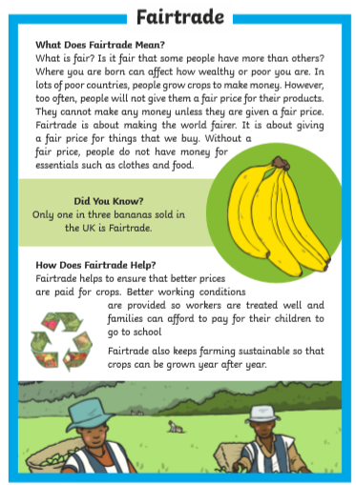
Guided Reading
Page 1
Read the text below before answering the questions on the following slides.

Slide 32
Guided Reading
Page 2
Read the text below before answering the questions on the following slides.

Slide 33
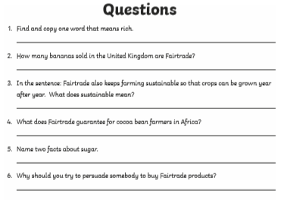
Questions

Slide 34
Date: Wednesday 10th February
LO To be able to practise phonics sounds.
LO To be able to answer questions about a text.
Please practise phonics every day for 20 minutes.
Subject: Phonics

Slide 35
Set 1 Sounds
Skip this slide if your child is not focusing on this set.
Today’s sound:
Please click the link or copy the below link into the internet:
https://www.youtube.com/watch?v=TAHUPTFjvaY&list=PLPVrkr0oJX1tBTpbocNce93WUH8G-um6A&index=15
Or copy the below into YouTube:
‘Phonic Lesson - Set 1 Sound - Learning to Read and Write “b" for Reception and Year 1’ – Early Years Learning is Fun
Scavenger Hunt!
What can you find in your house that begins with b?

Slide 36
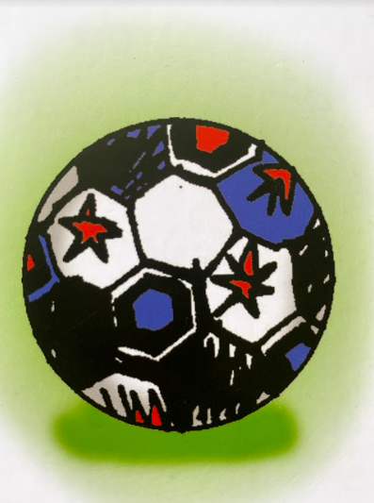
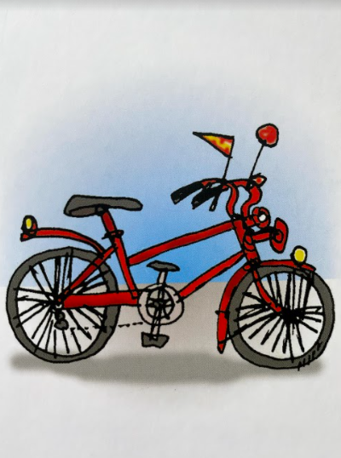
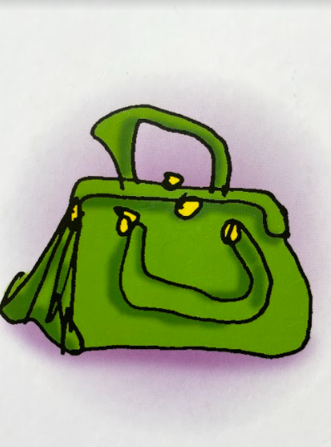
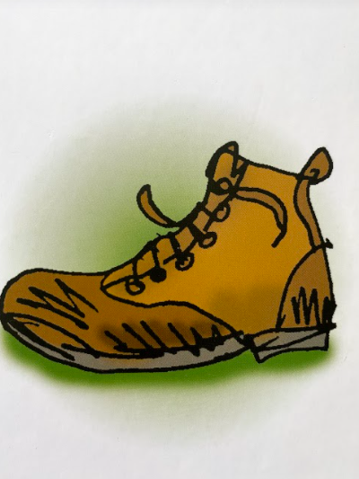
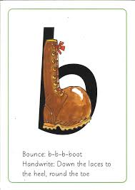
Today’s sound is b. Can you say b, b, b to your adult?
I have some pictures of things that begin with the sound b.
Try saying them out loud to your adult.
b b ball
b b bicycle
b b bag
b b boot
Hiding behind the boot is the grapheme b. Can you point to it and say b?
When you see this side of the card say b.
Look at the picture on the left.
That is a
boot.
When you see this picture, as quick as you can say boot.

Slide 37
Below, I have given you some cards. Point to each one and say boot or b.
Now let’s have a go at writing the sound b. Use your finger and move it over the picture card saying, “Down the laces to the heel, round the toe” or b b b until you have traced the whole grapheme.
Now have a turn on your own. Keep practising until you get it right.

Slide 38
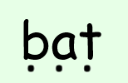
Set 1 Sounds
Now its time to Fred talk, read the word. Let me show you.
Here is my green word.
I am going to point to the button below each sound and say it out loud. This is Fred Talk.
b e d, after sounding out the word remember to read the word, bed. I have now read the word.
Now time to read some words including ‘b’. You could even practise writing these words!

Slide 39
Recap: Set 2 Sounds
Skip this slide if your child is not focusing on this set.
Today’s sound:
Please click the link or copy the below link into the internet:
https://www.youtube.com/watch?v=Y46--B_7BMs&list=PLPVrkr0oJX1sBGLJU2hNbPE2neuhezWSu&index=3
Or copy the below into YouTube:
‘Phonic Lesson - Set 2 ‘igh’ sound for Reception and Year 1’ – Early Years Learning is Fun
Can you think of any words with the ‘igh’ sound in it?

Slide 40
Today’s sound is igh.
Can you say igh, igh, igh to your adult?
Look at the picture on your left. What can you see?
Can you see that they are flying a kite? Yes that’s right they are saying,
“igh, fly high”
Let’s Fred Talk some ‘ee’ words.
high might tight.
On the other side of the card is the trigraph, igh.
These letters are
special friends.
They are three letters that make one sound. When we see them we say,
igh.
When we see the picture we say,
“igh,
fly high”
igh

Slide 41
Below, I have given you some cards. Point to each one and say igh or fly high.
igh
igh
igh
Now let’s have a go at writing the sound igh. You already know how to form each letter. Now we simply put them together to write the sound igh
igh
Now have a turn on your own. Keep practising until you get it right.

Slide 42
Set 2 Sounds
Now its time to Fred talk, read the word. Let me show you.
Here is my green word.
I am going to point to the button below each sound and say it out loud. This is Fred Talk.
h igh, after sounding out the word remember to read the word, high.
I have now read the word.
Now time to read some words including ‘igh’. You could even practise writing these words!

Slide 43
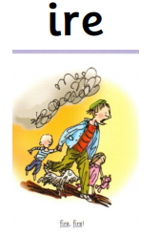
Set 3 Sounds
Skip this slide if your child is not focusing on this set.
Today’s sound:
Please click the link or copy the below link into the internet:
https://www.youtube.com/watch?v=2k2eXy0fCQc&list=PLPVrkr0oJX1smTl2RWUHKgvupRrMZkKEE&index=15
Or copy the below into YouTube:
Phonics Lesson - Set 3 sound ‘ire' for Foundation Stage and Year 1
Can you think of any words with the ‘ire’ sound in it?

Slide 44
Today’s sound is ire. Can you say ire, ire, ire to your adult?
Look at the picture on your left. What can you see?
Can you see a fire?
“fire, fire!”
Let’s Fred Talk some ‘oa’ words.
f ire h ire w ire
On the other side of the card is the digraph, ire.
These letters are
special friends.
They are three letters that make one sound. When we see them we say,
ire.
When we see the picture side we say,
“fire, fire!”

Slide 45
Below, I have given you some cards. Point to each one and say ire or fire.
Now let’s have a go at writing the sound ire. You already know how to form each letter. Now we simply put them together to write the sound ire
Now have a turn on your own. Keep practising until you get it right.

Slide 46
Set 3 Sounds
Now its time to Fred talk, read the word. Let me show you.
Here is my green word.
I am going to point to the button below each sound and say it out loud. This is Fred Talk.
f ire, after sounding out the word remember to read the word, fire. I have now read the word.
Now time to read some words including ‘ire’. You could even practise writing these words!

Slide 47
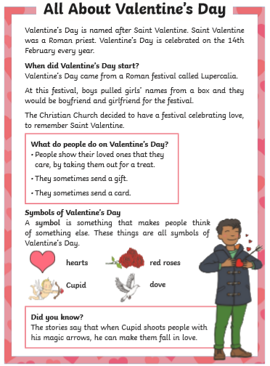
Guided Reading
Guided Reading
Page 1
Page 1
Read the text below before answering the questions on the following slides.

Slide 48
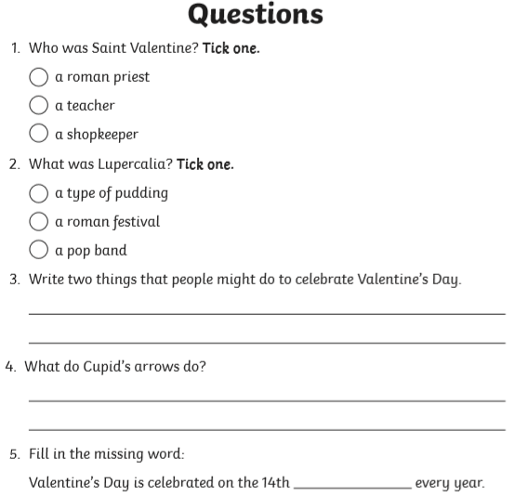
Questions

Slide 49
Date: Thursday 11th February
LO To be able to practise phonics sounds.
LO To be able to answer questions about a text.
Please practise phonics every day for 20 minutes.
Subject: Phonics

Slide 50
Set 1 Sounds
Skip this slide if your child is not focusing on this set.
Today’s sound:
Please click the link or copy the below link into the internet:
https://www.youtube.com/watch?v=a8VTwa9Wj6M&list=PLPVrkr0oJX1tBTpbocNce93WUH8G-um6A&index=16
Or copy the below into YouTube:
‘Phonic Lesson - Set 1 Sound - Learning to Read and Write “e" for Reception and Year 1’ – Early Years Learning is Fun
Scavenger Hunt!
What can you find in your house that begins with e?

Slide 51
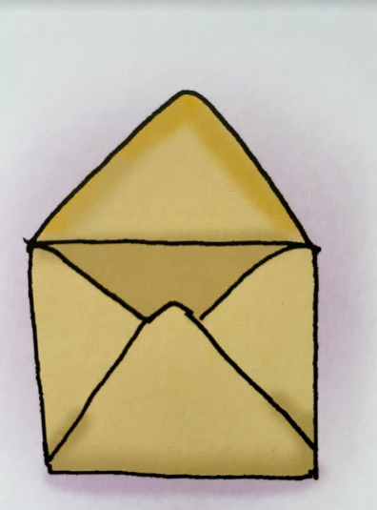
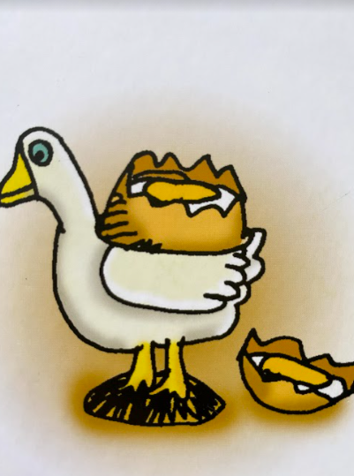
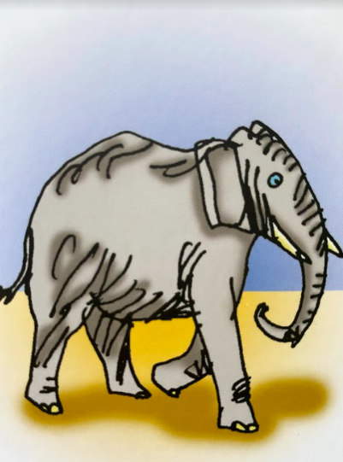
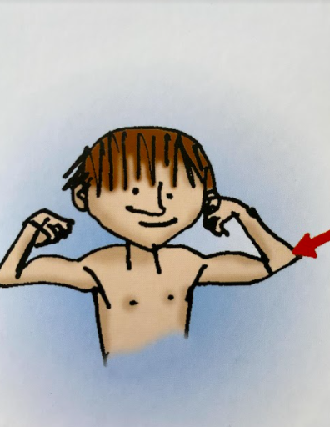
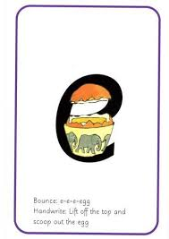
Today’s sound is e. Can you say e, e, e to your adult?
I have some pictures of things that begin with the sound e.
Try saying them out loud to your adult.
e e envelope
e e egg
e e elephant
e e elbow
Look at the picture on the left.
That is an
egg.
When you see this picture, as quick as you can say egg.
Hiding behind the egg is the grapheme e. Can you point to it and say e?
When you see this side of the card say e.

Slide 52
Below, I have given you some cards. Point to each one and say egg or e.
Now let’s have a go at writing the sound e. Use your finger and move it over the picture card saying, “Lift off the top and scoop out the egg” or e e e until you have traced the whole grapheme.
Now have a turn on your own. Keep practising until you get it right.

Slide 53
Set 1 Sounds
Now its time to Fred talk, read the word. Let me show you.
Here is my green word.
I am going to point to the button below each sound and say it out loud. This is Fred Talk.
b e d, after sounding out the word remember to read the word, bed. I have now read the word.
Now time to read some words including the sound ‘e’. You could even practise writing these words!

Slide 54
Recap: Set 2 Sounds
Skip this slide if your child is not focusing on this set.
Today’s sound:
Please click the link or copy the below link into the internet:
https://www.youtube.com/watch?v=iiap-EZwJAs&list=PLPVrkr0oJX1sBGLJU2hNbPE2neuhezWSu&index=4
Or copy the below into YouTube:
‘Phonic Lesson - Set 2 ‘ow’ sound for Reception and Year 1’ – Early Years Learning is Fun
Can you think of any words with the ‘ow’ sound in it?

Slide 55
Today’s sound is ow.
Can you say ow, ow, ow to your adult?
Look at the picture on your left. What can you see?
Can you see the polar bear blowing the snow? Yes that’s right they are saying,
“ow, blow the snow”
Let’s Fred Talk some ‘ow’ words.
low snow blow.
On the other side of the card is the digraph, ow.
These letters are
special friends.
They are two letters that make one sound. When we see them we say,
ow.
When we see the picture
we say,
“ow,
blow the snow”
ow

Slide 56
Below, I have given you some cards. Point to each one and say ow or blow the snow.
ow
ow
ow
Now let’s have a go at writing the sound ow. You already know how to form each letter. Now we simply put them together to write the sound ow.
Now have a turn on your own. Keep practising until you get it right.

Slide 57
Set 2 Sounds
Now its time to Fred talk, read the word. Let me show you.
Here is my green word.
I am going to point to the button below each sound and say it out loud. This is Fred Talk.
b l ow, after sounding out the word remember to read the word, blow.
I have now read the word.
Now time to read some words including ‘ow’. You could even practise writing these words!

Slide 58
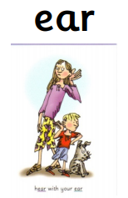
Set 3 Sounds
Skip this slide if your child is not focusing on this set.
Today’s sound:
Please click the link or copy the below link into the internet:
https://www.youtube.com/watch?v=XSFO8wytlHI&list=PLPVrkr0oJX1smTl2RWUHKgvupRrMZkKEE&index=16
Or copy the below into YouTube:
Phonics Lesson - Set 3 sound ‘ear' for Foundation Stage and Year 1
Can you think of any words with the ‘ear’ sound in it?

Slide 59
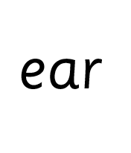
Today’s sound is ear. Can you say ear, ear, ear to your adult?
Look at the picture on your left. What can you see?
They are listening with their ear.
“Hear with your ear”
Let’s Fred Talk some ‘ear’ words.
h ear d ear f ear
On the other side of the card is the digraph, ear.
These letters are
special friends.
They are three letters that make one sound. When we see them we say,
ear.
When we see the picture side we say,
“hear with your ear”

Slide 60
Below, I have given you some cards. Point to each one and say ear or hear with your ear.
Now let’s have a go at writing the sound ear. You already know how to form each letter. Now we simply put them together to write the sound ow
Now have a turn on your own. Keep practising until you get it right.

Slide 61
Set 3 Sounds
Now its time to Fred talk, read the word. Let me show you.
Here is my green word.
I am going to point to the button below each sound and say it out loud. This is Fred Talk.
h ear, after sounding out the word remember to read the word, hear. I have now read the word.
Now time to read some words including ‘ear’. You could even practise writing these words!

Slide 62
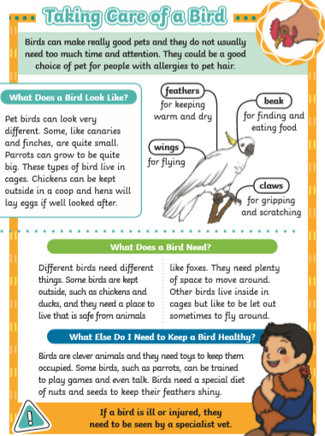
Guided Reading
Page 1
Read the text below before answering the questions on the following slides.

Slide 63
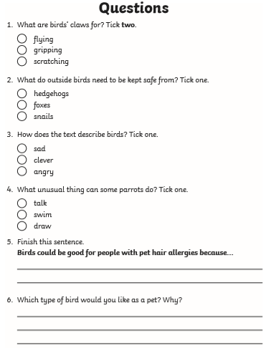
Questions

Slide 64
Date: Friday 12th February
LO To be able to practise reading and writing tricky words.
LO To be able to answer questions about a text.
Please practise phonics every day for 20 minutes.
Subject: Phonics

Slide 65
My Turn, Your Turn
Pick a slide appropriate to your child’s ability
Grown ups to read ‘tricky words’ and children to repeat.
Can you then point to the words without saying them and the children have a go at reading them?
Finally, children to have a go writing them!

Slide 66
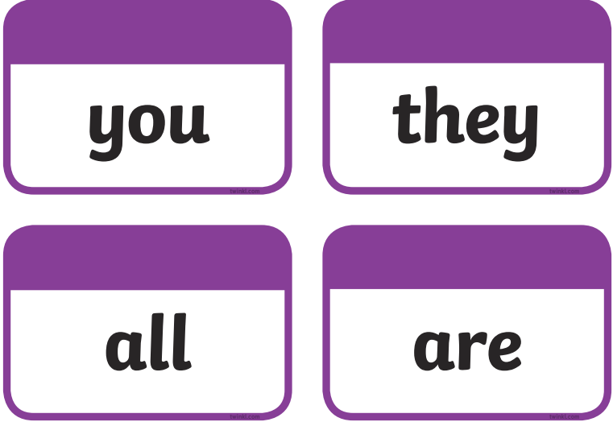
My Turn, Your Turn
Pick a slide appropriate to your child’s ability
Grown ups to read ‘tricky words’ and children to repeat.
Can you then point to the words without saying them and the children have a go at reading them?
Finally, children to have a go writing them!

Slide 67
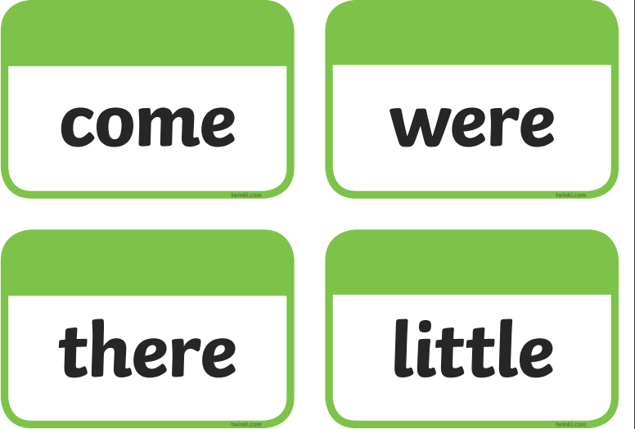
My Turn, Your Turn
Pick a slide appropriate to your child’s ability
Grown ups to read ‘tricky words’ and children to repeat.
Can you then point to the words without saying them and the children have a go at reading them?
Finally, children to have a go writing them!

Slide 68
My Turn, Your Turn
Pick a slide appropriate to your child’s ability
Grown ups to read ‘tricky words’ and children to repeat.
Can you then point to the words without saying them and the children have a go at reading them?
Finally, children to have a go writing them!

Slide 69
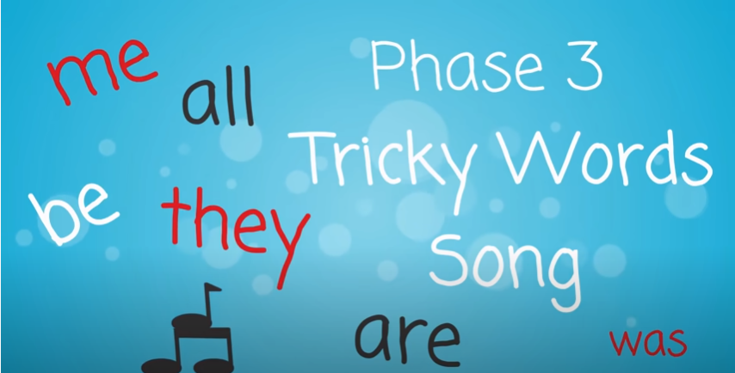
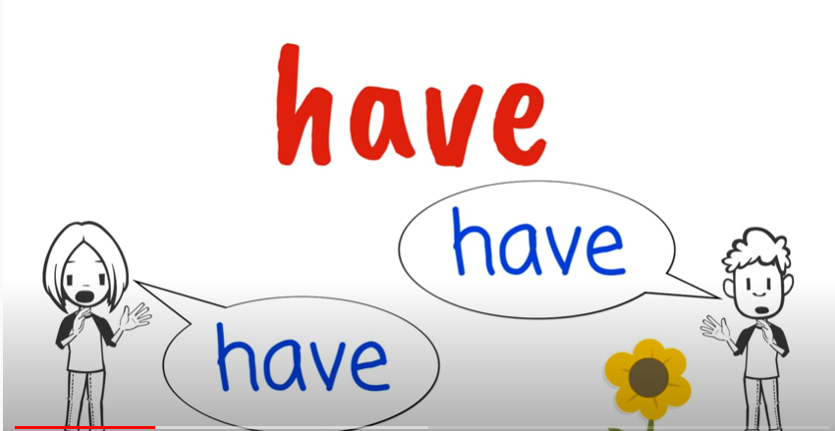
Tricky Words!
https://www.youtube.com/watch?v=TvMyssfAUx0
‘Tricky Words and Sight Words Song’ - YouTube
https://www.youtube.com/watch?v=R087lYrRpgY&t=2s
‘Phase 3 Say Hello To’ - YouTube
https://www.youtube.com/watch?v=3NOzgR1ANc4
‘Phase 4 Tricky Words Song’ - YouTube

Slide 70
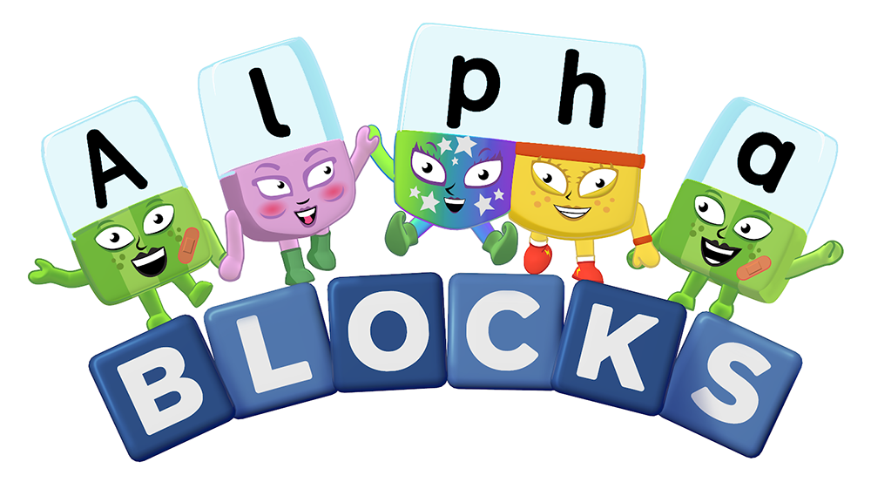
Games & Videos!
https://www.phonicsplay.co.uk/resources
Username: jan21
Password: home
https://www.bbc.co.uk/bitesize/topics/zcqqtfr
https://www.phonicsbloom.com/
https://www.bbc.co.uk/cbeebies/shows/alphablocks
https://www.youtube.com/channel/UC_qs3c0ehDvZkbiEbOj6Drg

Slide 71
Daily Phonics Videos
Click the below link, copy and paste into the internet or search ‘Ruth Miskin Training’ in YouTube to see daily phonics videos.
Read Write Inc are offering free phonics lessons on YouTube. Videos for all abilities are available.
They are posted at 9.30am and are available for 24 hours.
https://www.youtube.com/channel/UCo7fbLgY2oA_cFCIg9GdxtQ

Slide 72
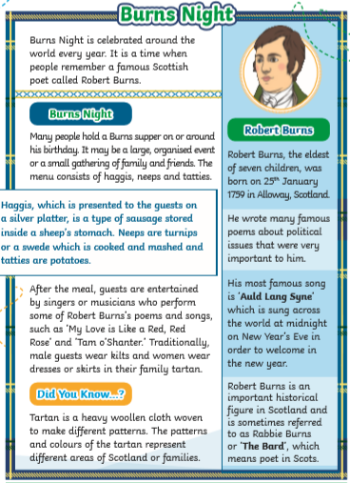
Guided Reading
Page 1
Read the text below before answering the questions on the following slides.

Slide 73
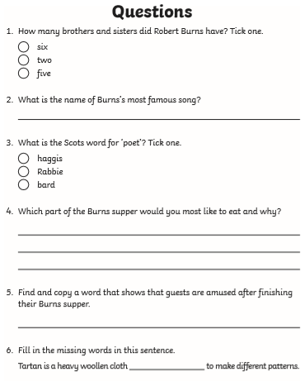
Questions

