Slide 1
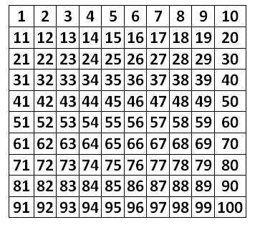
18.1.21
Mental Starter: Identify the prime numbers
Remember:
Prime numbers are special numbers, greater than 1, that have exactly two factors, themselves and 1.
19 is a prime number. It can only be divided by 1 and 19.
9 is not a prime number. It can be divided by 3 as well as 1 and 9.
Task: Write down or highlight the prime numbers on/ from the 100 square.

Slide 2
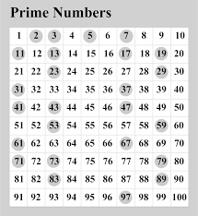
Check your answers.
Look over any numbers you might have missed out or wrote down incorrectly.

Slide 3



Date: 18.1.21
L.O: To be able to identify properties of 3D shapes
Subject: Maths

Slide 4
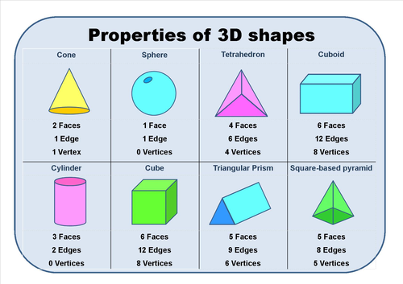
Look over these 3D shapes and their properties.
Can you find any examples of these around the house?
Can you name the shape of the different faces on each 3D shape?
A face is a flat or curved surface on a 3D shape.
An edge is where two faces meet.
A vertex is a corner where edges meet. The plural is vertices.

Slide 5
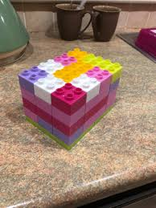
Practical idea:
You could have a try at making the 3D shapes using lego

Slide 6
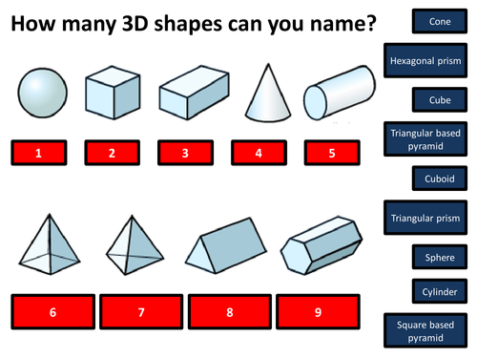
Task 1: Match the name to the shapes. You can write them under the shape or the shape number then the name of the shape.
Task 2: Write down the properties of the different shapes.
Use the headings below:
Name
Faces
Vertices
Edges

Slide 7
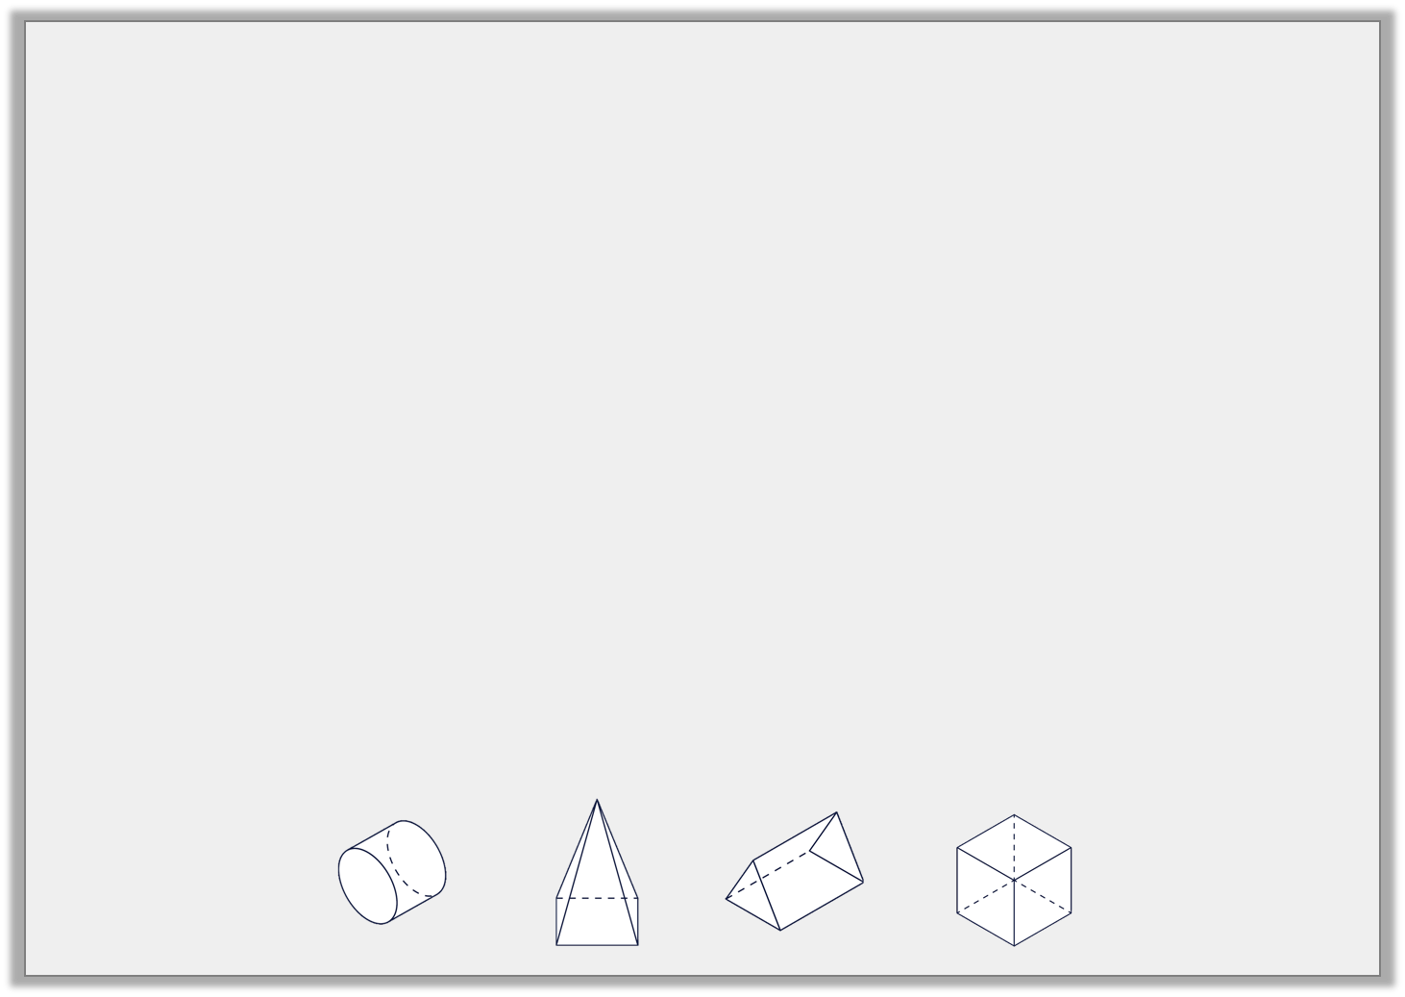
Complete the chart using your knowledge of 3D shapes.
Extension:
Complete the table.
Name | Image | Properties
 |  | 6 faces, 12 edges and 8 vertices
 |  | 5 faces, 8 edges and 5 vertices
 |  | 3 faces, 2 edges and 0 vertices
 |  | 5 faces, 9 edges and 6 vertices
1.
2.
3.
4.
3.
4.
1.
2.

Slide 8
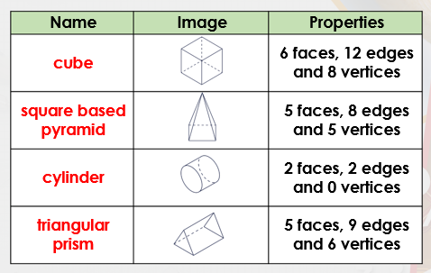
Answers:
5
9
2
7
3
8
1
5
6
Did you correctly match the shapes?
If so, well done!
If you didn’t, can you recap the shapes to ensure you know each name.

Slide 9

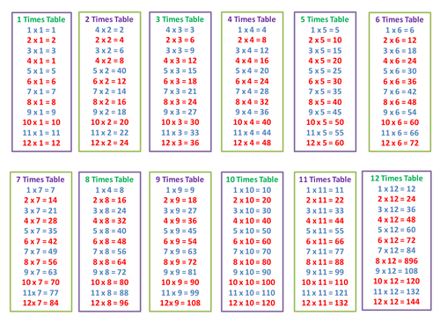
Times table practise
Now you have finished your written job, please spend at least 15mins practising your times tables.
This can be done on TTRS, hit the button or any other times table website.
Copy and paste the following link into a web browser:
https://www.topmarks.co.uk/maths-games/7-11-years/times-tables
Alternatively, you can use the help sheet to support you.

Slide 10
19.1.21
Mental Starter: Squared numbers
Remember: A square number is a number multiplied by itself. This can also be called 'a number squared'. The symbol for squared is ².
2² = 2 x 2 = 4
3² = 3 x 3 = 9
Write down the answers to these numbers when squared.
4²
5²
6²
7²
8²

Slide 11
Answers:
Write down the answers to these numbers when squared.
4 x 4 = 16
5 x 5 = 25
6 x 6 = 36
7 x 7 = 49
8 x 8 = 64
Did you get the questions correct?
If so, well done!
If you didn’t, can you find your mistake and see how you went wrong?
Re-try the question.

Slide 12
Date: 19.1.21
L.O: To be able to identify 3D shapes using 2D representations
Subject: Maths

Slide 13
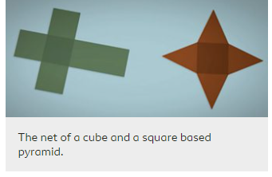

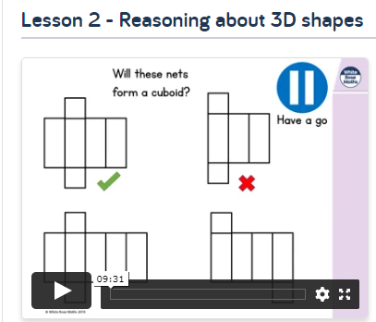
Nets of shapes
The net of a 3D shape is what it looks like if it is opened out flat. A net can be folded up to make a 3D shape.
There may be several possible nets for one 3D shape.
Copy and paste the link below into a web browser page. Watch the video to find out more about nets of shapes.
https://www.bbc.co.uk/bitesize/topics/zt7xk2p/articles/z247tv4
Here is a home learning video from White Rose maths which will support your learning of nets. Copy and paste the link below into a web browser:
https://whiterosemaths.com/homelearning/summer-archive/year-5/
Select Week 11
Find lesson two which looks like the picture shown.
Complete the work on the following slides after watching the video.

Slide 14
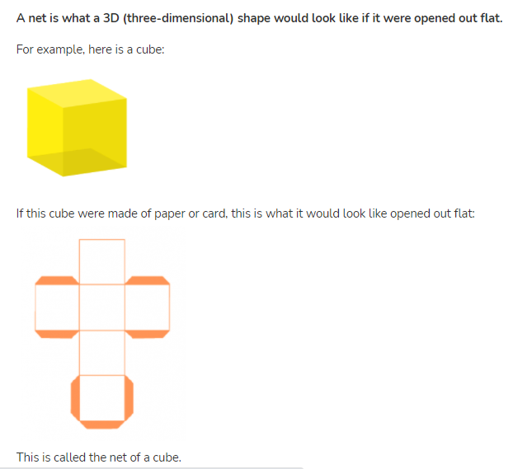

Slide 15
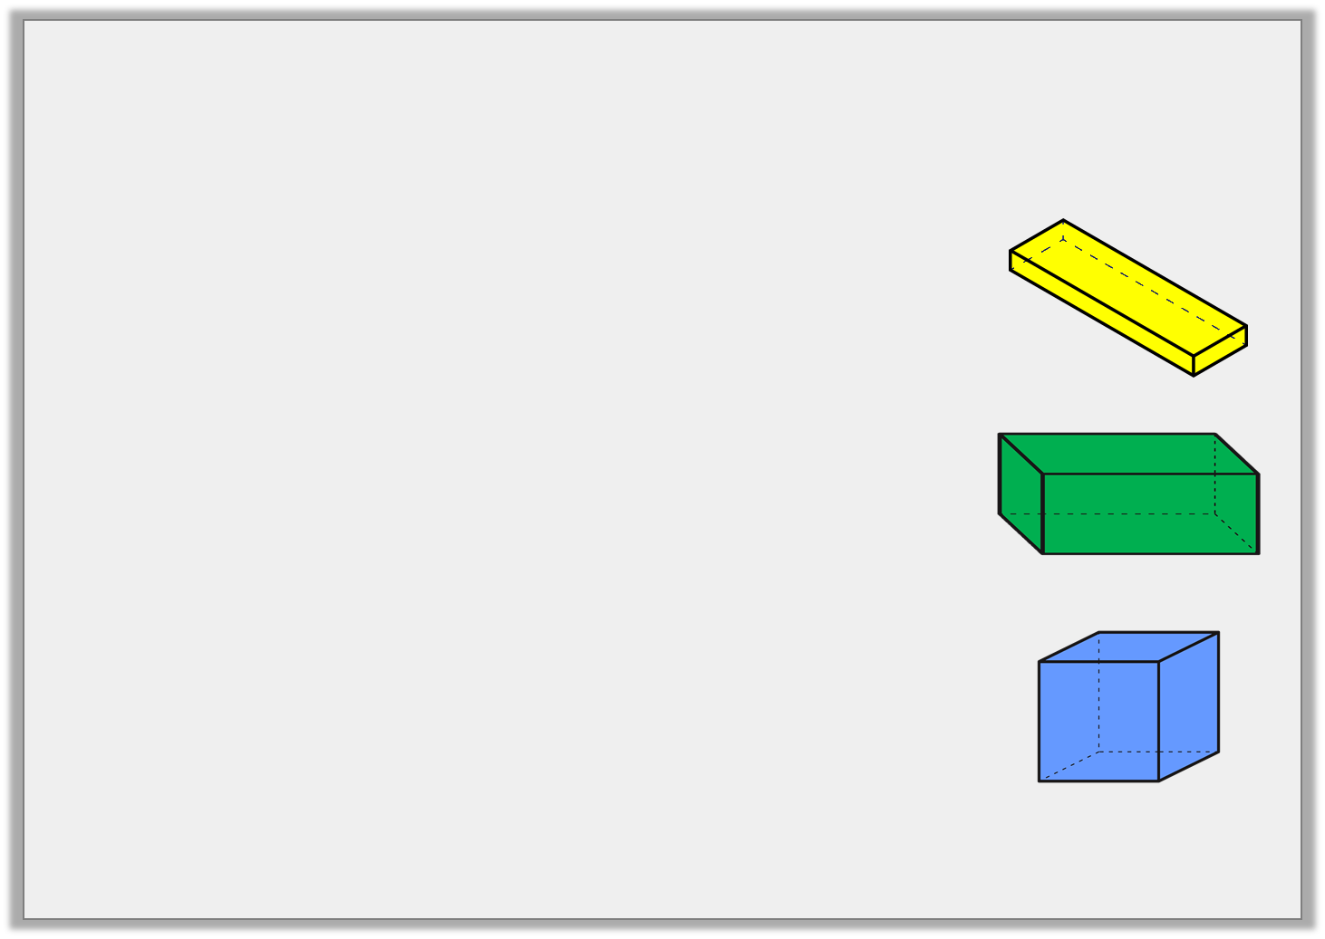
Try this:
Match the net to the correct 3D shape.

Slide 16
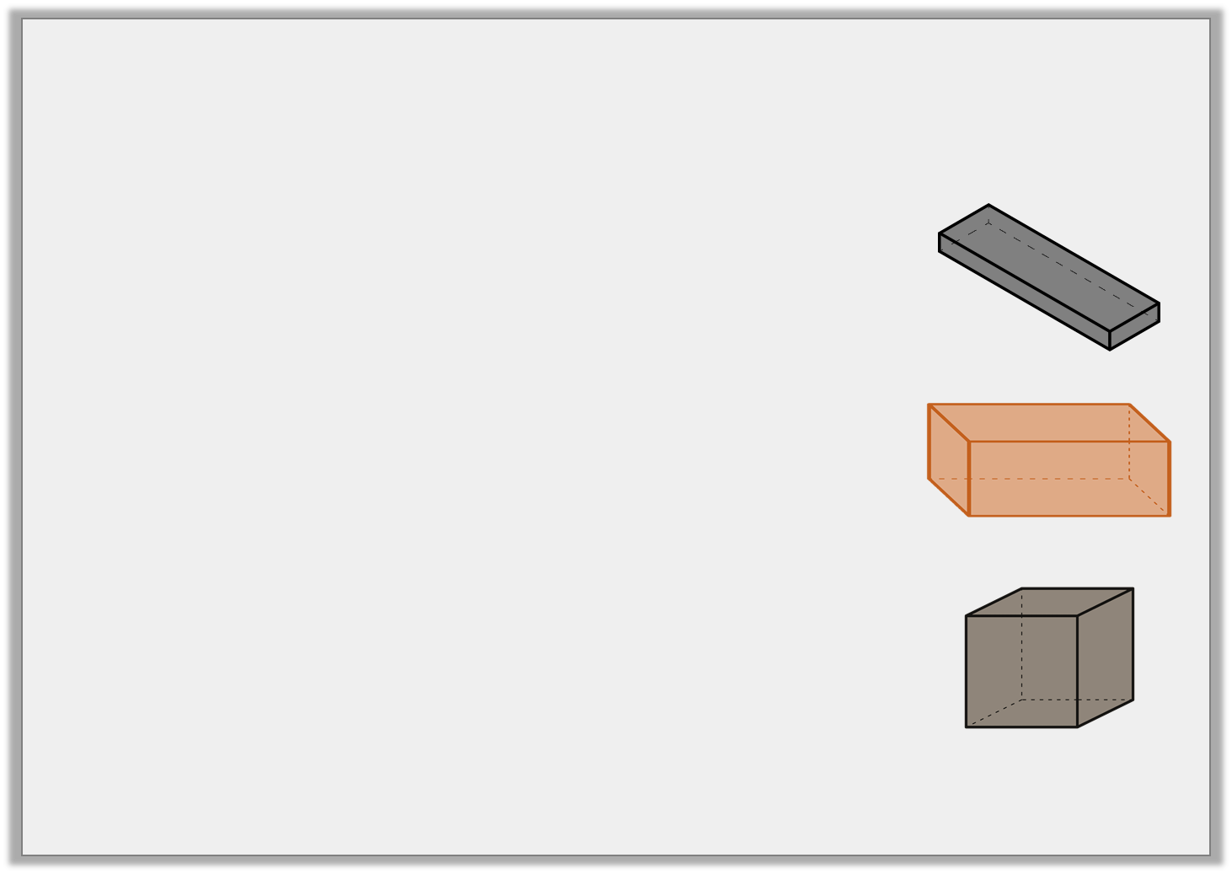
Answer:
Match the net to the correct 3D shape.

Slide 17
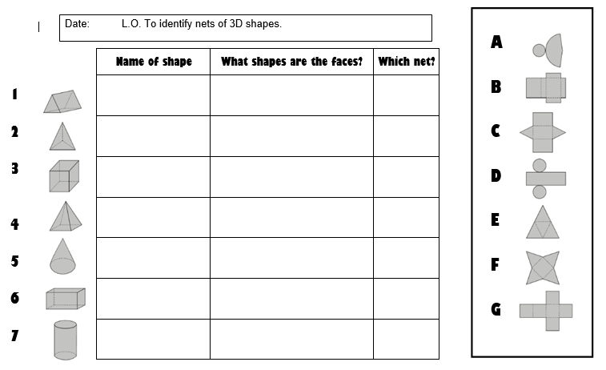
Task: Match the nets to the shapes. You can write on the sheet or write the number of the shapes with the number of the matching net.
Extension: Write the name of the 3D shape and the 2D shape of each face.
You could have a try at making the different nets to create the 3D shapes.

Slide 18
Reasoning task
Which of these 3D shapes could cast this shadow?
Explain your answer.
Square based
pyramid
hexagonal
prism
pentagonal
prism

Slide 19
Answers:
Did you get the questions correct?
If so, well done!
If you didn’t, can you find your mistake and see how you went wrong?
Re-try the question.
Triangular prism Triangles, rectangles C
Triangle based Triangles E
Pyramid
Cube Squares G
Square based Squares, triangles F
Pyramid
Cone Circle, semi- circle A
Cuboid Squares, rectangle B
Cylinder Circles, rectangle D

Slide 20
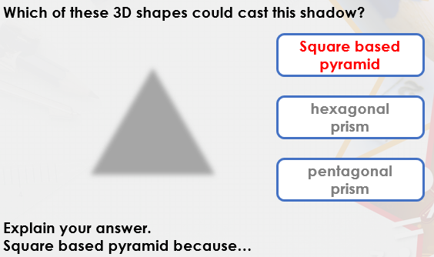

Slide 21
Times table practise
Now you have finished your written job, please spend at least 15mins practising your times tables.
This can be done on TTRS, hit the button or any other times table website.
Copy and paste the following link into a web browser:
https://www.topmarks.co.uk/maths-games/7-11-years/times-tables
Alternatively, you can use the help sheet to support you.

Slide 22
20.1.21
Mental Starter: Cubed numbers
A cube number is a number multiplied by itself 3 times. This can also be called 'a number cubed'. The symbol for cubed is ³.
Eg. 2³ = 2 × 2 (=4) × 2 = 8
Try these:
3³ = 3x 3 =____ then x 3=
4³
5³

Slide 23
Answers:
Did you get the questions correct?
If so, well done!
If you didn’t, can you find your mistake and see how you went wrong?
Re-try the question.
3³ = 3 x 3 = 9 x 3 = 27
4³ = 4 x 4 = 16 x 4 = 64
5³ = 5 x 5 = 25 x 5 = 125

Slide 24
Date: 20.1.21
L.O: To be able to draw and identify features of regular polygons
Subject: Maths

Slide 25
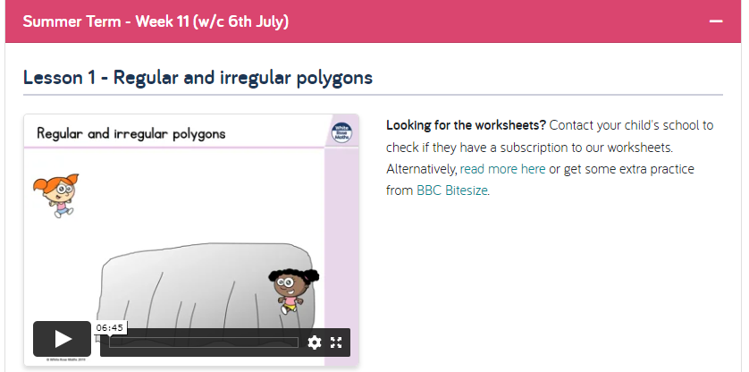
Introduction:
If you have access to the internet, copy and paste the link into a web browser.
https://whiterosemaths.com/homelearning/summer-archive/year-5/
You will need to scroll to the bottom of the page and select ‘Week 11 (w/c 6th July).
Then select lesson 1( as shown in the picture)
Click play and watch the video.
Follow on with the tasks as shown
in this ppt for the rest of the day.
If you do not have internet access,
Simply continue and read through the
Information which follows this page.

Slide 26
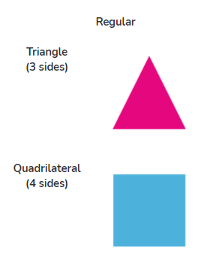
What are regular polygons?
A polygon is a flat, two-dimensional (2D) shape with straight sides that is fully closed (all the sides are joined up). The sides must be straight. Polygons may have any number of sides.
A regular polygon is a polygon in which all sides are of all the same length and at the same angles.
Copy and paste the web address into a browser and watch the video.
https://www.bbc.co.uk/bitesize/topics/zvmxsbk/articles/z98n4qt

Slide 27
Task: Decided on which statement goes where, write the numbers into the table or create your own table to write the numbers in
Discuss these statements about polygons.
Are they true or false?
True | False
1. They have 5 or more sides
2. They are made up of straight lines
5. They are 3D shapes
3. They are 2D shapes
4. They are a closed shape (no gaps)
7. They can have curved sides
6. They include open shapes

Slide 28
Answers:
Discuss these statements about polygons.
Are they true or false?
True | False
4. They are a closed shape (no gaps)
5. They are 3D shapes
6. They include open shapes
2. They are made up of straight lines
7. They can have curved sides
3. They are 2D shapes
1. They have 5 or more sides

Slide 29
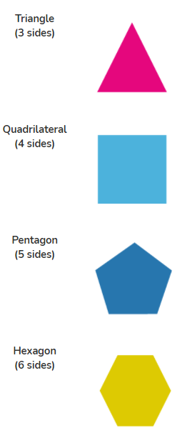
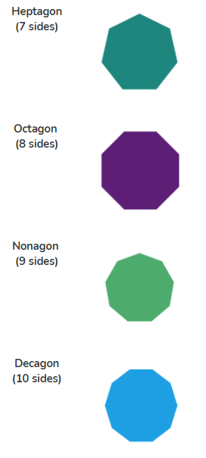
Task: Use a pencil and ruler (or whatever equipment you have at home) to draw regular polygons. Write down the name and properties of the shape.
Draw at least 6 polygons

Slide 30
Times table practise
Now you have finished your written job, please spend at least 15mins practising your times tables.
This can be done on TTRS, hit the button or any other times table website.
Copy and paste the following link into a web browser:
https://www.topmarks.co.uk/maths-games/7-11-years/times-tables
Alternatively, you can use the help sheet to support you.

Slide 31
21.1.21
Mental Starter: Rounding to the nearest 10
To round a number to the nearest 10, look at the ones digit. If the ones digit is 5 or more, round up. If the ones digit is 4 or less, round down. E.g. 134 - round down = 130
Try these: Write the answers next to the number or on paper
127 236 571
189 643 892

Slide 32
Answers:
127 up = 130 236 up = 240 571 down = 570
189 up = 190 643 down =640 892 down = 890

Slide 33
Date: 21.1.21
L.O: To be able to sort and identify features of irregular polygons
Subject: Maths

Slide 34

What are irregular polygons?
An irregular polygon is a polygon with sides and/or angles of differing lengths and sizes. (Although they still must be straight and joined up.)
Copy and paste the web address into a browser and watch the video.
https://www.bbc.co.uk/bitesize/topics/zvmxsbk/articles/z98n4qt

Slide 35
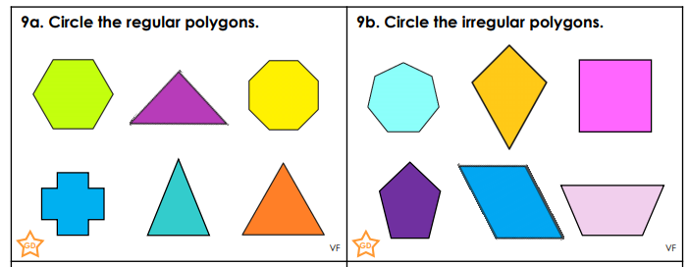
You could write the colour of each shape which is regular and irregular on paper.
Can you name the shapes?

Slide 36
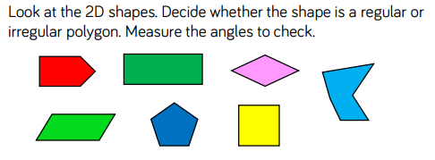
Sort the shapes into regular and irregular polygons. You could cut the shapes out and sort them into groups or number each shape to sort into a table on paper.
Regular | Irregular

Slide 37
Extension: Complete on paper or write your answer in the box
Has Toni sorted these shapes correctly? Explain your answer.
Toni has not sorted the polygons correctly because…
 | Regular Polygon | Irregular Polygon
Has 5 sides
Not 5 sides
A
B
C
E
D
F

Slide 38
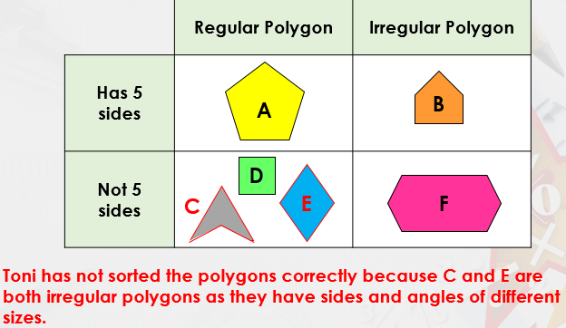
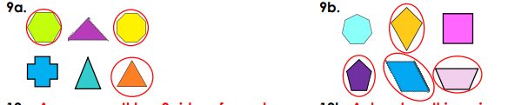
Answers:
Regular Irregular
1
3
4
6 5
7
2.
3.
4.
1.
6.
7.
5.
Regular Irregular

Slide 39
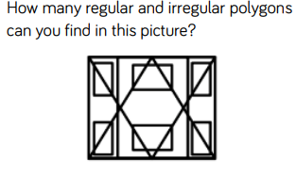
Challenge: Try this and discuss with someone else what you think!

Slide 40
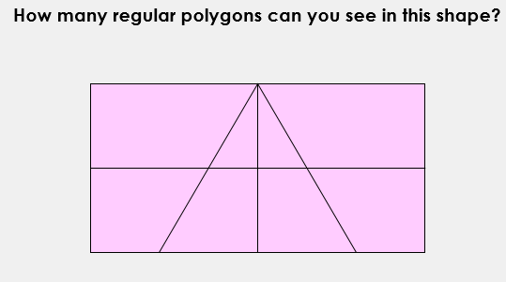
22.1.21
Mental Starter: Write your answer down

Slide 41
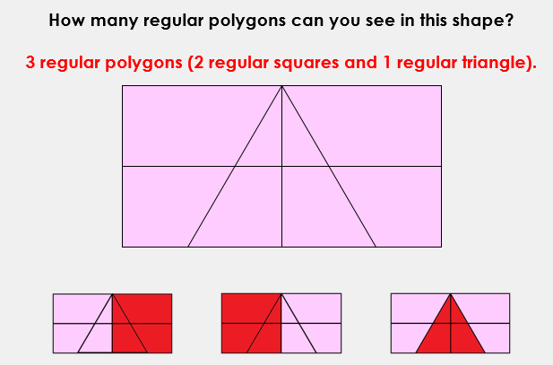
Answer:

Slide 42
Date: 22.1.21
L.O: To be able identify features and draw irregular polygons
Subject: Maths

Slide 43
Recap:
An irregular polygon is a polygon with sides and/or angles of differing lengths and sizes. (Although they still must be straight and joined up.)

Slide 44


Count the number of sides of these irregular polygons
Challenge: Draw your own irregular polygons and list the properties eg. number of sides, curved sides.
Create irregular polygons with the following number of sides:
3
4
5
6
7
8
9
10
What is the maximum number of sides you can draw?
2. 3.
4. 5. 6.

Slide 45
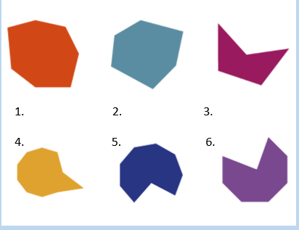
7
6
5
10
9
8

Slide 46
Times table practise
Now you have finished your written job, please spend at least 15mins practising your times tables.
This can be done on TTRS, hit the button or any other times table website.
Copy and paste the following link into a web browser:
https://www.topmarks.co.uk/maths-games/7-11-years/times-tables
Alternatively, you can use the help sheet to support you.

